Slide 1
Indian Health Service Estimating CSC on Program Income
Michelle Begay, Acting Director, division of isdeaa
Bemidji pre-negotiations, May 7, 2026

Slide 2
Objectives
Discuss Summary of Decision
Decision Points & Basic Methodology
Overview of Certification Form
Review current template and changes
Next Steps

Slide 3
Summary of Decision
Becerra v. San Carlos Apache Tribe, 602 U.S. 222 (2024)
Holding that IHS must pay eligible CSC incurred by Tribes and Tribal organizations that expend program income under their ISDEAA contracts and compacts.
Actions for implementation:
Resolve pending litigation
Resolution of CDA Claims in process and those to be submitted
Methodology development & Policy changes as we look forward

Slide 4
Tribal Engagement
Dear Tribal Leader Letter (DTLL) sent June 13, 2024 on interim methodology and initial CDA claims process.
Meet with CSC Advisory Group (CSCAG) 6 times
June 26, 2024, Virtual
July 24-25, 2024, Washington, DC
August 13, 2024, Virtual
October 24, 2024, Hybrid, Washington, DC
November 7, 2024, Hybrid, Scottsdale, AZ
November 15, 2024, Virtual (finalized recommendations)
Initiated Tribal Consultation Sept 10 and comments closed Oct 11th. Final report for comments completed Nov 4th.

Slide 5
CSCAG Recommendations
Definition of program income – 2 CFR 200.1, and consistent with IHS authorities
CSC will be based on actual expenditures
Use of a Certification Form
Agreement to follow current IHM for direct CSC calculation
Still some decisions to be made on pre-award and start-up.
Payment of costs already included in third-party reimbursements (i.e. duplication)
Excludes expenditures on services to ineligible non-Indians (i.e. non-bens)*
*Federal and Tribal CSCAG members were not in consensus.

Slide 6
Actions Implemented
DTLL Guidance sent December 2024 – Template and guidance
Link: Final Decision on Becerra and CSC
Updated Data systems for tracking
Standardized language for Funding Agreements

Slide 7
What is Program Income
Decision was to utilize 2 CFR 200.1, and consistent with IHS authorities
eCFR :: 2 CFR Part 200 -- Uniform Administrative Requirements, Cost Principles, and Audit Requirements for Federal Awards
Program income means gross income earned by the recipient or subrecipient that is directly generated by a supported activity or earned as a result of the Federal award during the period of performance except as provided in § 200.307(c).
May include
Reimbursements from Medicaid, Medicare, & private insurance
May not include
Interest earned on advances of Federal funds
Grant funds
105(l) lease payments
If in Doubt???
Check with your Accountant, Auditor or legal counsel

Slide 8
Overview of Certification form
Ensure all boxes are completed and signed by authorized Representative.
Review each of the certification statements:
All expenses meet general purpose of contract 25 U.S.C. § 5325(m) and 25 U.S.C. § 1641
Exclude costs that could be duplicative, or already compensated (e.g., 105(l) leases)
Amounts are subject to negotiation and reconciliation.
Amounts to include in Certification boxes
Verify if this is an estimate or final reconciliation – need one cert form for each year under review
B. Total expenditures minus C. Passthroughs and exclusions* should equal D. Total Program Income Direct Cost Base
B – C = D
*If Salaries or Salaries/Fringe, then passthroughs/exclusions should equal all non-personnel costs

Slide 9
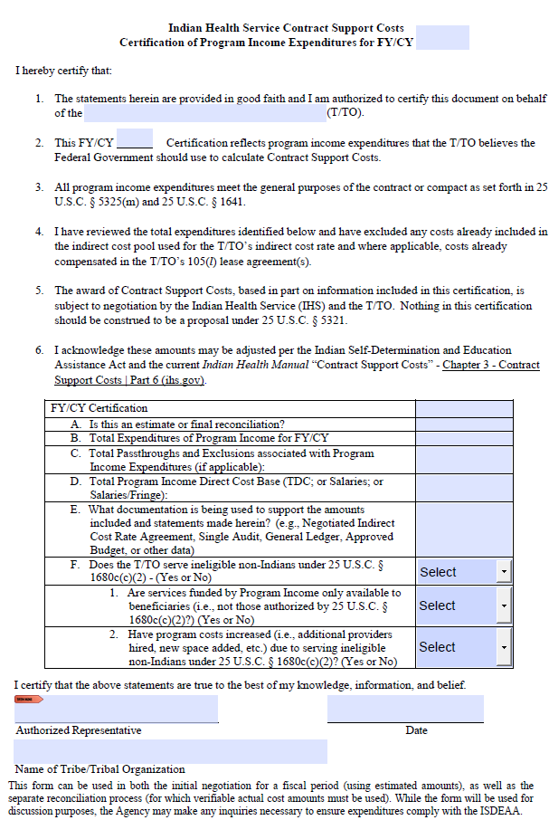
First Half of the form are statements the Tribe or Tribal Organization is certifying

Slide 10
Second Half of the form are actual numbers the tribe is certifying for estimation or reconciliation
Should be signed by someone with authority at tribe

Slide 11
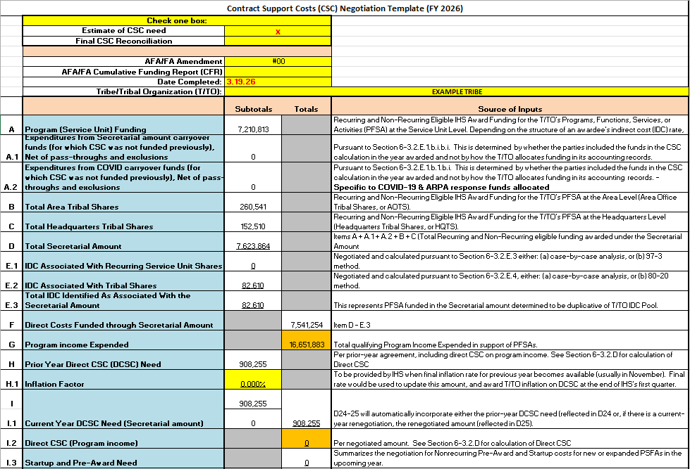
New CSC Template A- I.3

Slide 12
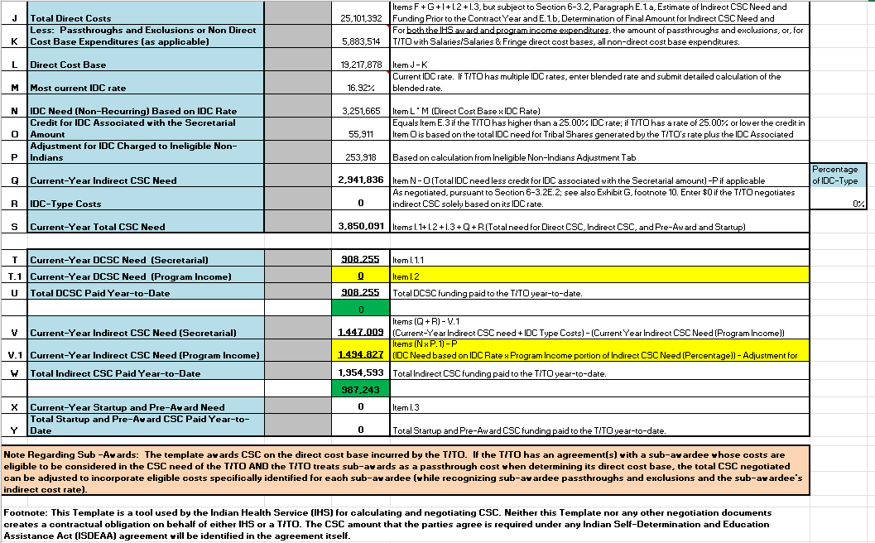
New CSC Template J - Y

Slide 13
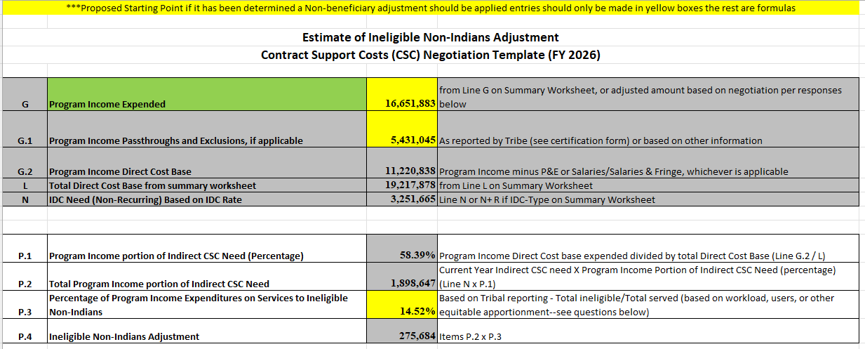
New CSC Template Ineligible non-Indians Adjustment

Slide 14
Offset for Ineligible Non-Indians
Request information from Tribe to support – By user or by total visits
Can run standard NDWS report if Tribe is submitting appropriate data to IHS.
Can reduce the base for offset “G - Program Income Expended” if Tribe can provide actual expenditure data for programs only serving AI/AN.

Slide 15
Inclusion of Program Income in Indirect Cost Pool
One limitation of estimation is the Tribe must complete the certification form.
Inclusion of program income expenditures in Tribe/Tribal Organization’s Indirect Cost Rate Proposals to Interior Business Center (DOI/IBC) or Cost Allocation Services (HHS/CAS) assists in the calculation of CSC for eligible expenditures of program income
Allows application of the appropriate indirect cost rate
Provides more concrete information for future estimates
Helps inform passthroughs

Slide 16
CSC Negotiations Activity to Date
Negotiated with 40+ Tribes for FY25/FY26 funds
Mix of Title I and Title V
Direct Contract Support Costs
Negotiated Lump Sum Indirect-type costs
Total Amounts Negotiated for FY25 - $431M
Total Amounts Negotiated for FY26 - $238M
Payment amounts range from $100K - $125M

Slide 17
Contract Disputes Act (CDA) Claims
During FY 2025, the team developed and tested standardized analysis templates and procedures to ensure consistency in reviewing. For FY2026, the team is currently developing a process to pay those eligible CSC CDA claims through open appropriations monthly.
Claims are being worked in order received.
If a Tribe/Tribal Organization has multiple claims they will be settled as a group (i.e. 2018-2024)
Claims that are not submitted in writing to the awarding official within 6 years of accrual are barred by the statute of limitations and will be denied in the ordinary course. Currently claim year is FY2020.
All claims should be submitted to your local ALN or Awarding official as well as the general email box at IHSCDAClaims@ihs.gov

Slide 18
CSC CDA Claims Update
The status of Contract Support Costs CDA Claims is:
Total Claims Filed: 781 claims totaling close to $4.8 billion
Total Outstanding Claims: 662 claims totaling $3.7 billion
Total Claims Closed: 119 claims
Total Claims Settled: $967 million in claims settled for $577 million
Total Claims Deemed Denied: $50 million
Claims in settlement negotiations: 92 claim years ready for settlement totaling $898 million

Slide 19
Actions for Final Implementation
Conduct Tribal training
Alaska Pre-Negotiations in Anchorage - March 19th.
Self-Governance Conference – April 7th
Recorded Online training – TBD
Bemidji Pre-Negotiations - May
Convene CSC Advisory Group in CY26 (tentative June)
Update IHM policy to incorporate program income.

Slide 20
Next Steps
Tribes must Complete Certification form and submit to their Area negotiator.
To help move the reconciliation process forward, we respectfully ask that tribes share their approved indirect rates (NICRA) and proposals by emailing them (FY21-FY26)
Due to recent staffing changes at both BIA and HHS-CAS, we are aware of the current backlog.

Slide 21

21

