Slide 1
Indian Health Service
Indirect Contract Support Costs
May 7, 2026
Bemidji Area Pre-Negotiations

Slide 2
Objectives
Review authorities for CSC Indirect Type Costs
Walk through a proposal
Discuss common issues and pitfalls

Slide 3
Why would a tribe Negotiate a IDC Type Agreement?
Most Tribes and Tribal organizations have IDC rates that are negotiated with their cognizant Federal agency.
For most Tribes the cognizant agency is the Interior Business Center (IBC) at the Department of the Interior.
For Tribal organizations that primarily receive awards from the Department of Health and Human Services (HHS), their cognizant Federal agency is HHS Cost Allocation Services (CAS)
Rate isn’t representative of costs for medical operations
Rate is outdated
Tribes preference

Slide 4
Two Ways to Estimate
Use of a negotiated IDC rate (IBC or CAS)
Negotiating indirect-type costs under IHM 6-3.2E (2)

Slide 5
Negotiating Indirect-Type Costs.
Chapter 3 - Contract Support Costs | Part 6 - 6-3.2E (2)
A lump sum amount for "indirect-type costs" may be negotiated with awardees that do not have negotiated IDC agreements with their cognizant agency or that request such a negotiation, even if they have a negotiated rate. This annual lump-sum amount may be calculated by negotiating a fixed amount for "indirect-type costs.“
IHS becomes the rate making agency and reviews all Indirect costs to determine a lump sum amount.

Slide 6
Categories of costs
Categories often considered "overhead" or "indirect-type" are generally in the categories of:
**The negotiation of indirect-type CSC funding must ensure the amounts are still consistent with the definition of CSC in 25 U.S.C. § 5325(a)(2)-(3)
Management and Administration | Facilities and Facilities Equipment | General Services and Expenses
Governing Body | Building Rent/Lease/Cost Recovery | Insurance and Bonding
Management and Planning | Utilities | Legal Services
Financial Management | Housekeeping/Janitorial | Audit
Personnel Management | Building and Grounds | General Support Services
Property Management | Repairs and Maintenance | Interest
Records Management | Equipment | Depreciation/Use Fees
Data Processing
Office Services

Slide 7
Terms to Understand – Defined in IHM
Direct Cost Base
Indirect Costs
Exclusions
Ineligible Funding
Reconciliation
Indirect Cost Pool
Cognizant Agency

Slide 8
Provisions of the Law
25 U.S.C. § 5325(a)(2)-(3) - §5325. Contract funding and indirect costs
(2) There shall be added to the amount required by paragraph (1) contract support costs which shall consist of an amount for the reasonable costs for activities which must be carried on by a tribal organization as a contractor to ensure compliance with the terms of the contract and prudent management, but which—
  (A) normally are not carried on by the respective Secretary in his direct operation of the program; or
  (B) are provided by the Secretary in support of the contracted program from resources other than those under contract.
(3)(A) The contract support costs that are eligible costs for the purposes of receiving funding under this chapter shall include the costs of reimbursing each tribal contractor for reasonable and allowable costs of—
  (i) direct program expenses for the operation of the Federal program that is the subject of the contract; and
  (ii) any additional administrative or other expense incurred by the governing body of the Indian Tribe or Tribal organization and any overhead expense incurred by the tribal contractor in connection with the operation of the Federal program, function, service, or activity pursuant to the contract, except that such funding shall not duplicate any funding provided under subsection (a)(1) of this section.

Slide 9
Information to Request from Tribe
IDC Proposal
Most current Audit
Previous rate agreements if available

Slide 10
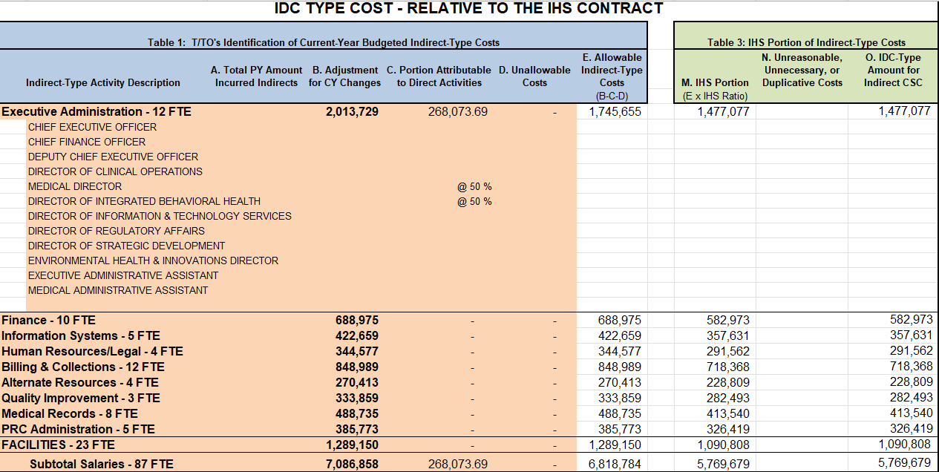
Example Costs - Staffing

Slide 11
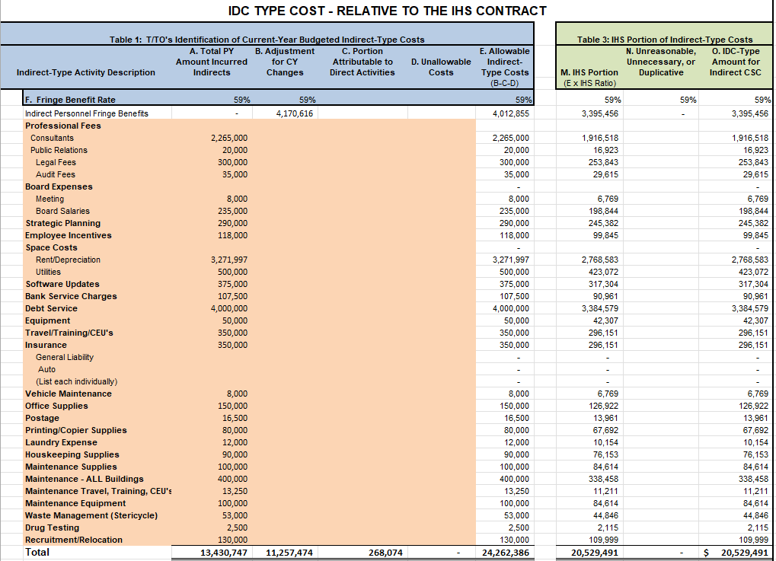
Non-Payroll

Slide 12
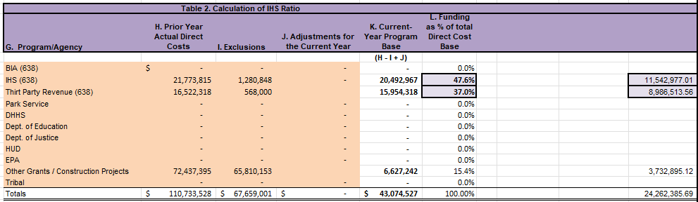
Calculate the Ratio of IHS programs
IHS = 47.6%
Third Party = 37.0
Comprises 84.6% of the Cost Pool

Slide 13
After agreement
Final lump sum amount will be entered into line “R” IDC-Type Costs of the current CSC template. (Account for split between Secretarial and Program Income)

Slide 14

14

