Slide 1
t Urban Reports
May 05, 2026
Indian Health Service
Tammy King
Agency Lead Negotiator/Urban Coordinator

Slide 2
Overview
What reporting is required
When are the reports due
How does this match up to the contract

Slide 3
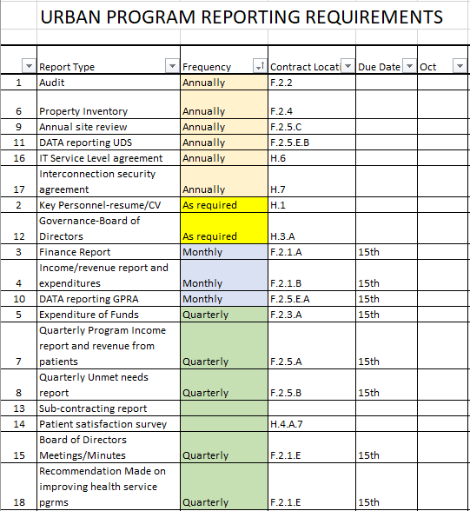
Reporting Requirements

Slide 4
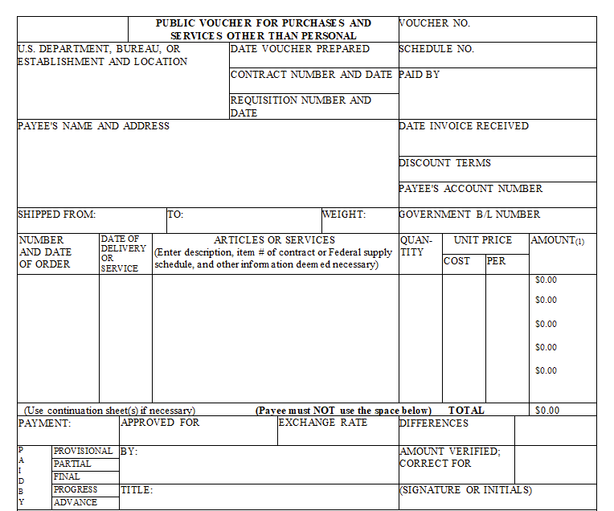
Public Voucher SF 1034

Slide 5
Contract: F.2. Reporting Requirements
F.2 REPORTING REQUIREMENTS
The Contractor shall submit to the Contracting Officer the following reports.
F.2.1 Financial Reports
A. The Contractor shall complete and submit monthly financial reports, including vouchers (Government Standard Form (SF) 1034, “Public Voucher for Purchase and Services Other Than Personal,” and SF 1035, “Continuation Sheet, Public Voucher for Purchase and Services Other Than Personal”), by the 15th of each month, beginning with the first full calendar month following the effective date on the contract.
Notes:
The Indian Self-Determination and Education Assistance Act (ISDEAA) authorizes Tribes to contract with IHS and the BIA to independently operate programs or portions thereof. Passed in 1975 to allow Tribal management of programs that previously had been managed on their behalf by HHS and DOI. The ISDEAA consists of two authorities ◦ Title I: Self-Determination (Contract) ◦ Title V: Self-Governance (Compact) Tribally operated programs offer a range of services based on population size, need, and resources.

Slide 6
Reporting Requirements Continued
B. A monthly summary statement of program income/revenues and expenditures that relate to the contract should be included with the SF1034
C. The Contractor shall maintain records of the receipt and disposition of program income in the same manner as that required for the contract funds that gave rise to program income, showing the source of the income, the purposes for which it was expended, and any other information required by the Contracting Officer.
D. Final Payment…
E. Invoices shall be accompanied by a comprehensive narrative of the facets of the program’s progress. Quarterly invoices and narratives shall by submitted to the contract specialist. Program income reports, revenues from patients, shall by included with the quarterly invoice. The contractor’s quarterly narrative report shall be submitted by the 15th day following each quarter:

Slide 7
Quarterly Report Requirements
1. Identification of gaps between the unmet health needs of urban Indians and the resources
available to meet such needs; and
2 Recommendations made to the Secretary and Federal, State, local, and other resources
agencies on methods of improving health service programs to meet the needs of urban
Indians.
3. Detailed information on activities conducted by the Contractor, including copies
of board minutes.

Slide 8
Contract: F.2.3 Expenditure of Funds
The contractor shall submit a quarterly report on the amounts and purposes for which funding under the contract is expended, including:
1. The number of eligible Urban Indians to whom services were provided; and
The number and type of services provided to those eligible Urban Indians.
B. In determining whether to include a particular individual on the report, the Contractor may consider documents including but not limited to:
Certificate of Degree of Indian Blood (CDIB); Bureau of Indian Affairs Form 4432; Tribal membership card; Tribal correspondence; official birth certificate(s) that establish first or second degree descendancy.

Slide 9
Contract: F.2.4 Personal Property
• Government-owned contractor-held property is defined as property that is required for the performance of work and acquired or provided by the contractor while under contract to the IHS. Alternately, the property may be government furnished equipment; property is acquired by the IHS and subsequently made available for use by the contractor.
Inventory report required at the end of each contract year. See Part I, Section G.4.D

Slide 10
Contract: F.2.5 Program Reports
Quarterly Program Report
The Contractor shall, consistent with 25 U.S.C. §§ 1655 and 1657, submit quarterly reports demonstrating compliance with the contract, including an explanation of activities conducted pursuant to the contract, information gathered, an accounting for the amounts and purposes for which Federal funds were expended, and such other information as the Government may request.

Slide 11
Quarterly Unmet Needs Report
The Contractor shall, consistent with 25 U.S.C. §§ 1653(a), 1655, and 1657(a), submit an unmet needs report quarterly. The report includes information gathered by the contractor to:
identify gaps between unmet health needs of Urban Indians and the resources available to meet such needs; and
(2) make recommendations to the Secretary and Federal, State, local, and other resource agencies on methods of improving health services to meet the needs of Urban Indians.

Slide 12
Contract: F.2.2 Audit Reports
A. The Contractor shall complete and submit an annual audit report that complies with the requirements of the Single Audit Act of 1984, P.L. 98-502, as amended, and Federal regulations at 45 C.F.R. Part 45, within the earlier of 30 days after receipt of the auditor’s report or nine months after the end of the Contractor’s fiscal year.
B. The Contractor shall submit the audit reports to:
Federal Audit Clearinghouse
HHS Office of Inspector General
Division of Acquisition Policy, Indian Health Service
Chief Contracting Officer - Bemidji

Slide 13

Questions

