Slide 1
t
BAO Updates
May 05, 2026
Indian Health Service
Tammy King
Agency Lead Negotiator/Urban Coordinator

Slide 2


Partners
Thank you to Great Lakes Area Tribal Health Board

Slide 3
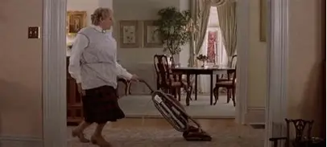
House Keeping
Restrooms
Breakfast/Lunch – Great River Room
Evaluations
Presentations

Slide 4
Updates
Budget Formulation – November in Minnesota
Matt Ireland – 105(l)
Heidi Voss – Behavioral Health Consultant
Jessica Anderson – Urban Coordinator
Ken Ramano & Rose Counoyer - Retired

Slide 5

ISDEAA Portal
FY27 Documents upload soon
Uploading 105(l) leases and payments
Title V’s – Engaging our Web developer to add Title V to Portal.
  Repository
Title I
  FY27 Proposals due July 2nd
  CY27 Proposals due Sept 30th
Notes:
The Indian Self-Determination and Education Assistance Act (ISDEAA) authorizes Tribes to contract with IHS and the BIA to independently operate programs or portions thereof. Passed in 1975 to allow Tribal management of programs that previously had been managed on their behalf by HHS and DOI. The ISDEAA consists of two authorities ◦ Title I: Self-Determination (Contract) ◦ Title V: Self-Governance (Compact) Tribally operated programs offer a range of services based on population size, need, and resources.

Slide 6
CSC/CDA
Process FY25 & 26 3rd Party CSC
  Prior to 25 would be CDA
FY 20 is closing Sept 30 for FY; Dec 31 for CY
3rd Party CSC and HD101 Training and Technical Assistance

Slide 7

MMIP
Date And Time
05-05-2026 @ 12:00 PM to
05-05-2026 @ 03:00 PM
Location
Rosa Parks Circle, 135 Monroe Center St NW, Grand Rapids, Michigan

Slide 8

Questions

