Slide 1
Peter Christensen Dental Clinic
Lac du Flambeau Band of Lake Superior Chippewa

Slide 2
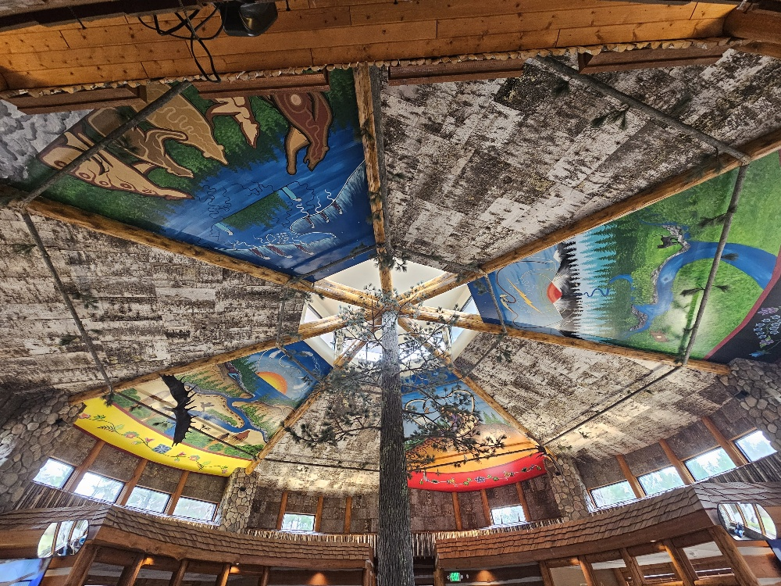


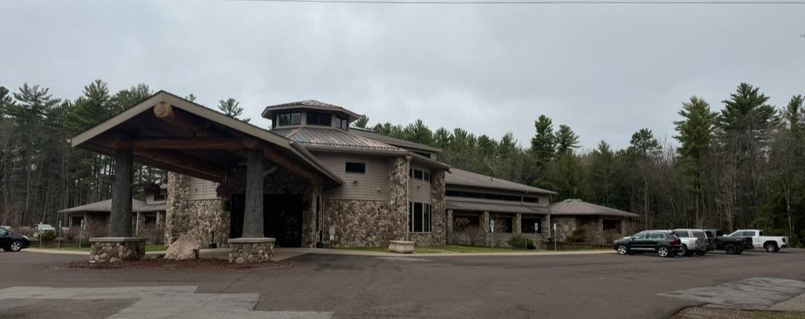

Slide 3
Our Team – Separate from the Health Clinic
Built in 2013
36,000 square feet
32 treatment chairs
50 employees
On our way to 6 Full time General Dentists + 1 more next year
One full time, one part time Pediatric Dentists
Part time Oral Surgeon
Full time Orthodontist on the way
2 part time General dentists
5 full time Hygienists, 2 part time
Notes:
Recruitment is a long game………………………………………Relationships other places bring options others don’t have.

Slide 4
Productivity -
1000-1400 patient appointments per month
~160 no shows
~150 walk ins
Typically ~15% no show rate overall
Must confirm by noon day before, or pull appointment
We proactively reach out with texts and calls to get them before noon
Ultimately on the patient to do it, they sign our policy

Slide 5
Meet Your Patients Where THEY Are
Notes:
We can give a diagnosis of where they are, but we can not put them in a box and say that is where they are in their mind. They are where they want to be, where they are ready to be, but not always where they need to be to be healthy.

Slide 6
DATA DATA DATA
Keep track of their attendance
Make dummy codes to track
Keep notes in the clinical notes when they miss, with detail, consider the detail
If they miss an appointment, contact them, but don’t reschedule them yet
Notes:
Don’t “use it against” them, use it for information, discernment Not to be punitive, but probably not a good idea to put a regular no-shower first appointment in AM – Unless they say that is the only time they can come.
Many will make a follow up appointment at the time they no show to save embarrassment. Too often they burn you again. Have them call back when they are ready to make the appointment. Never the same time.

Slide 7
How do you calculate No Shows?
No Shows / (Patients with confirmed appointments that came + No Shows)
OR
No Shows / (Total Patients Seen (confirmed and walk in)+ No Shows)

Slide 9
Who shows up to appointments?
People who WANT the appointments
Notes:
Pain, Injury or Infection – they want to be at their appointment. Those that want to get themselves in a better place. Those that want to keep themselves in a good place. Those who feel pressured, or don’t feel the importance of their health will not show up.

Slide 10
Pick the Right People
Find the right people, don’t put up road blocks, and don’t cheap out on them.
Pay them more than they are asking if at all possible.
Benefits of long term staff/providers
Example has to be from the top down
Attitude vs Desperation for a Body
Teachable vs Knows It All
Team Work vs Personal Accolades
Mentor vs Discipline
Notes:
This can be hard. Texas Example. Getting people to live away from cities is hard. There are a limited number of people willing to do it. Once you find someone, they still need to be the RIGHT someone. Finding the right combination and who that looks like could be hours to discuss, but these are some key things to look for in a candidate. AVOID DESPERATION – Discernment is critical here

Slide 11
We Are All Actors
Who are we when we are with our patients?
We are characters in their life, we are not the main character
Our personal troubles go away, you are there for them.
You live in their world when you are with them.
Notes:
I am not the person talking to you in my personal life. I avoid large groups and would prefer to not be in them, but here I am. Today, I am a presenter. My role for the day. The same needs to happen with our patients. We can not bring our personal, or work issues into the room with the patient. They should never be able to tell there was conflict in your conversation minutes ago. You are on stage. If you can’t do that, you are hurting your patient’s ability to get the care they need.

Slide 12
Do not consider dismissing a tribal member
Set boundaries for what is appropriate, and stick to them.
Write policy to address issues, get support of those above you on how to deal with problems
Notes:
Not sure how everyone handles this. I have heard of clinics that decline to care for tribal members for one reason or another. There could be a situation I have not experienced that would require this for safety, but almost always there should be a work around. Communication with the patient is key. A disorderly behavior ordinance is VERY helpful. Consider working with leadership before pushing someone away. If they stay away, that is on them.

Slide 13
Be available when they need you, even when it is hard.
Notes:
Walk in exam appointments, any time. EXAM!!!!! Yes, any time your doors are open. No Caps or limits. They will have to wait at times, but where else can they go? Does this promise an immediate fix to EVERY problem, at the expense of scheduled patients? NO. But it is a part of the system that meets the patient “where they are, not where you are”.

Slide 14
Give them options
No Treatment is always an option, tell them so.
They may make the “wrong” choice, but it will be their choice.
We should be ready when they change their mind
This doesn’t mean sugar coat.
No need to sell, tons of work to do, let them decide on their own
Notes:
Give them the options, including NO TREATMENT. I am not a used car salesman trying to clear my lot. They have choices. Tell real risks and benefits, but they make the final decision. They can’t make you do something unethical, but you can’t force them into treatment either. Active long-term inflammation and infection is bad on their whole body, but they need to decide if they want to act or not. Dentures are an emotional decision for most people, the dentist should not rush them. Example – Indications present for SRP, they say no. Don’t do a prophy, unethical. Did you do a debridement?
They only want 2 root tips out, because they chew with the rest, get the ones out you can and get them Abx is indicated.

Slide 15
Questions?

