Slide 1
IPP for Vendors
05/05/2026
Indian Health Service Tammy King
Agency Lead Negotiator/Urban Coordinator

Slide 2

Why IPP?
Invoicing Processing Platform
Reduces Cost
Strengthens Security
Increases Efficiency
Vendor can enter information directly into the treasury system
Acceptance or Rejection of invoices happens more quickly
Payments are quicker

Slide 3

First Steps
Gaining Access
1. Register with Login.gov:
IPP uses Login.gov for secure sign-in. If you don’t already have an account, you can register at https://login.gov.
2. Ensure you are registered in SAM.gov:
Your organization must have an active SAM.gov registration to use IPP.

Slide 4

Gaining Access to IPP
Continued
3. Request Access to IPP:
You’ll need to reach out to the IPP Help Desk to request access or troubleshoot login issues. You can contact them at:
IPP Customer Support: IPPCustomerSupport@fiscal.treasury.gov
SIK IPP Help Desk: sik.ipphelpdesk@sikts.info.org (as mentioned in the error message)
**Be sure to include your name, organization, UEI/DUNS number, and a detailed explanation of the issue.

Slide 5
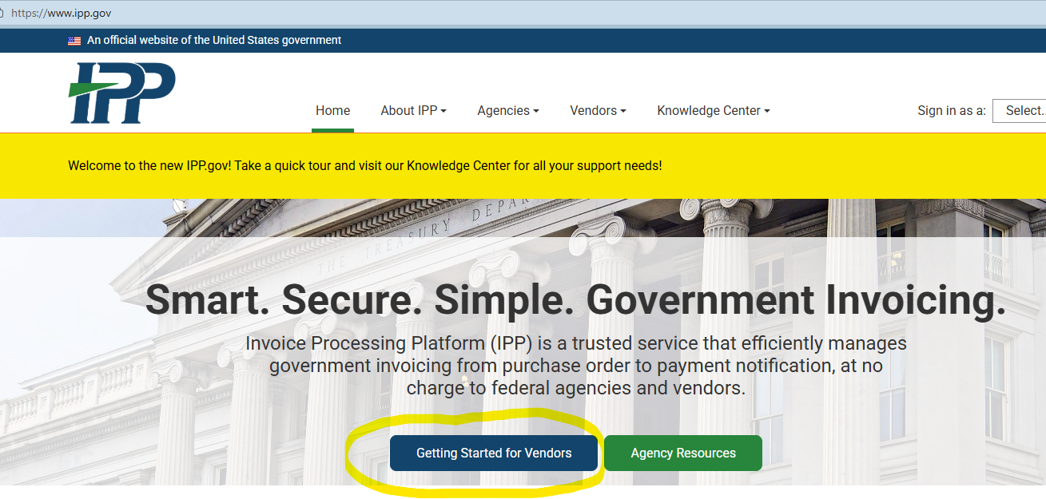
IPP.GOV
Website

Slide 6
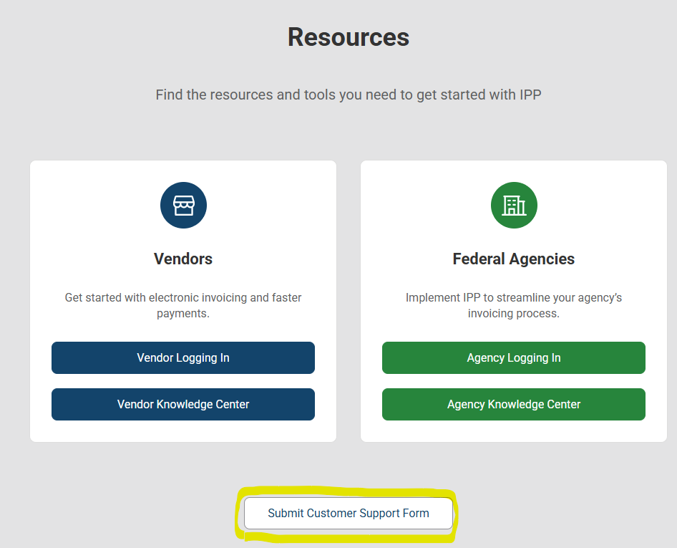
Resources
From IPP.GOV

Slide 7

What Happens Next
After Logging into IPP
The Vendor Administrator can add additional users
New users will receive an email - ID.me or Login.gov
Users will have access to IPP’s Collector Module
View Purchase Orders
Submit Invoices
Access Payment Information

Slide 8

How it works
IHS will upload a Purchase Order/Task Order (PO)
Vendors will review and download
Vendors can “flip” the PO into a digital invoice
When the invoice is submitted, emailed to COR for approval
Once approved, payment is generated

Slide 9

IPP Customer Support
Phone Support (866) 973-3131
The IPP Customer Support Team is available to assist users Monday through Friday (excluding federal holidays) from 8 a.m. to 6 p.m. Eastern Time
IPP FAQs (link)
DAP Invoice Processing Platform (IPP) Knowledge Center - Vendor Issues
IPP Vendor Training: https://www.ipp.gov/vendors/training-vendors

Slide 10
Questions?

