Slide 1
Ambulatory Accreditation Trends 2025
Bemidji Area IHS FY27 Pre-Negotiations
Grand Rapids, MI
May 5, 2026
Indian Health Service
CDR Matthew Ellis, MPH, CIC, AL-CIP, CDIPC, REHS
Institutional Environmental Health Officer
Infection Prevention & Control Consultant/
Patient Safety Lead

Slide 2
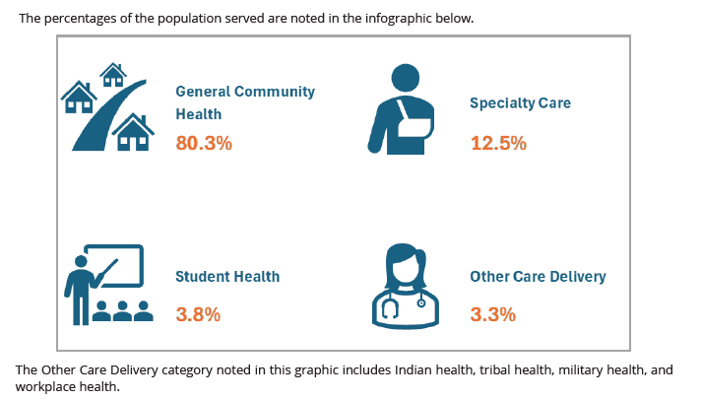

Accreditation Association for Ambulatory Health Care (AAAHC)

Slide 3
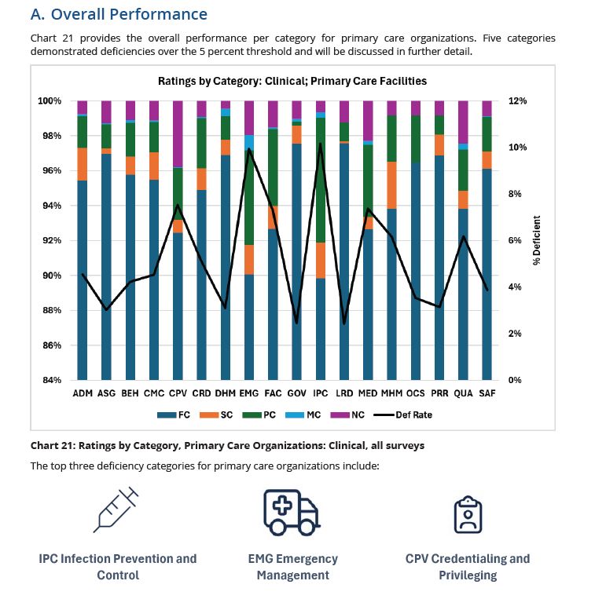
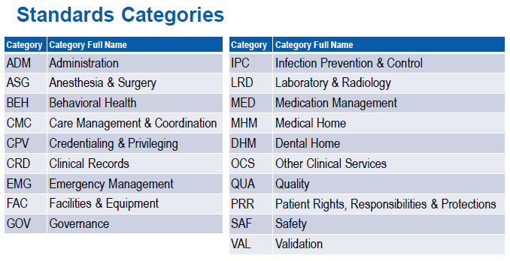

Slide 4
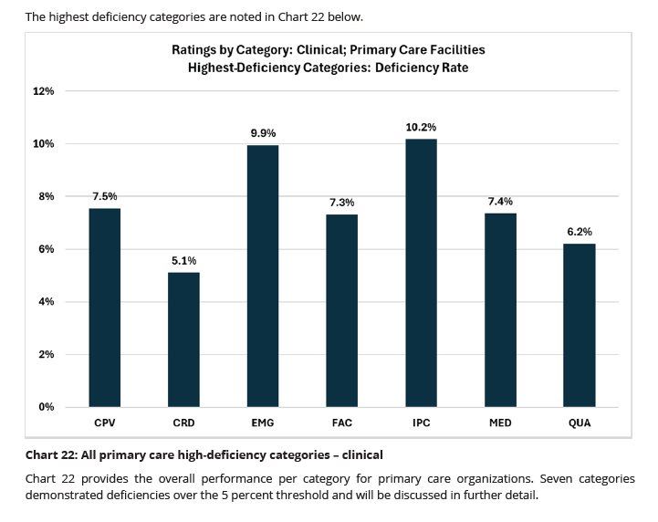
Overall Performance

Slide 5
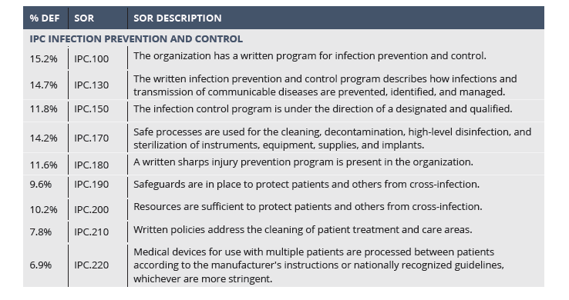
Infection Control & Prevention (IPC) Highest-Deficiency Standards
Notes:
While fundamental principles of infection prevention and control remain the same as hospitals and ambulatory
surgery centers, the primary care setting offers some unique challenges which can lead to less emphasis on
rigorous infection control practices. These challenges include lean staffing, lack of infection prevention trained
professionals, limited surveillance data, variable patient acuity, lack of reinforcement, and a lower perceived risk
of health care associated infections. Robust education and training, strong policy and procedures, and the focus
on a culture of safety, will assist primary care settings in maintaining high standards for infection prevention and
patient safety.
Your organization can also participate in the AAAHC Safe Injection Practices Benchmarking Study and the Hand
Hygiene Benchmarking Study when you purchase the annual benchmarking subscription. More details can be
found at https://www.aaahc.org/quality-institute/benchmarking-studies/.

Slide 6
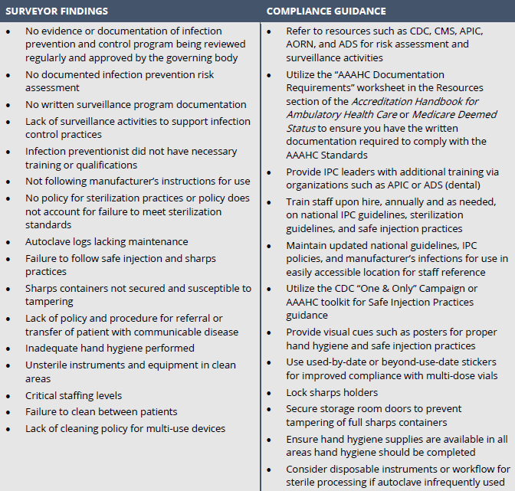
IPC Survey Findings

Slide 7
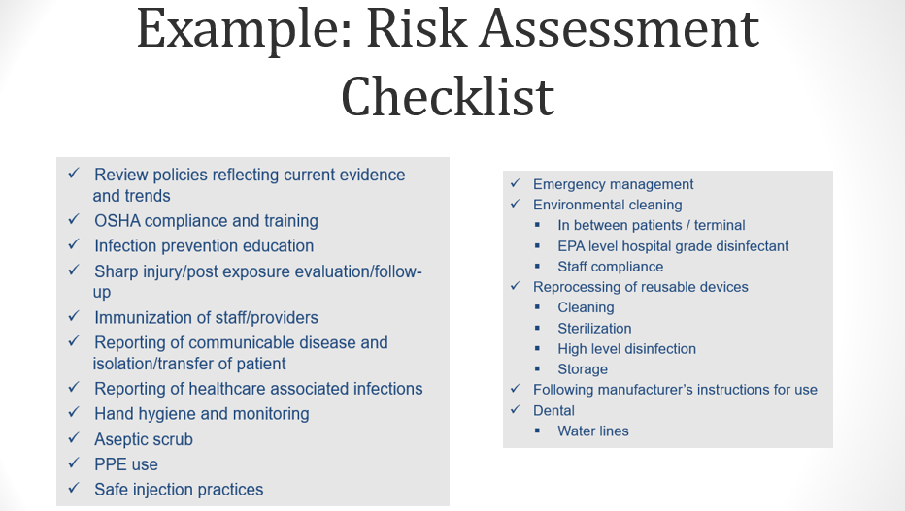

Slide 8
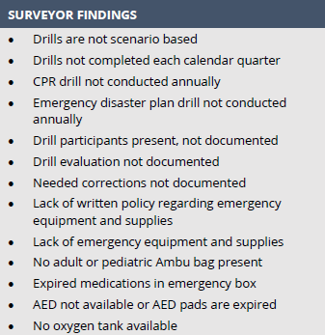
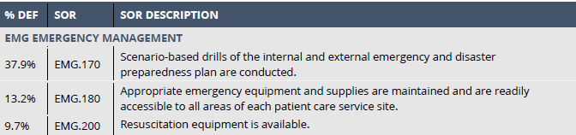
Emergency Management Deficiency Standards
Notes:
Issues related to performing scenario-based drills continue to be the highest deficiency Standard despite its
criticality to patient and team member safety. Success with this Standard takes pre-planning of the drill timing
and a scenario appropriate to the facility's procedures, location, and risk assessment.
The importance of performing these drills allows health care providers to apply their skills in a realistic
environment, without risking patient harm, to build confidence in the event of a real-life emergency situation.
Drills also build teamwork, communication, and trust. They identify gaps in plans, policies, and procedures, and
highlight training needs related to equipment, supplies or processes. Drills also provide an environment where
mistakes can be made and learning can occur, and staff can build the confidence needed when faced with real
crisis situations.

Slide 9
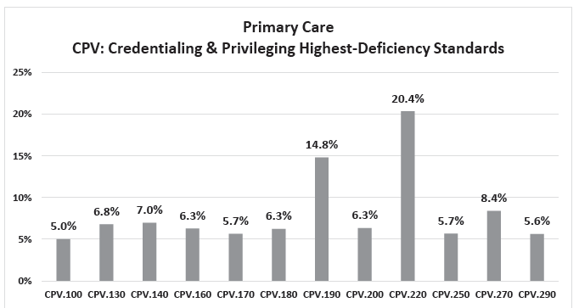

Slide 10
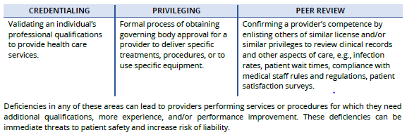
Credentialing, Privileging, Peer Review
“Credentialing, privileging, and peer review are three separate but related processes.”

Slide 11
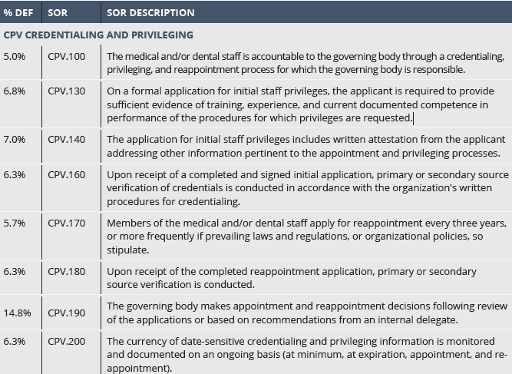
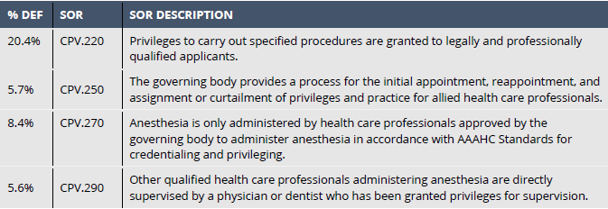
Credentialing & Privileging Highest-Deficiency Standards

Slide 12
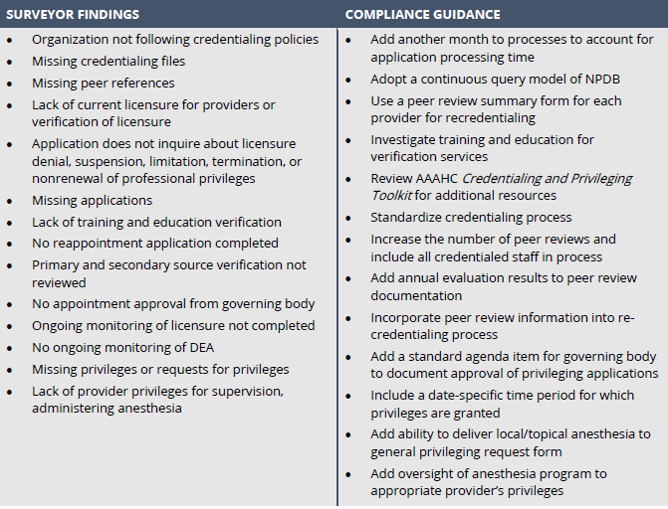
CPV Common Survey Findings

Slide 13
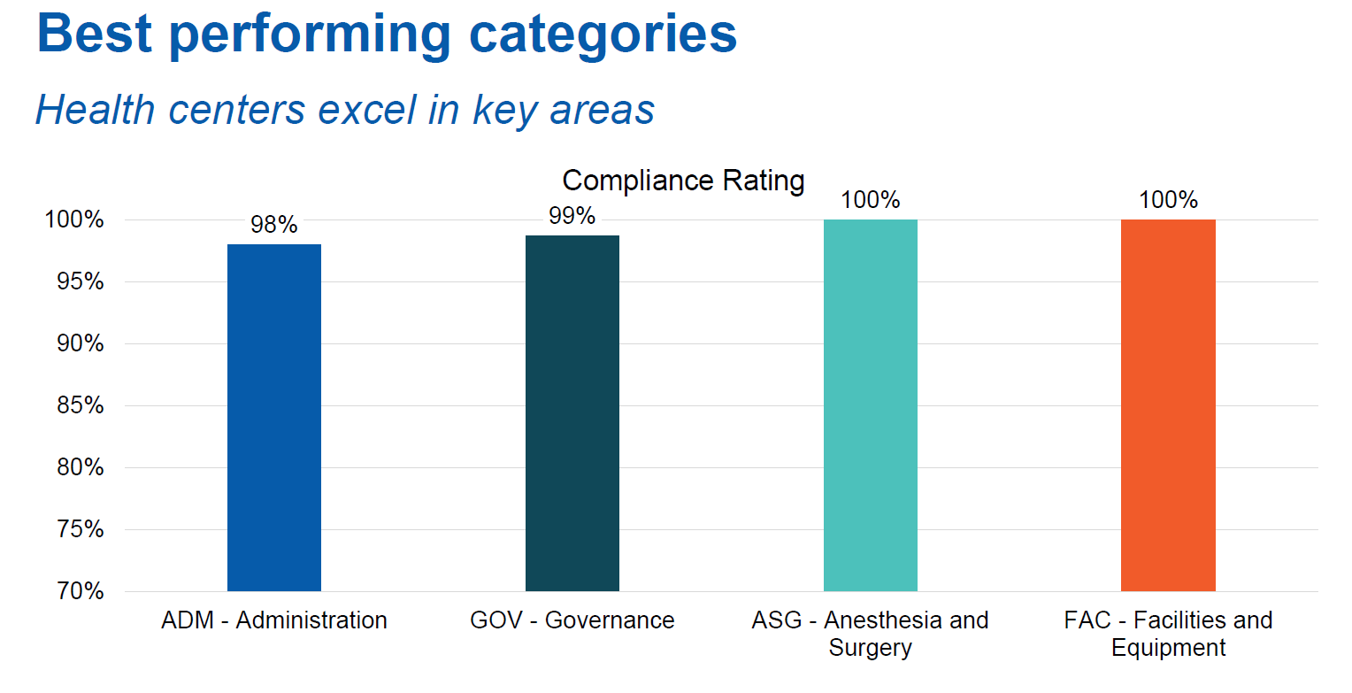
IHS Specific Best Performing Trend
9 Reaccreditation surveys: 9/29/24 – 9/28/25

Slide 14
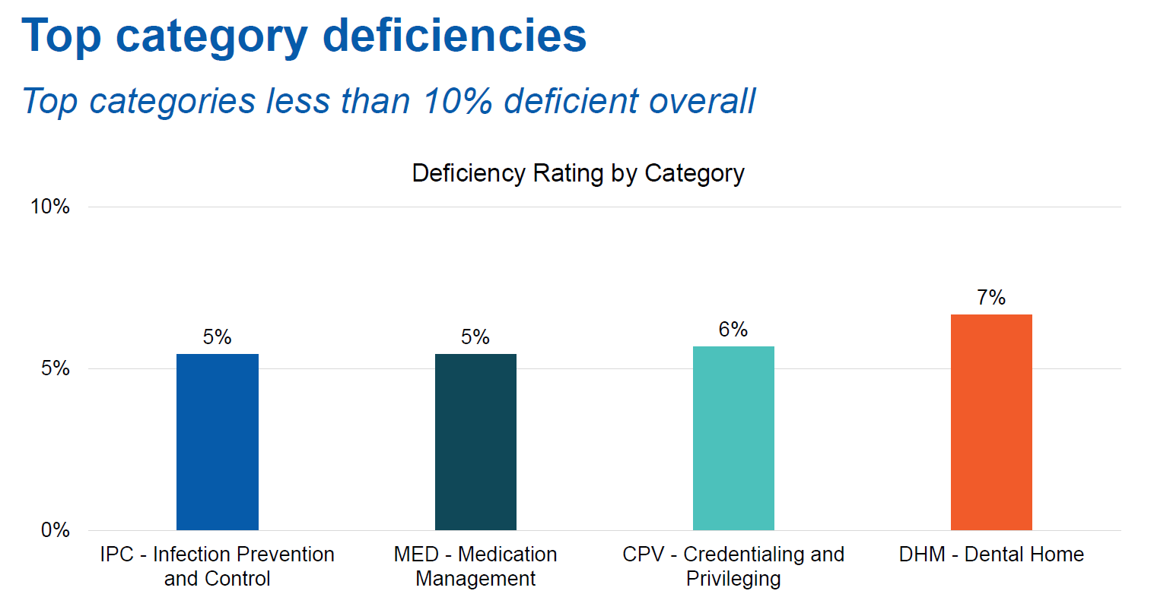
IHS Specific Standard Deficiency Trend

Slide 15
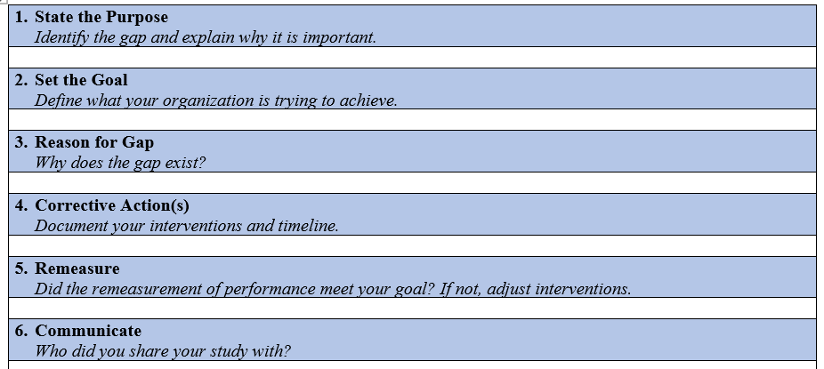
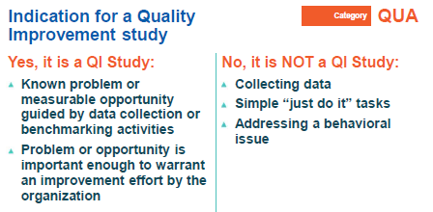
Revised AAAHC QI Study Framework
The organization demonstrates that continuous improvement is occurring by conducting quality improvement studies when the data collection processes reveal a problem or improvement opportunity.

Slide 16
Accreditation=Risk Mitigation
Creates a system to mitigate and reduce risk with a customized review of your organization and deliver best
practice recommendations to continuously improve patient outcomes

Slide 17
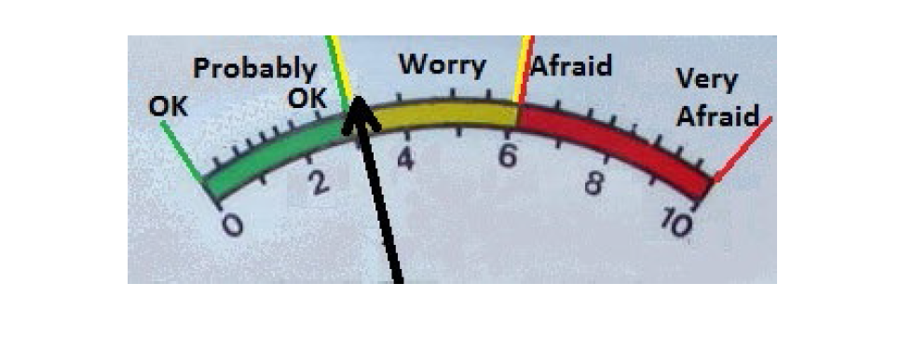
Sterilization???

Slide 18
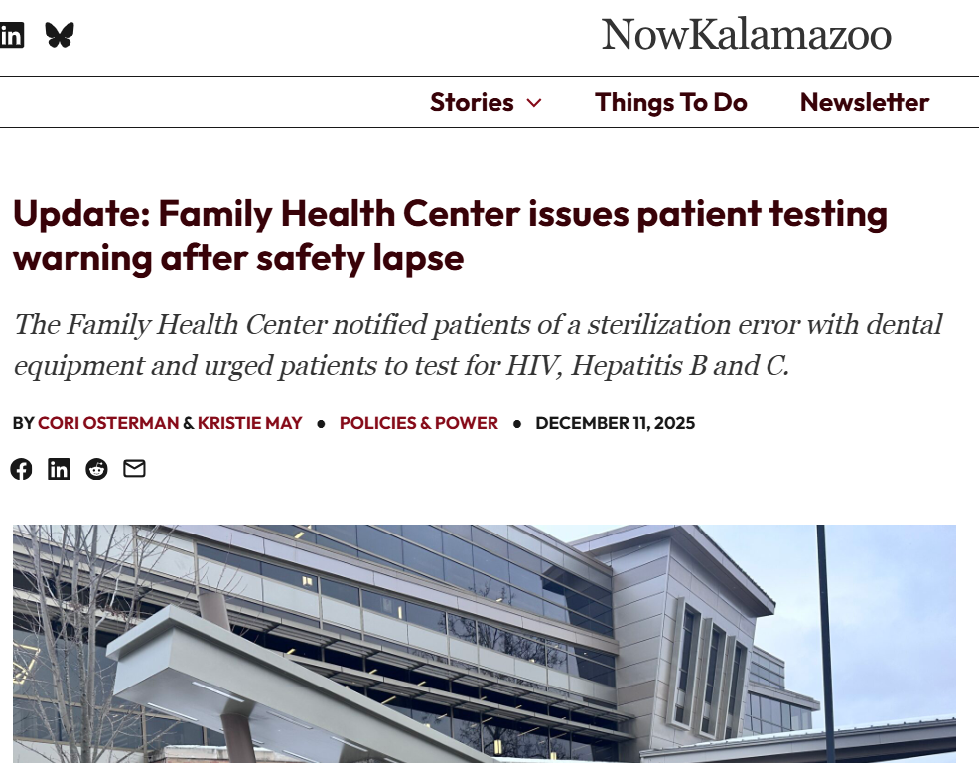
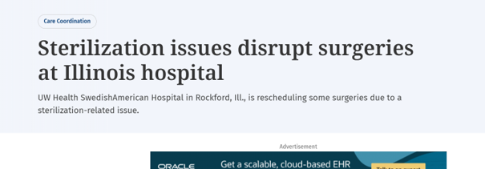
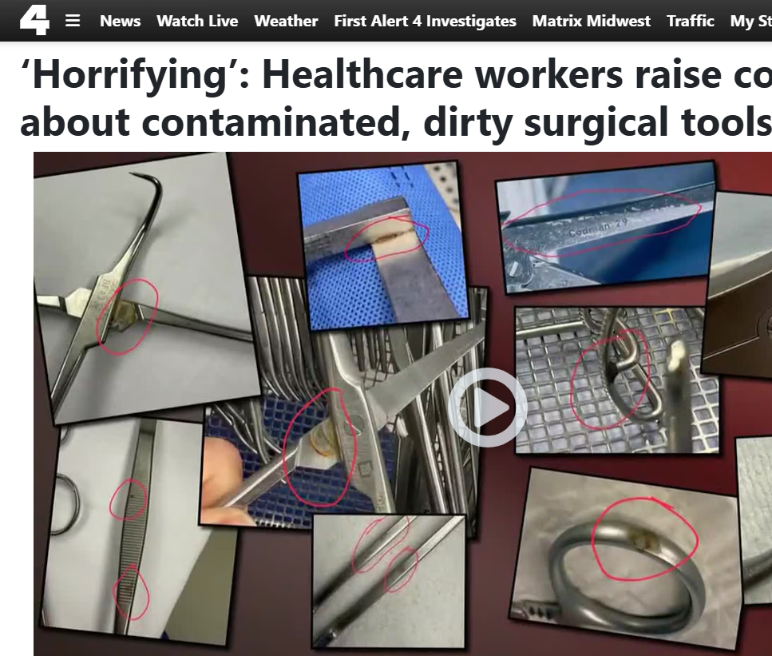

Slide 19
Sterilization Breach Protocol

Slide 20
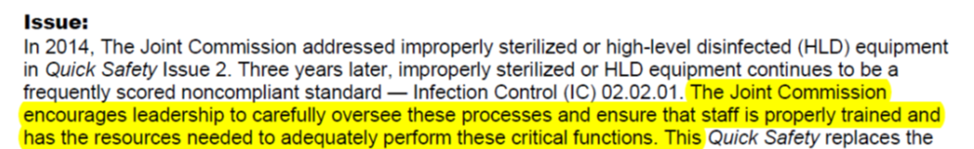
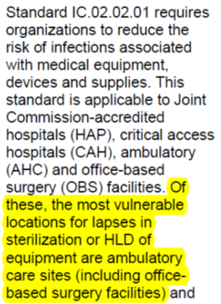
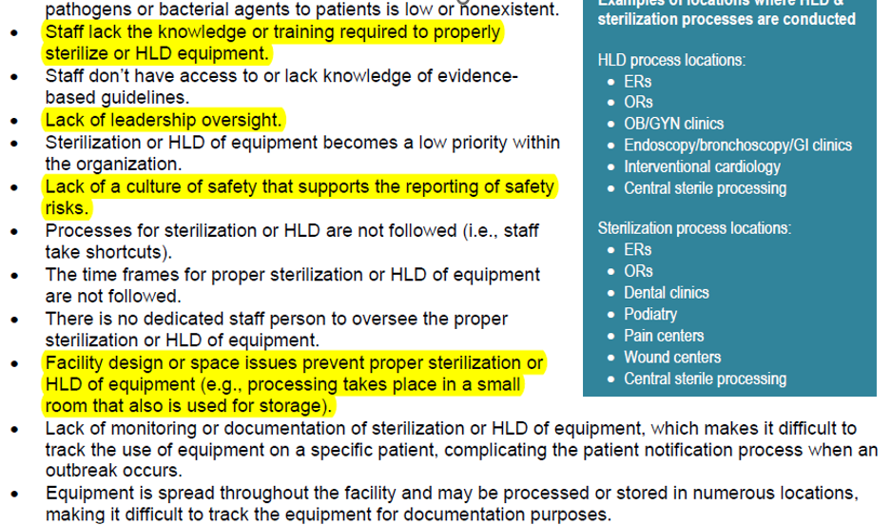
TJC Quick Safety Alert: Improperly Sterilized Equipment- a growing problem

Slide 21
Area Accreditation Support
OCS can provide consultative support for organizations seeking New accreditation
  AAAHC Standards Training
  Support with annual IPC programmatic infection control risk assessment
  AAAHC policy review and development
  Implementation of IPC and Safety accreditation Dashboards and resources
  Limited onsite mock surveys, accreditation prep activities and coaching
  Infection Control and Safety Committee Consultation
  Quality Studies
  Connection to IHS HQ Office of Quality accreditation and consulting contracts for Accreditation Association for Ambulatory Healthcare (AAAHC)

Slide 22
Questions??
Jonathan Merrell RN, BSN, MBA
Bemidji Area Deputy Director, Office of Clinical Support Services
Jonathan.Merrell@ihs.gov
Or
Matthew R. Ellis, MPH, CIC, AL-CIP, CDIPC, REHS
Commander, USPHS
Office of Clinical Support
Area Infection Prevention & Control Consultant
Area Patient Safety Lead
Area I-STAR Quality Manager
Mobile: 218.407.3890
Email: matthew.ellis@ihs.gov

