Slide 1
Indian Health Care Improvement Fund/Level of Need Funded
5/7/2026
Indian Health Service Jason Douglas
Bemidji Area Statistical Officer

Slide 2
25 US Code § 1621 Indian Health Care Improvement Fund
§ 1621 Indian Health Care Improvement Fund Summary
The IHCIF is a means by which the HHS Secretary, acting through IHS, is authorized to expend funds, directly or under the authority of the Indian Self-Determination and Education Act, for the purpose of…
Eliminating the deficiencies in health status and health resources of all Indian Tribes;
Eliminating backlogs of the provision of health care services to Indians;
Meeting the health needs of Indians in an efficient and equitable manner, including the use of telehealth and telemedicine when appropriate;
eliminating inequities in funding for both direct care and CHS programs; and
Augmenting the ability of the IHS to meet a variety of responsibilities including (next page)

Slide 3
25 US Code § 1621 Indian Health Care Improvement Fund
Clinical care (inpatient and outpatient)
Primary, secondary, tertiary care
Preventative health
Dental care
Mental health
Emergency medical services
Treatment, rehabilitation, and control of alcoholism and drug abuse
Injury prevention programs
Home health care and CHR
M&I

Slide 4
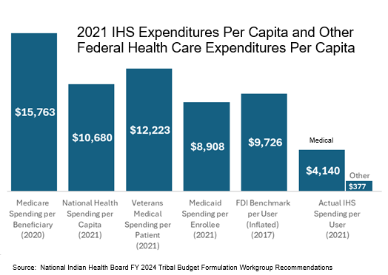
25 US Code § 1621 Indian Health Care Improvement Fund

Slide 5
25 US Code § 1621 Indian Health Care Improvement Fund
No offset or limitation
Funds appropriated under the IHCIF will not offset or limit other appropriations
Funds are allocated directly to Service Units and Tribal Organizations
Apportionment of funds will be determined by the IHS in consultation with (and active participation of) affected Indian Tribes and Tribal organizations
Historically, apportionment has been on the basis of Level of Need Funding (LNF)

Slide 6
25 US Code § 1621 Indian Health Care Improvement Fund
2018 Omnibus Spending Bill included $5.5 billion for IHS
An increase of $498 million over 2017 enacted level
Of this, $72 million has been earmarked for the Indian Health Care Improvement Fund (IHCIF)
The methodology to calculate health care resource deficiencies is specified in 25 US Code § 1621

Slide 7
25 US Code § 1621 Indian Health Care Improvement Fund: Enacted Amounts
Fiscal Year | Enacted Amount |  | Fiscal Year | Enacted Amount
FY 2000 | $ 10,000,000 |  | FY 2014 | $ -
FY 2001 | $ 30,000,000 |  | FY 2015 | $ -
FY 2002 | $ 23,000,000 |  | FY 2016 | $ -
FY 2003 | $ 26,212,000 |  | FY 2017 | $ -
FY 2004 | $ - |  | FY 2018 | $ 72,000,000
FY 2005 | $ 11,094,000 |  | FY 2019 | $ -
FY 2006 | $ - |  | FY 2020 | $ -
FY 2007 | $ - |  | FY 2021 | $ -
FY 2008 | $ 13,782,000 |  | FY 2022 | $ -
FY 2009 | $ 15,000,000 |  | FY 2023 | $ -
FY 2010 | $ 45,543,000 |  | FY 2024 | $ -
FY 2011 | $ - |  | FY 2025 | $ -
FY 2012 | $ 11,981,000 |  | FY 2026 | $ -
FY 2013 | $ -

Slide 8
LNF
LNF calculates resource needs compared to the cost of a benchmark level of care.
Historically, this benchmark has been Federal employee health insurance
LNF serves two primary purposes
A benchmark to help justify IHS budget requests
To assist in the allocation of IHCIF funding

Slide 9
LNF Methodology
Rank order all potential recipient sites by LNF score
Lowest LNF scores: greatest resource deficiency
Set a qualifying “cut-off” LNF score
determines the degree that funds are narrowly targeted among a few sites or spread out more broadly
lowest 1/5 of sites, 1/2 of sites, etc.
Calculate dollar allocation for each qualifying recipient site

Slide 10
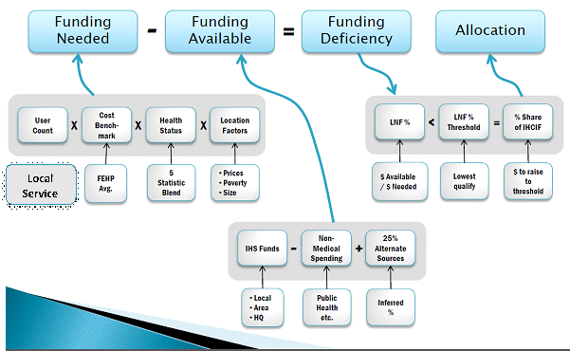
LNF Conceptual Framework

Slide 11
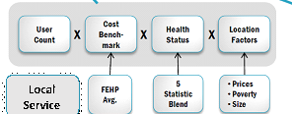
LNF Funding Needed
User Count/Population
User count shapes formula results more than any other data
Modified HQ User Population is used here
Cost Benchmark
Calculates resources as if they were allocated based on a benchmark
Currently this benchmark is CMS Health Expenditure Model (Categories 1-4)
Benchmark is customized for sites considering local conditions
Health Status
Benchmark is actuarially adjusted for anticipated higher costs of AI/AN patients whose health status is typically lower than that of the general population

Slide 12
LNF Funding Needed (continued)
Location Factors
Benchmark Calculation
Premiums
Cost shares
Population characteristics
Adjustments for site economic factors
AK vs. lower 48 states
Internal economies of scale
External health care price index
Adjustments for Area health factors
Poverty
Birth rates
Life expectancy
Disease rates

Slide 13
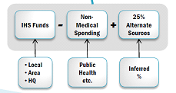
LNF Funding Available
IHS Funds/Resources
Non-Medical Spending
Facility and administrative costs
Alternate Resources
The health resources available to an organization provided by the Indian tribe, private insurance, and any State/Local government programs
This has historically been difficult to calculate - 25% has been used in the past as a placeholder.
This was changed to site-specific coverage value (percent) based on IHS site level coverage data. For sites with missing or outdated enrollment data, the State average was used. For sites whose coverage value exceeds the State average, the value was capped at the State average.

Slide 14
Final Results
In 2018, the cutoff was drawn at 34.84%
Nationally, 40 Tribes had LNF scores below this amount
Of the $71.3 million, Bemidji Area Tribes received $6.6 million (9.3%)
Tribes in 8/12 IHS Areas received IHCIF funds
9 of the 40 recipient Tribes were in the Bemidji Area

Slide 15
Final Notes
There has been no LNF-related funding in either since 2018
When funding is attached to an appropriations bill, the IHS Director will convene another LNF workgroup
IHS and Tribal representation
In 2018, 2 Tribal and 2 Federal representatives from each Area
Area Director will make announcement if/when the workgroup reconvenes
Outstanding issues:
Fractionalization of users

