Slide 1
Exports and HQ User Population
May 6th, 2026

Slide 2
Main Topics
This presentation is essentially a HQ User Population 101
  Why is it used?
  How is it collected?
  How is it calculated?

Slide 3
Main Topics
This presentation is essentially a HQ User Population 101
  Why is it used?
  How is it collected?
  How is it calculated?

Slide 4
HQ User Population Definition
An estimate of the number of Indian registrants, residing within an IHS service delivery area (PRCDA) with at least one workload-reportable direct or contract, inpatient, ambulatory care, or dental encounter during the last three years.
Produced annually after the end of each fiscal year
Used for IHS Headquarters Distributions (HQ Shares)

Slide 5
Why HQ User Population
HQ User Population was first developed as a method for counting users – that’s it
State Departments of Health tabulate vital statistics (births, deaths) by county.
As a result, keeping track of AI/AN users by county in order to merge with State records was a fairly effective and uniform method for tracking population change.
However, HQ User Population is used for much more than just tracking population growth these days

Slide 6
HQ User Population Application
Headquarters User Population is used for at the Headquarters level:
  IHCIF
    Distributed by Level of Need
    HQ User Population is a major factor in a Tribe’s LNF
  Headquarters Shares
  Congressional Increases
  Facility Planning

Slide 7
How are User Population Data Collected?
Through EXPORTS
From RPMS – HL7
  NDW (GDW Option under DATA menu)
    Patient Care Component
    Patient Registration
    Dental Encounters
  CHS (PRC)& CHR
  BHS
From commercial packages – HL7 or SFF
  Registration File
  Encounter File(s)
Deadline of the end of October each year for submitting exports for that user population cycle.

Slide 8
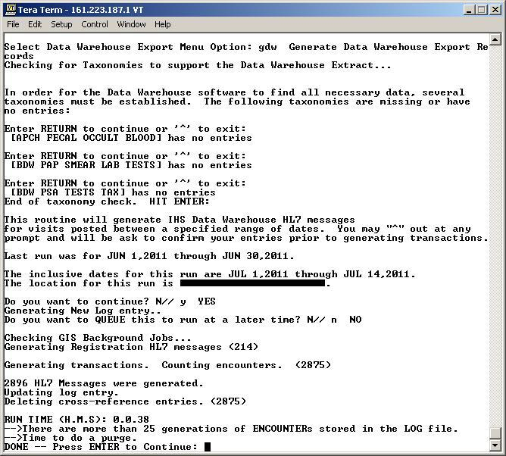
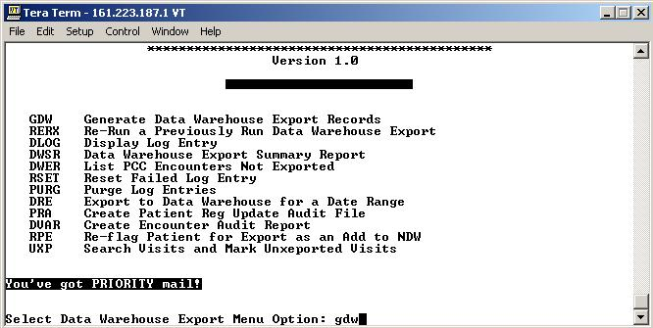
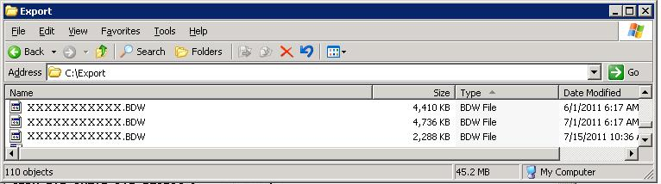
RPMS NDW Export Process

Slide 9
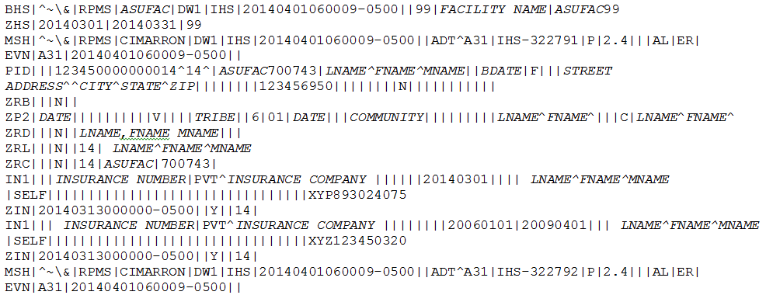
HL7 Format Example

Slide 10
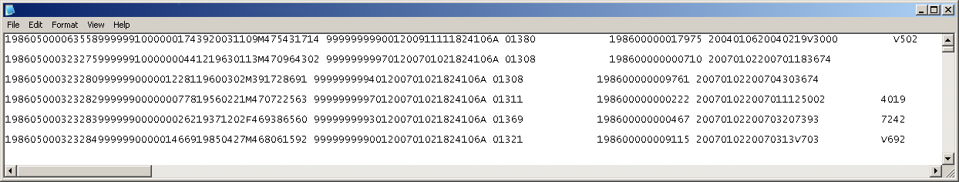
Non-RPMS Export Process
More complex
Could involve the work of a database administrator
Transform data in your database into something that can be processed by the NDW
  HL7 format preferred, pipe-delimited required at a minimum

Slide 11
Exports are transmitted to the National Data Warehouse
The ASO and any other specified points of contact will receive acknowledgement and post-load reports when the file is received and processed.
  Email NPIRSHD@ihs.gov to make changes to recipient lists.

Slide 12
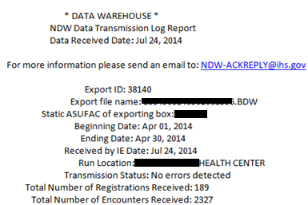
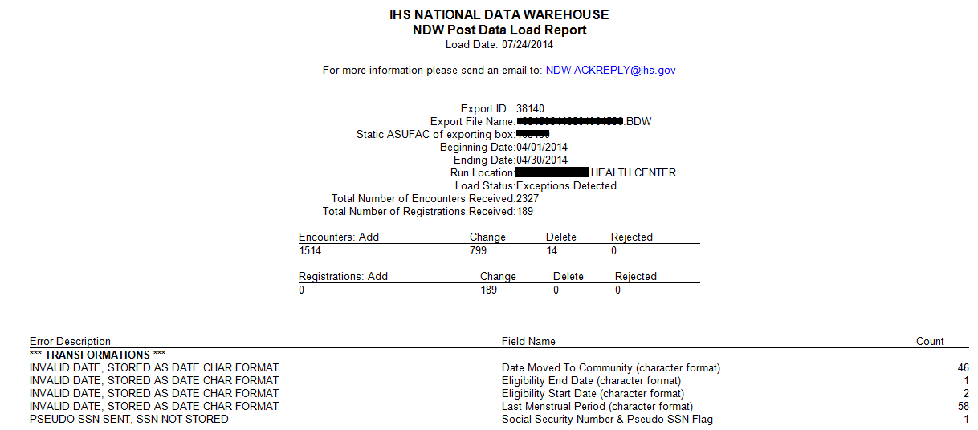

Slide 13
What is User Population
An “estimate” of users
  No such thing as an “absolute” count of users
  “Unduplication”
L Name | F Name | DOB | Sex | SSN | Residence
Smith | Pat | 12/28/1977 | -- | 111-11-1111 | Traverse City
Smith | Patricia | 12/28/1977 | F | 111-11-1111 | Charlevoix
Smith | Patrick | 10/10/1986 | M | 222-22-2222 | Traverse City
Smythe | P | -- | M | -- | Traverse City

Slide 14
Unduplication
The initial step in this logic excludes registration records that do not have a valid:
  chart facility code, chart number, first or middle name, or last name
Next, registration records are grouped by area (Bemidji, Aberdeen, etc.)
Records are unduplicated

Slide 15
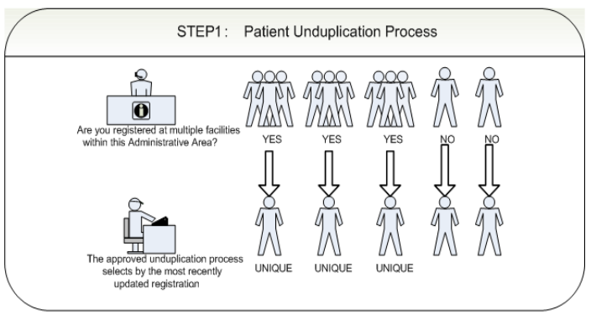

Slide 16
Unuplication, cont.
Unduplication is performed separately for each area.
The logic checks to see if the following fields for each given registrant match those on an existing registrant:
  ASUFAC
  Chart Number
  Gender
  first 6 characters of the ‘First Name,’
  first 8 characters of the ‘Last Name’
  additional close match on ‘Date of Birth’
  If there is not an exact match on ‘name,’ an exact match on date of birth is sufficient.

Slide 17
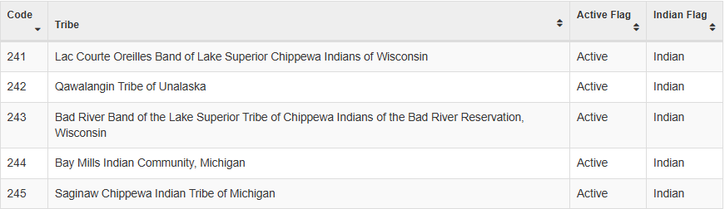
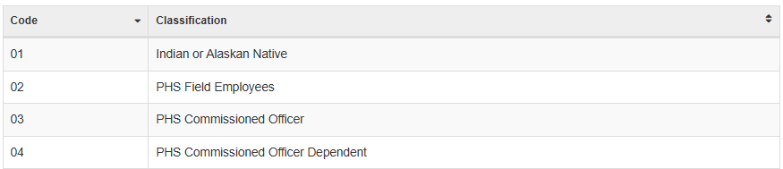
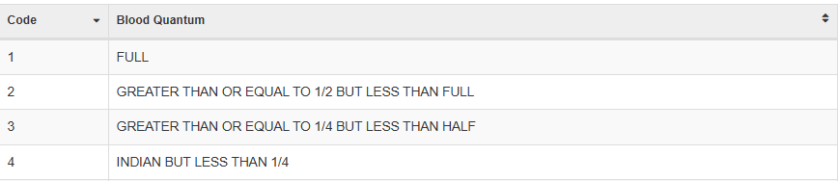
Verification of AI/AN Status
An Indian Registrant is defined as an individual who’s most current registration identifies the individual as:
  A member of a federally recognized tribe (Indian Indicator = ‘Y’) based on Tribe Code
  Has a beneficiary classification code of ‘01’ or…
  Has a blood quantum code of ‘1,’ ‘2,’ ‘3,’ or ‘4’

Slide 18
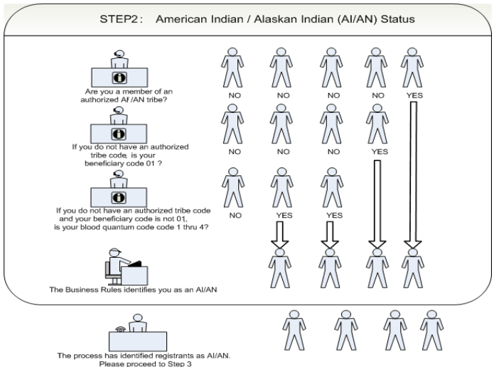

Slide 19
Verification of “Active” status
Does the registrant have at least one ‘workload-reportable’ encounter record with a date within the last three-fiscal-year period preceding the User Pop end date?
Direct outpatient encounter
  ‘Clinic code’ has a value found in the Standard Code Book with ‘Workload report flag’ = ‘Y’; and
  ‘Provider code’ has a value found in the Standard Code Book with ‘Provider status’ = ‘A’ and ‘Reporting workload flag’ = ‘Y’; and
  ‘Location of encounter’ has a valid APC Facility Code in the Standard Code Book
Direct inpatient encounter
  Same as criteria as direct outpatient encounters

Slide 20
Active status, cont.
CHS outpatient encounter
  ‘CHS provider type’ = ‘ 01’ (Hospital - GM&S), ‘05’ (Physician), ‘06’ (Optometrist), ‘07’ (Dentist), ‘12’ (Pharmacy), ‘16’ (All Other), ‘17’ (Chiropractor), ‘18’ (NHSC - PNP), ‘19’ (NHSC - CNW)
CHS inpatient encounter
  ‘CHS provider type’ = ‘01’ (Hospital - GM&S), ‘03’ (Hospital – Psychiatric), ‘04’ (Nursing Home)
Dental encounter
  None of the ‘ADA codes = ‘9130’ (Cancelled Appointment), or ‘9140’ (Broken Appointment - No Show)
  First ‘ADA code’ must not be blank

Slide 21
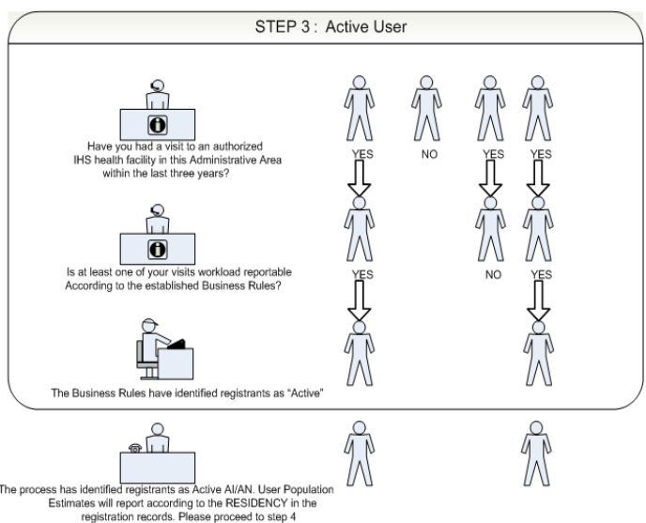

Slide 22
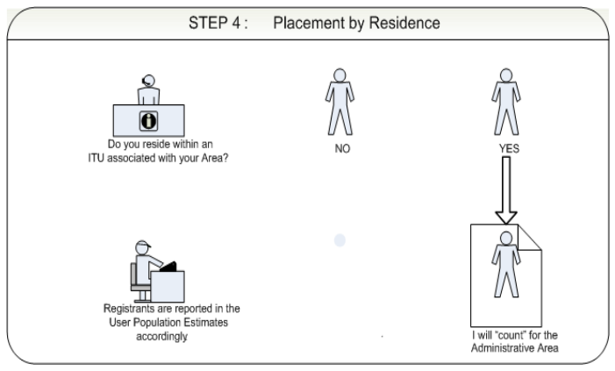

Slide 23
Community of Residence
Patients are not assigned to a Tribe for user population
Patients’ most recent community of residence is used
User population tables:
  Users by Service Unit
  Users by County
  Users by County x Community
  Users by County x Tribe
CHSDA split agreements are used for shared counties.

Slide 24
Shared PRCDA Counties
Area Policy
  Affected tribes come to an agreement with the area’s assistance (data). If no agreement, the Area Director makes a decision.
  As a result, there is a variety of methods for dividing the users in a shared county.
When a shared CHSDA county is between tribes in different service units
  Community splits
When a shared CHSDA county is between tribes in the same service unit (with one exception)
  Straight percent split
  Percent split based on tribe of membership

Slide 25
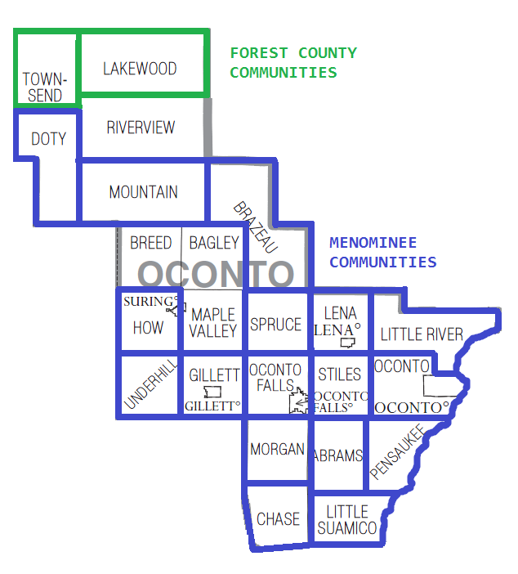
Community Split Example

Slide 26
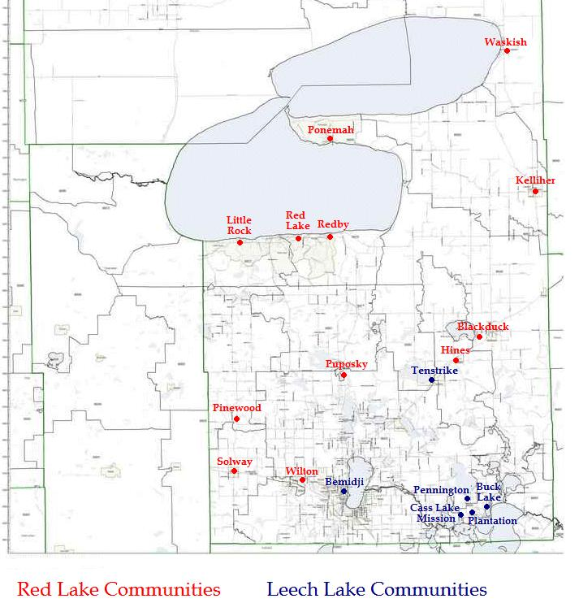
Another Community Spit Example

Slide 27
Percent Split Example
County X: 400 Active Users
Tribe A: 25% of County X = 100 Users
Tribe B: 75% of County X = 300 Users

Slide 28
“Relative” Percent Split by Tribe
EXAMPLE
  There are 500 active AI/AN in a county shared (X) between two tribes (A & B)
  Tribe A has 75 members in X County and Tribe B has 125 members in X County
  There are an additional 300 AI/AN patients who are not tribe A or B members.
 | Users | % | Final Count
Tribe A Members | 75 | 75/200 = 37.5% | 75 + (.375 * 300 = 113) = 188
Tribe B Members | 125 | 125/200 = 62.5% | 125 + (.625 * 300 = 187 = 312
“Other” Members | 300
Total | 500 |  | 500

Slide 29
More Split Examples
Hybrid
  County is shared by 3 tribes
  Tribe A gets credit for their own members only
  Tribes B and C get credit for their own members and then a relative portion of the “other” users
Another Hybrid
  County is shared by 3 tribes
  Tribe A gets credit for their own members only
  Tribes B and C get credit for their own members and a fixed percentage of the remaining users

Slide 30
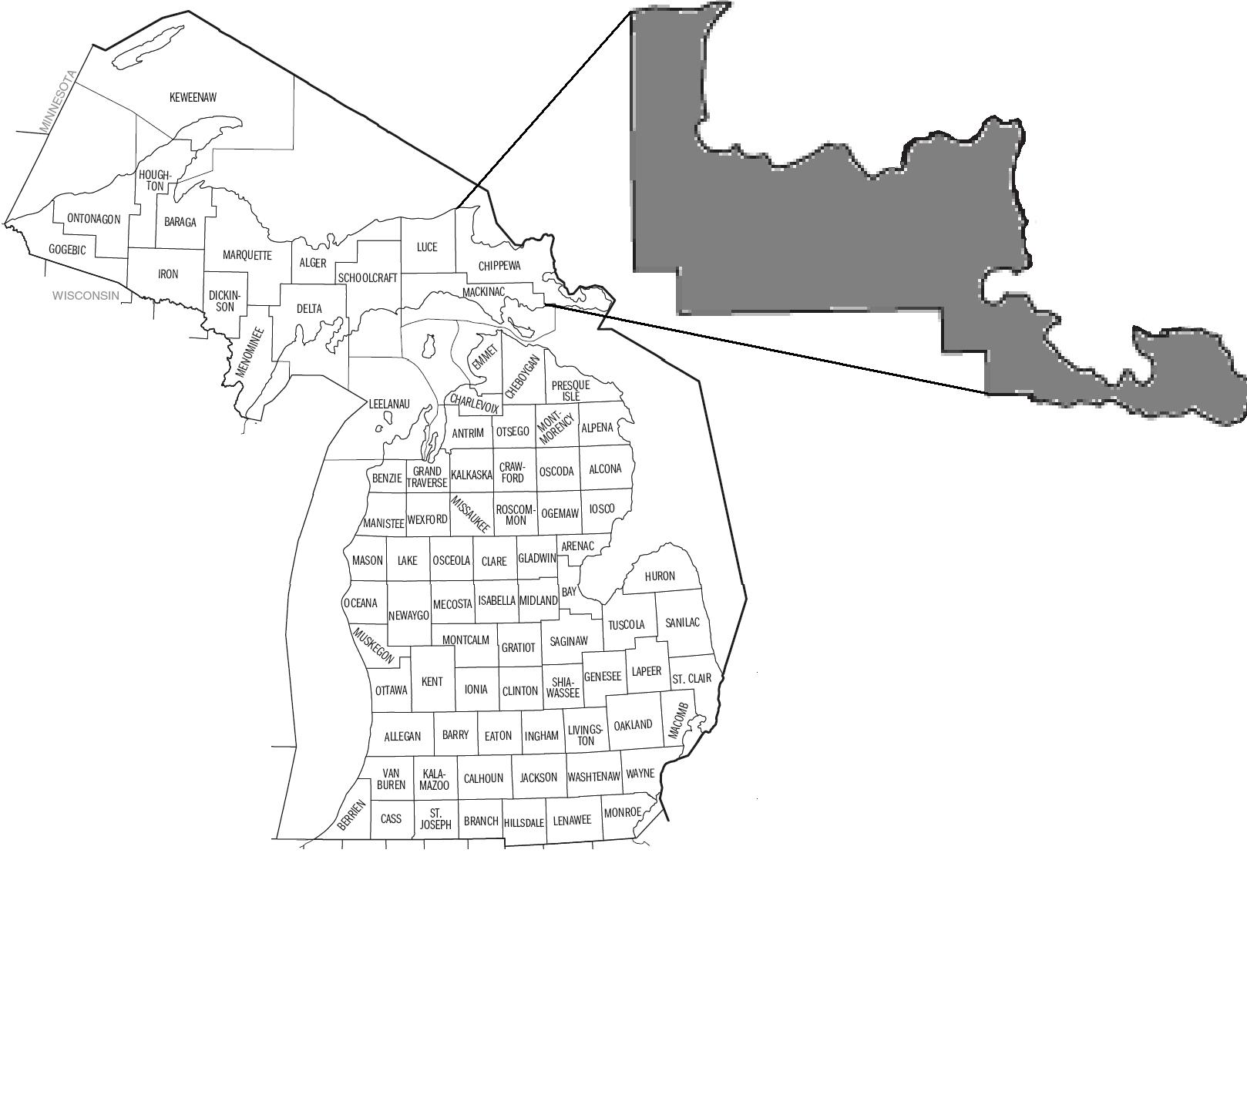
Split Example

Slide 31
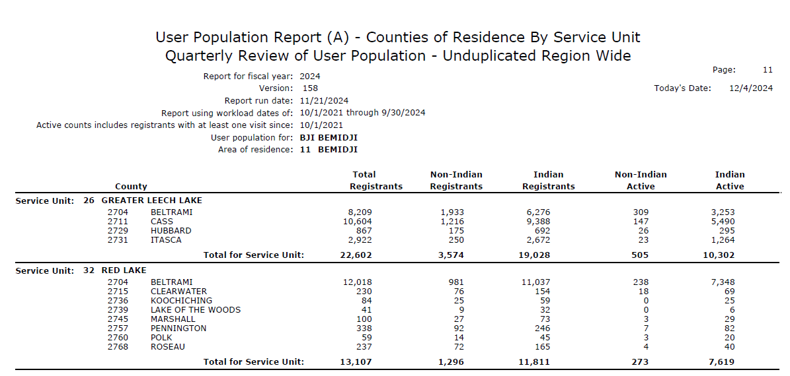
User Population Report

Slide 32
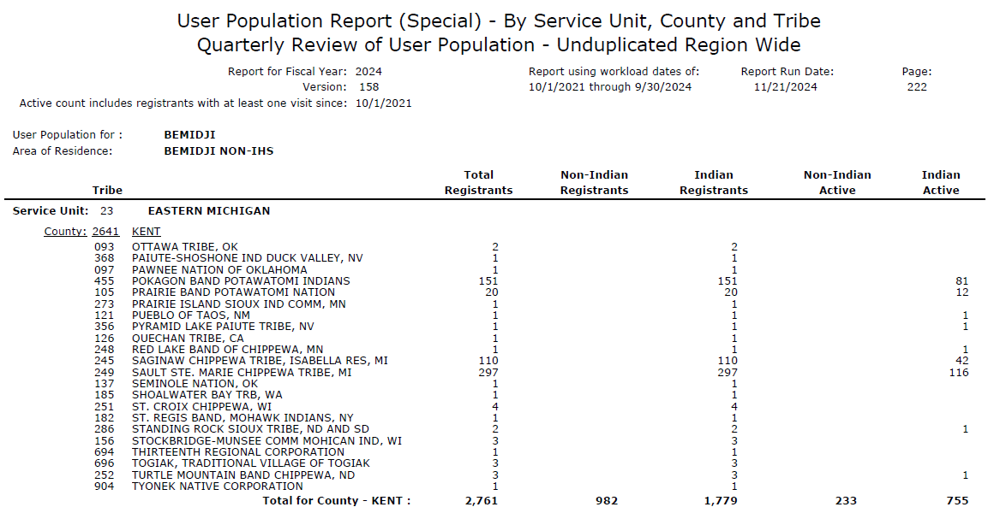

Slide 33
Maximizing User Population - PRCDAs
For many tribes, PRCDA splits have the biggest impact on User Population.
Many of these splits were agreed upon in the early 2000s and may be out of date
  a re-evaluation of encounters may show patterns of usage that justify a change in CHSDA user allocation.
For some tribes, current PRCDA designations may not accurately represent the geographic region in which their patients reside.

Slide 34
PRCDA Redesignation
The Tribe submits a request to the Bemidji Area IHS Director, providing the following information as stated in the IHS Manual (pages 9- 12) Redesignation of CHSDAs:
  The estimated number of Indian people who will be included and/or excluded for eligibility for CHS/PRC;
  Tribal governing body’s designation of the categories of Indian people to be included or excluded from eligibility for CHS/PRC;
  The estimated costs of including additional Indian people in the CHSDA as determined in accordance with the IHS resource allocation guidelines currently in effect;
  The impact of the change in the CHSDA on the level of CHS/PRC being provided to eligible Indian people in the original CHSDA, and,
  The justification for the change in the CHSDA.

Slide 35
PRCDA Redesignation, cont.
The Area Director analyzes the proposal and makes a recommendation of acceptance or rejection
The request and recommendation of acceptance or rejection of the Area Director is submitted to the IHS Director through the Headquarters Chief, CHS Branch, for action;
If recommended, the IHS consults with the Tribe and publishes a notice with requests for comments in the Federal Register;
After a 30-day comment period and review of comments and if recommended, the IHS publishes a final notice in the Federal Register.
The change is effective on the date of the final notice in the Federal Register.

Slide 36
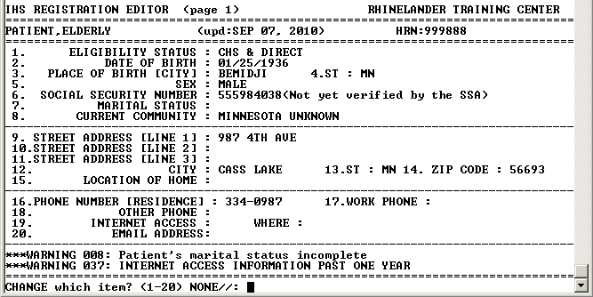
Maximizing User Pop - Community

Slide 37
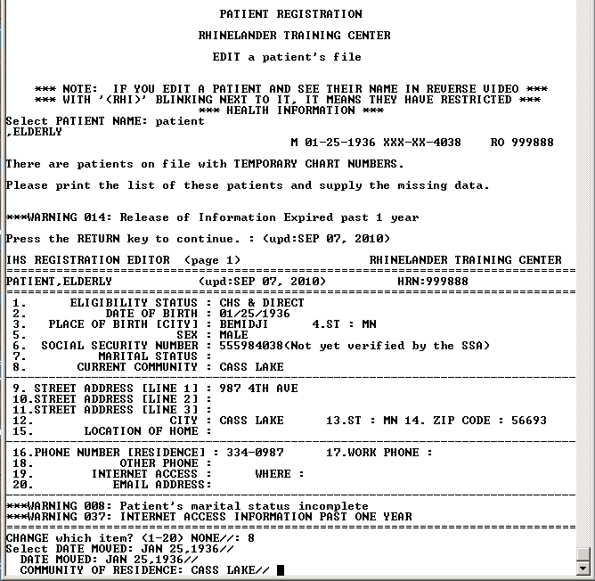
Maximizing User Pop – Community

Slide 38
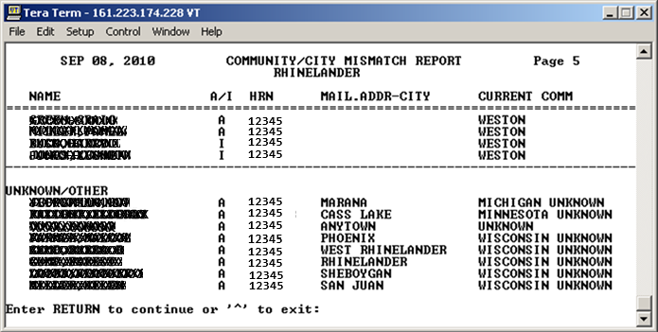
Maximizing User Pop - Community
IHS
REG
PTRG
RPT
BCC (Blank Community Code)

