Slide 1
Office of Clinical Support (OCS) Staff
Jonathan Merrell RN, BSN, MBA Director jonathan.merrell@ihs.gov
Area Statistician- Jason Douglas Jason.douglas@ihs.gov
Diabetes and (Nursing) Consultant- Phil Heuer DNP NP-BC philip.Heuer@ihs.gov
HPDP-CHR Consultant- Lucinda Charleston MPH Lucinda.Charleston@ihs.gov
Patient Safety-Infection Control Consultant- Matthew Ellis MPH, CIC, AL-CIP, CDIPC, REHS matthew.ellis@ihs.gov
Administration Support- Paula Jourdain
Pharmacy Consultant-Jessica Anderson PharmD, MHA, BCACP Jessica.Anderson@ihs.gov
Area Professional Recruiter-Anthony Buckanaga anthony.buckanaga@ihs.gov
Cindy Gunderson PharmD- Revenue Cycle Management Director
Clinical Applications Coordinator- Massa Kofa Ph.D., MHIHIM massa.kofa@ihs.gov
Interoperability Coordinator Karla Svingen CPHIMS karla.svingen@ihs.gov
Health Information Management Consultant – Vacant
  Cindy Gunderson Acting HIM cynthia.gunderson@ihs.gov
Area Pharmacy Clinical Applications Consultant LaDonna Lock BCACP, TTS ladonna.lock@ihs.gov
Area Behavioral Health Consultant Heidi Voss Heidi.voss@ihs.gov Bio Slide 2
Tele-Behavioral Health Provider- Janet Erickson PMHNP-BC

Slide 2
Bio CDR Heidi Voss
CDR Heidi Voss is joining IHS as the Bemidji Area Behavioral Health Consultant. CDR Voss has over 8 years’ experience as a board certified psychiatric mental health nurse practitioner and over 20 years as a registered nurse.
As a USPHS Officer, CDR Voss has an extensive background in hospital administration which includes 10 years with the Bureau of Prisons as a Health Services Administrator. She led them through 6 years of superior program reviews.
Once board certified as a psychiatric nurse practitioner, CDR Voss was selected as one of the first USPHS Officers to commission with the Veterans Administration, working as an in-person mental health provider for a rural community outreach clinic in Minnesota. With her strong connection to the BOP, she then returned to assist as a national tele-psychiatric mental health provider coordinating tele-health services as well as providing daily tele-mental health care for those incarcerated.
The combination of administrative skills, strong medical and mental health background supported her selection of Field Medical Coordinator for the Department of Homeland Security supporting both medical and mental health needs for immigration. Her oversight included a population of over 1000 detainees and 23 facilities in Minnesota, Wisconsin, North Dakota and South Dakota. She completed compliance site inspections, case reviews and approvals for medical and mental health requests. CDR Voss also supported critical needs for the agency deploying as a PMHNP to provide direct mental health services in high need facilities.
In her free time, CDR Voss serves as a volunteer clinical director for the Minnesota Special Olympics mental health program and will be the lead clinical director for the USA Games being held in Minnesota this June!

Slide 3


“Quality”
Improvement, Planning and Execution Overview
May 2026 Bemidji Area Pre-Negotiations

Slide 4
Quality Defined
According to the American Society for Quality (ASQ), “quality is defined as the totality of features and characteristics of a product or service that bear on its ability to satisfy stated or implied needs. It is also defined technically as a product or service free of deficiencies.”

Slide 5
“Quality” per Associates in Process Improvement
“We improve quality as we improve the match between products and services and the need they are designed to satisfy. The degree of matching is determined by the customer’s definition of quality. Customer research can aid understanding of how customers define it and how this definition differs among customer groups. Two completely different products can be considered high-quality as contrasting dimensions of quality are considered important for the two products. To compete on quality, an organization must determine what dimensions are important to the group of customers (segment of the market) on which the organization is focusing.”

Slide 6
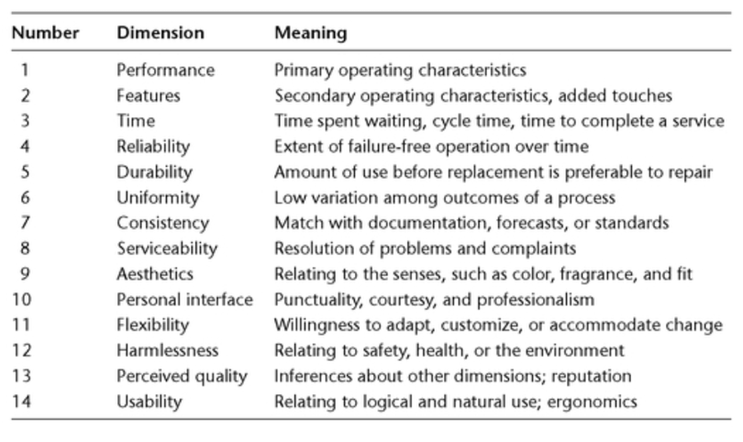
14 Dimensions of Quality
©The Improvement Guide, Second Edition (API)

Slide 7
“Improvement” Definitions
What is meant by the term improvement? Improvement has meaning only in terms of observation based on given criteria. In other words, improvement is a useful concept when it is defined by characteristics such as faster, easier, more efficient, more effective, less expensive, safer, cleaner, and so on. Sometimes it is enough to observe the impact of a change on these characteristics, but usually it is best to document the impact (collect data). Because the concepts of improvement and change are tied together so strongly, it is more useful to define them together. Fundamental changes that result in improvement: • Alter how work or activity is done or the makeup of a product • Produce visible, positive differences in results relative to historical norms • Have a lasting impact”
Langley, Gerald J.. The Improvement Guide: A Practical Approach to Enhancing Organizational Performance (Kindle Locations 591-595). Wiley Publishing. Kindle Edition.
Notes:
Transition from Improvement to leading QI and the need for leaders who can bring about positive change

Slide 8
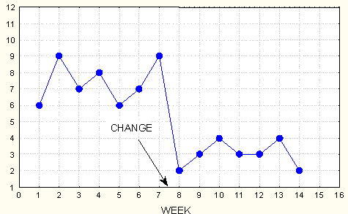
Operational Definition of Improvement
Alter how the work is done…Improvement is the result of some design or redesign of the system.
1
Cycle Time
Measures:
Outcome
Process
Balancing
Produce visible, positive differences in results relative to historical norms
2
before
after
3
and lasting impact
©The Improvement Guide, Second Edition (API) p.112-114

Slide 9
Three Categories of Improvement
Problems or Issues (From Internal or External Customers)
Reducing Cost while Maintaining or Increasing Quality
Creating Something New which Exceeds Customer Expectations (Perceived by the Customer as an Innovation)
Langley, Gerald J. (2009) The Improvement Guide: A Practical Approach to Enhancing Organizational Performance (2nd ed). Wiley Publishing. Kindle Edition.

Slide 10
Intended “Chain Reaction” from Quality Improvement
Understand the need
Define Quality (relative to the need)
  Improve Quality
  Improve the System
  Design a new product or service
  Redesign an existing product or service
  Design a new process
  Redesign an existing process
  One or more will happen:
  Decrease fixed costs
  Decrease variable costs
  Increase productivity
  Increase value
Joy in work
Decrease Costs
Increased Customer Loyalty

Slide 11
Five Activities for Leaders
The leadership team works together to establish and refine their leadership system working these five Activities for Leaders:
Establish organizational purpose
    Establish and create alignment around the organization’s purpose
View the Organization as a System
    Develop a Linkages of Process Map and a family of measurements that is used to drive improvements and manage the day to day business.
Establish a system to obtain Information
    Establish a system to obtain information relevant to the need the organization is fulfilling from customers, competitors, the market and internal to the organization.
Plan for Improvement
    Define strategic objectives and deploy structured business plans, charter priority improvement projects, allocate resources, integrate into Business Plan, Performance Plans and Reviews
Manage Improvement
    Manage individual and team improvement efforts – governance model, training, mentoring, recognition, etc.
Quality as an Organizational Strategy 2025 Norman, Lloyd, Williams

Slide 12
Framework Example
Vision
How can we better meet our purpose?
Planning
Strategic Objectives
Improvement Efforts
Resources
Purpose
Mission
Beliefs
Is there a need to change the purpose?
System for obtaining information
(customer focus)
Analysis of information
for improvement
Mainstay processes
Plans to run the system
Reacting to feedback
Establish Improvement Efforts
Measures of the system
Family of Measures
MFI
Managing Improvement Efforts
Business Perspective
Customer Perspective
Status of Improvement efforts
Operations Perspective
Employee Perspective
Feedback for improvement
Act
Plan
Study
Do
Products, services and tools
------------------------------------
Design and redesign of
Processes and products
Organization viewed as a system

Slide 13
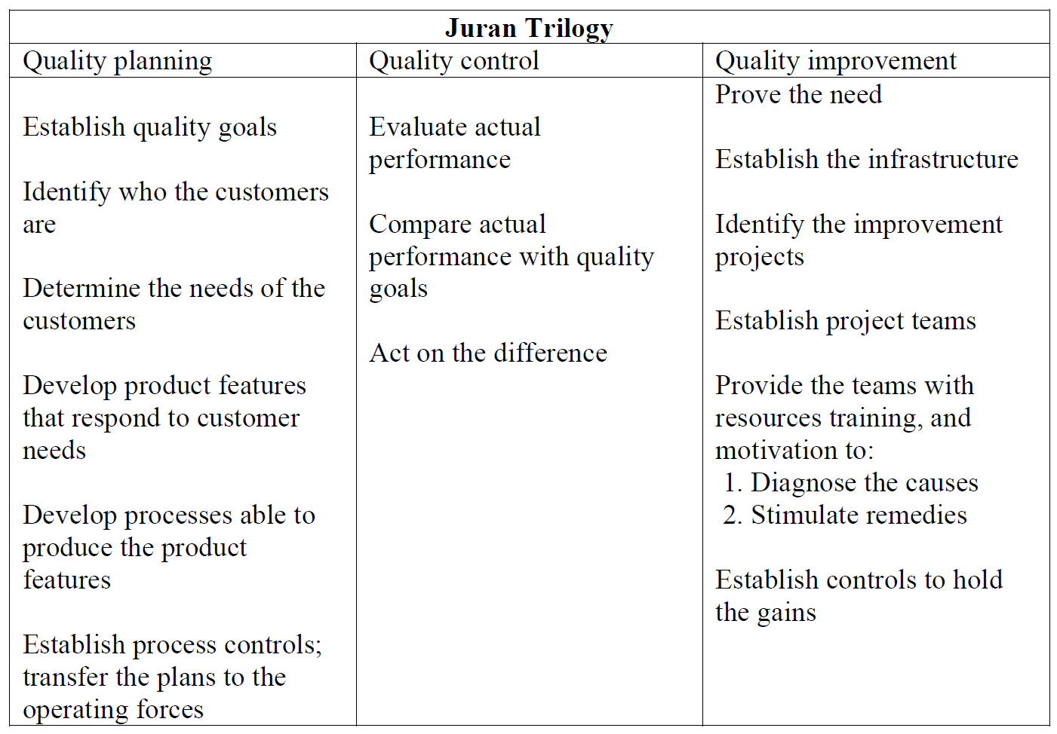
Quality

Slide 14
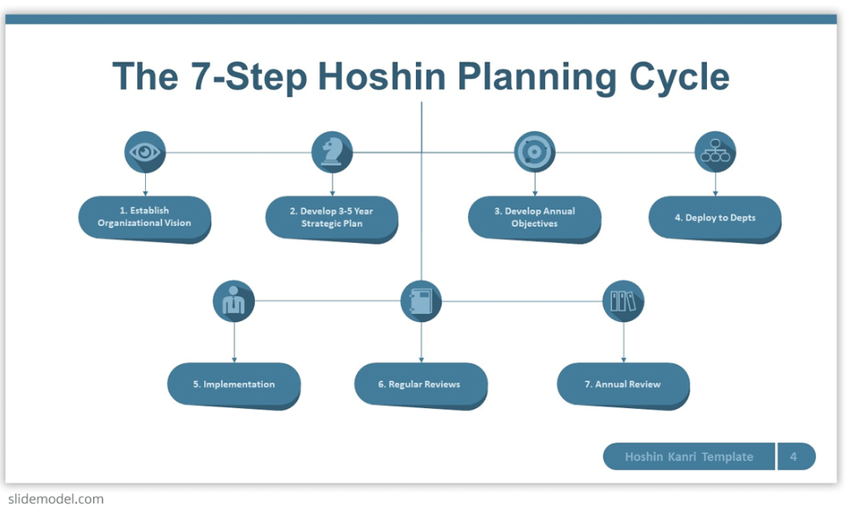
Quality and Operational Planning Example

Slide 15
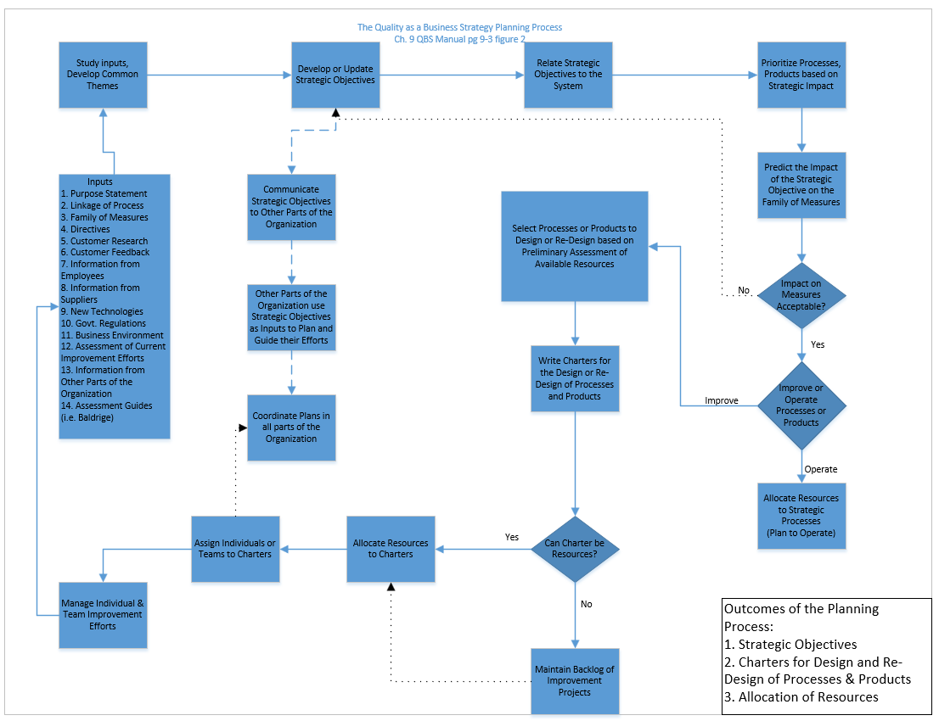

Slide 16
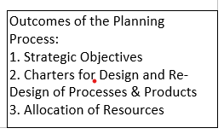
Outcomes of Quality Planning

Slide 17
How Do You Approach Getting Improvements in Place ?
1.
2.
3.
4.
5.
6.
7.

Slide 18
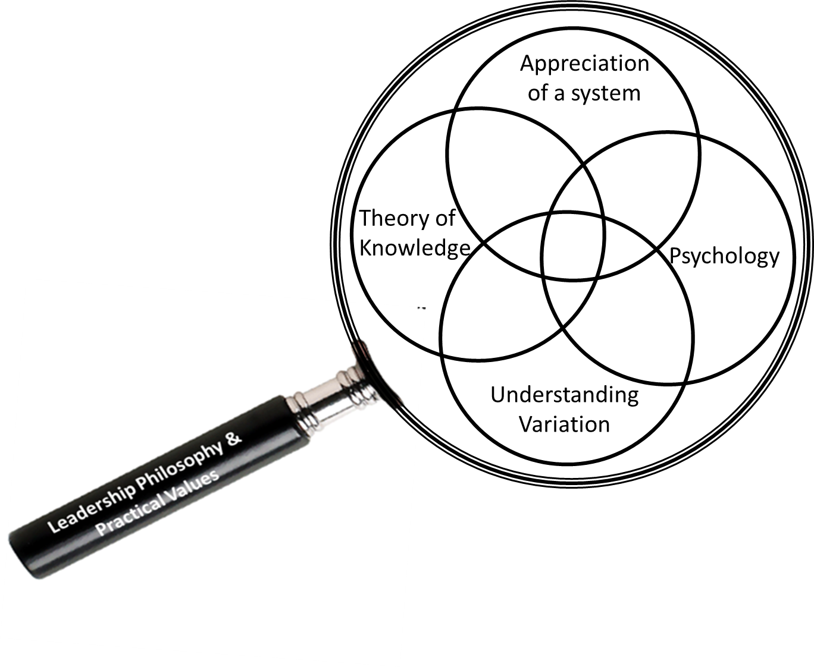
Profound Knowledge W. Edwards Deming
Systems Thinking
Understanding Variation
Psychology
Theory of Knowledge
Transforming Healthcare Leadership – A Systems Guide to Improve Care, Reduce Costs
& Improve Population Health, Maccoby, Norman, Norman, Margolies (2013); Ch. 5
Transforming Healthcare Leadership – A Systems Guide to Improve Care, Reduce Costs
& Improve Population Health, Maccoby, Norman, Norman, Margolies (2013); Ch. 5 p. 69
Notes:
Mental Models, Leadership Models, Business Modeling

Slide 19
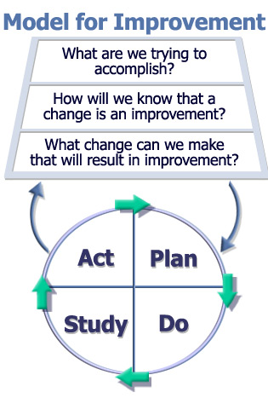
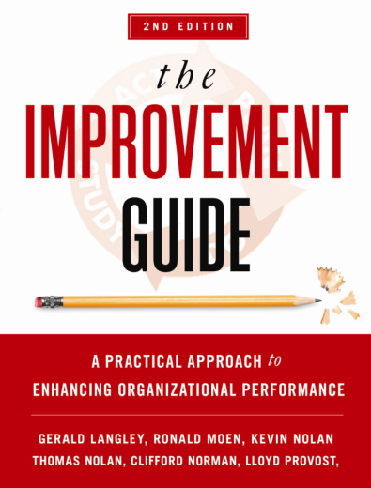

The Model for Improvement
IG p. 24
Notes:
This model allows for tremendous flexibility. It doesn’t prescribe particular tools at particular steps…may include many or few tools based totally on needs of project….

Slide 20
Fundamental Questions for Improvement
What are we trying to accomplish?
How will we know that a change is an improvement?
What changes can we make that will result in an improvement?
Improvement Guide, Chapter 1, p 24
Notes:
2
17
-Each member of API researched 5 successful and 5 unsuccessful teams (n=60 teams): All who could answer these 3 questions did get improvement, all who could not did not have improvement
When I’ve been asked to help stalled teams I ask them first question---often they haven’t got this questions answered. Divergence.
Question2: All improvement takes change, but not all changes are an improvement. Lloyd calls this feedback step more than measurement step, sometimes numerical data sometimes not
If we haven’t made a change we haven’t got a shot at improvement yet!
Unsuccessful teams can’t rattle off the changes they made!
1. Aim question
2. Feedback question
3. Ideas question

Slide 21
Reactive vs. Fundamental Changes
Reactive Changes
  Solve problems or react
  Return the system to prior condition
  Tradeoff among measures
  Short term impact
Fundamental Changes
  Design or redesign of some aspect of the system
  Necessary for improvement beyond problems
  Fundamentally alters the system
  Impacts several measures
  Long term impact
Improvement Guide, p.112 -114

Slide 22
Why this Model for Improvement?
Is useful for both process and product improvement.
Is applicable to all types of organizations.
Is applicable to all groups and levels in an organization.
Facilitates the use of teamwork to make improvements.
Provides a framework for the application of statistical tools and methods.
Encourages planning to be based on theory.
Emphasizes and encourages the iterative learning process.
Provides a way to empower people in the organization to take action.
Improvement Guide, Appendix C, p. 455
Notes:
Team work..this model has ultimate respect for subject matter experts. Not the “IA from on high” that tells team the “solution”….and advising implementation. Rather need team involved in developing ideas, testing, adapting…

Slide 23
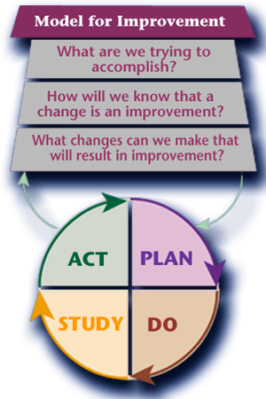
Model for Improvement
©Profound Knowledge Products, Inc. 2008 All Rights Reserved
Notes:
Measures may be some of the first questions we want to answer, or which can be worked on concurrent with tests on a small scale. At this point, AMI is ready to be given to the team to introduce them to the project. The questions can be developed at the first meeting.

Slide 24
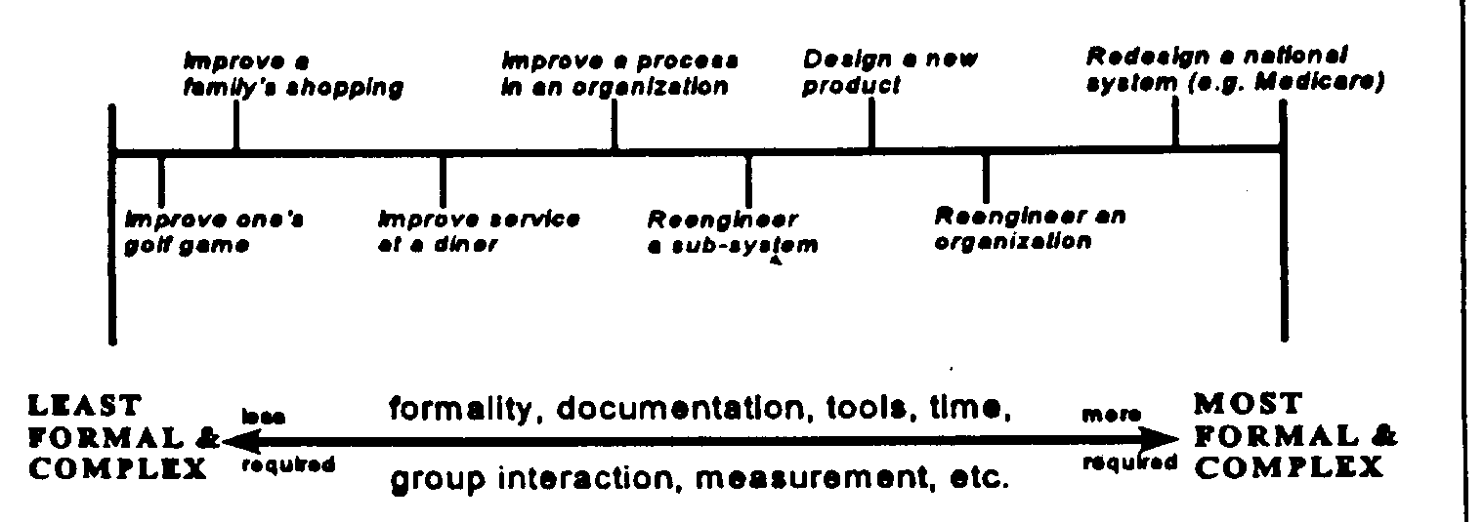
Scale of Documentation Discipline for Improvement Efforts
Tame Wicked Most Wicked

Slide 25
Why Improvement Fails:
The Good, The Bad & The Ugly
Notes:
Play G-B-Ugly Music

Slide 26
Why Improvement Fails
2010 Study
The Bad
The Ugly
Creating Structure to Turn the Good, Bad & Ugly into Great!
Notes:
After 35 years of improving and facilitating improvement…in multiple industries (mfg, distr, computer, healthcare, food) worldwide, I’ve made a LOT of mistakes… (but like Edison) but have also learned a LOT! Apologize…Opinionated… Energetic… maybe even Intense…
Share what I have learned and strategies to turn…..

Slide 27
Why Improvement Fails
Vague, Debatable Project Descriptions
Teams Wander Off Course
Measurement Criteria Not Defined Prior to Launch
Unable to Dedicate Sufficient Time to the Project
Barriers Not Addressed by Senior Management
No Standardized Structure
Wrong & Too Many Team Members
Untrained or “In-Training” Leaders and/or Team Members
Poor or No Documentation of Learning
Working with People is an Assumed Skill
NIH (Not Invented Here) Syndrome
Utopian Syndrome
Average of 21 Weeks Wasted*
*Reference:
A. Blanton Godfrey, Blitz Teams
Notes:
About 2010 ---- formally ran the Juran Institute & now works with the Institute for Healthcare Improvement (IHI)
De ja vue
Cat teams… 150
Talk later about what I learned on team makeup

Slide 28
…….and the Ugly!
World Hunger Charters
Wrong charters selected
Too many and/or wrong people on the team
The Caped Crusader Syndrome (No Team Needed)
Implementing Without Testing
    Best Practices Syndrome
    Malicious Obedience
Takes YEARS to get results!!!
Changes not sustainable
Notes:
1- a herd of elephants
2- indivi chooses charter… not aligned with strat obj… changed or dropped with mobility of mgmt. (new boss)
3. Social loafing … real knowledge is not in the room
4- born about 1986… Juran Impro Motorola…Marketed GE Jack Welch as Black Belt early 90’s
Lack of Rec of the team… people who helped – can’t improve without others…
5. We have all the answers…. ALL changes are improvements!.... We HOPE!
6. In the old days… improvement is all about tenacity… turnover, no documentation… reinventing the wheel.. Changing projects… People get tired… worn out… ready to move on!

Slide 29
The Good: Characteristics
Well Defined Charter
Subject Matter Experts on the team
Support by Management
Testing before Implementing
Time Allocated for the Team
Good Support Structure for Learning
Notes:
A good team knows what they are to accomplish, how they will know if the changes they make are improvements… and hopefully they have some ideas they want to try to make things better.

Slide 30
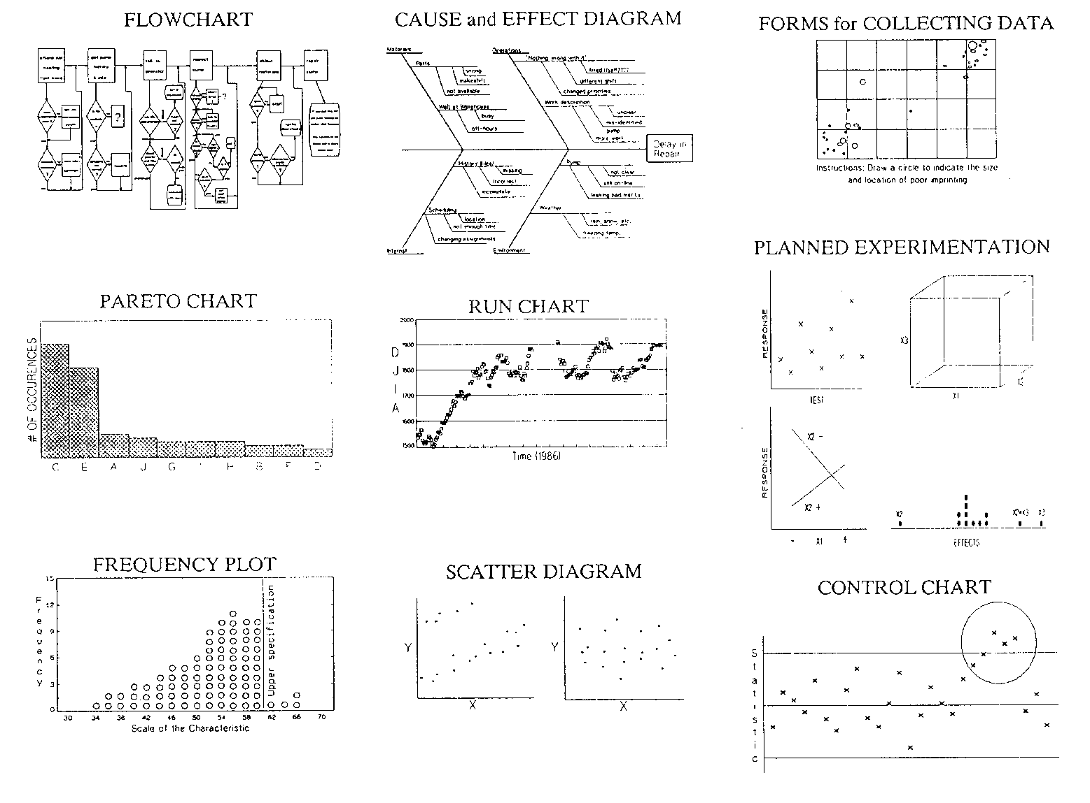
Basic Tools for Improving Processes
©Profound Knowledge Products, Inc. 2008 All Rights Reserved

Slide 31
Discussion/Questions?

