Slide 1
CHAP Webpage Overview
Updated: 03/26/2026

Slide 2

Notes:
1. Main Landing Page – CHAP Overview
Highlights CHAP as a national, multidisciplinary workforce model designed to expand access to care in Tribal communities
Emphasizes team-based, community-driven care that extends the reach of licensed providers
Reflects the program’s evolution from Tribal consultation to national implementation and governance
Reinforces the overarching focus on improving health outcomes through culturally responsive care

Slide 3
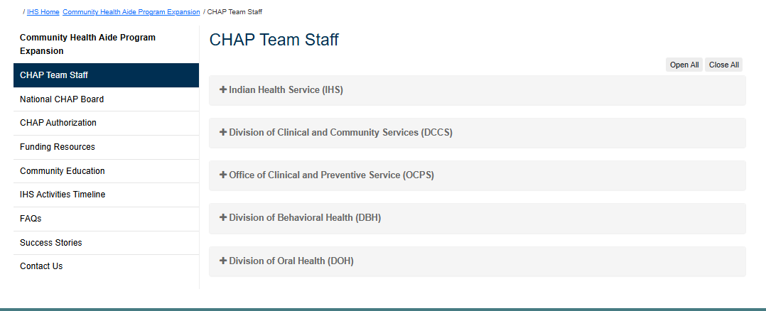
Notes:
2. CHAP Team Staff
Highlights the federal leadership and staff responsible for national coordination and implementation
Emphasizes the availability of technical assistance, program support, and policy guidance
Reinforces the role of the team in aligning national priorities with Tribal and Area-level needs

Slide 4
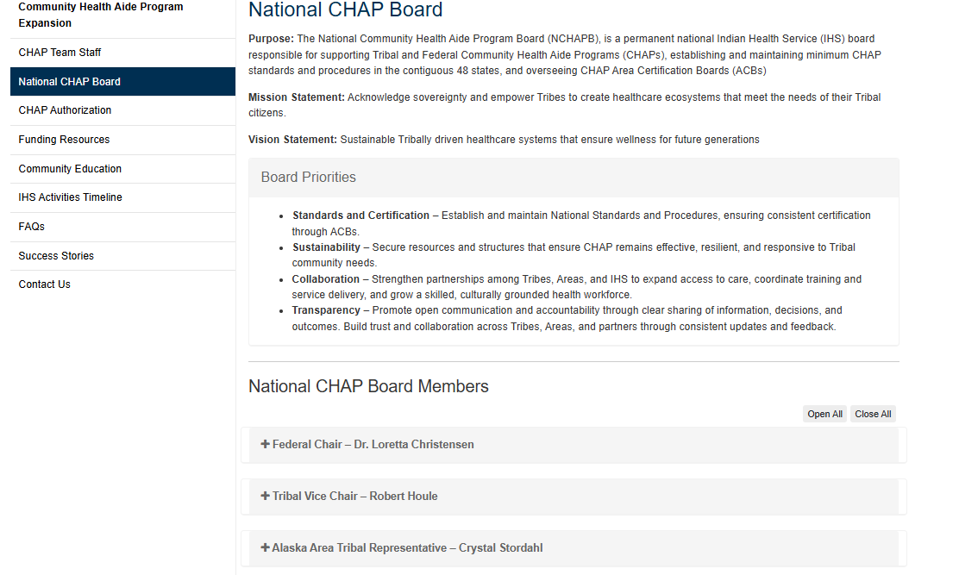
Notes:
3. National CHAP Board
Highlights the governance structure responsible for national oversight and strategic direction
Emphasizes standardization, accountability, and decision-making authority
Reflects the transition to a more formalized system that supports consistent yet flexible implementation

Slide 5
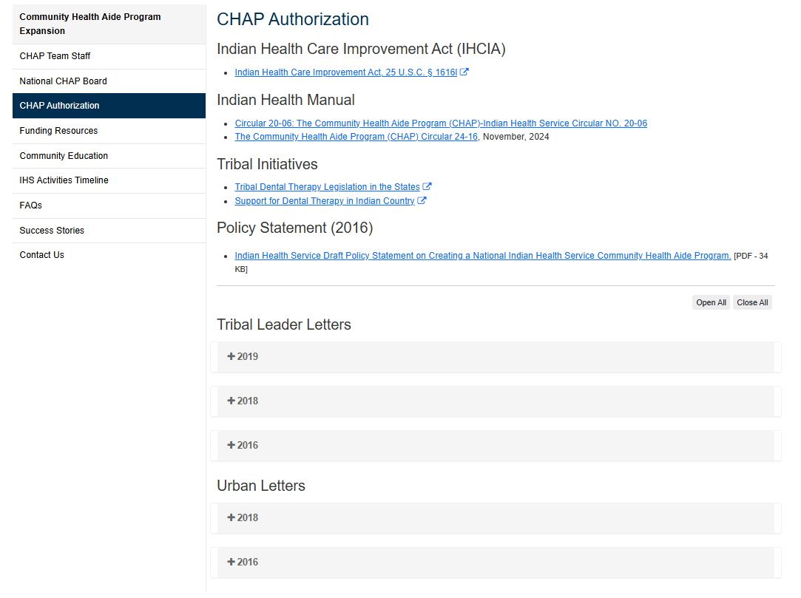
Notes:
4. CHAP Authorization
Highlights the legal and policy foundation of CHAP under the Indian Health Care Improvement Act
Emphasizes the role of IHS Circulars in defining program structure, certification, and governance
Reinforces CHAP as a federally authorized and nationally scalable program

Slide 6
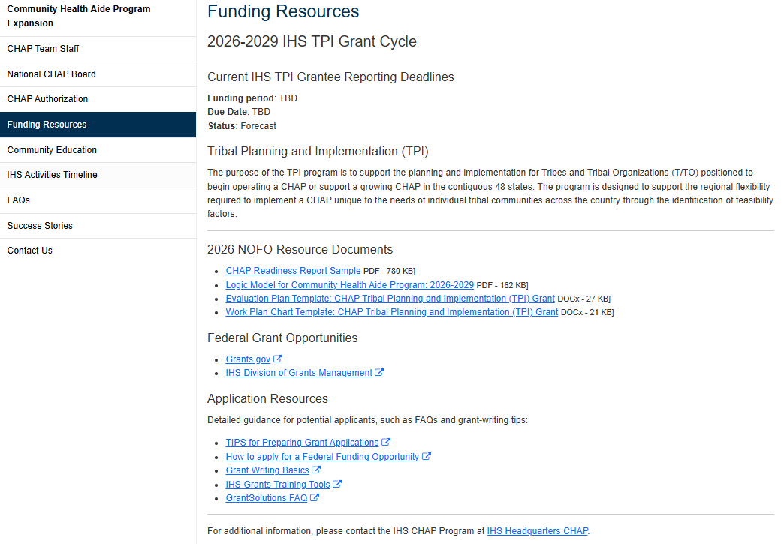
Notes:
5. Funding Resources
Highlights available funding opportunities and financial pathways to support CHAP
Emphasizes support for planning, workforce development, and program sustainability
Reinforces the ability for Tribes to build and scale programs based on community needs

Slide 7
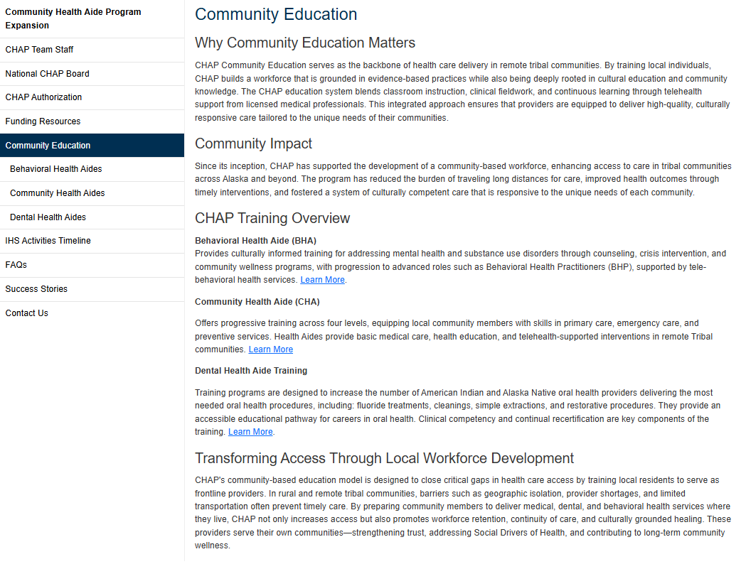
Notes:
6. Community Education
Highlights the three core CHAP disciplines and their roles within the care model
Emphasizes training pathways, scope of practice, and certification expectations
Reinforces the delivery of culturally appropriate, community-based care

Slide 8
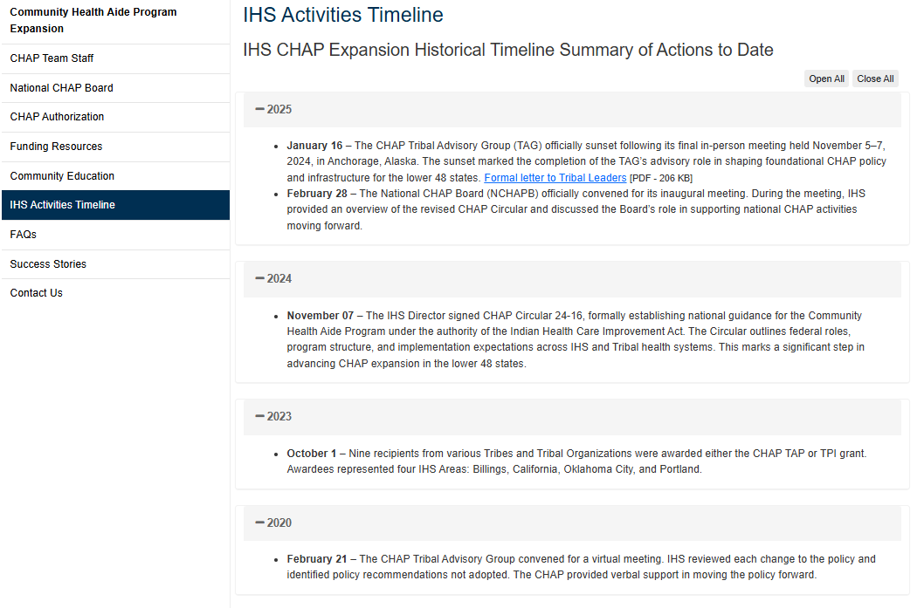
Notes:
7. IHS Activities Timeline
Highlights the historical evolution and key milestones of CHAP
Emphasizes the transition from a regional Alaska program to national expansion
Reinforces the intentional and phased approach to program growth and policy development

Slide 9
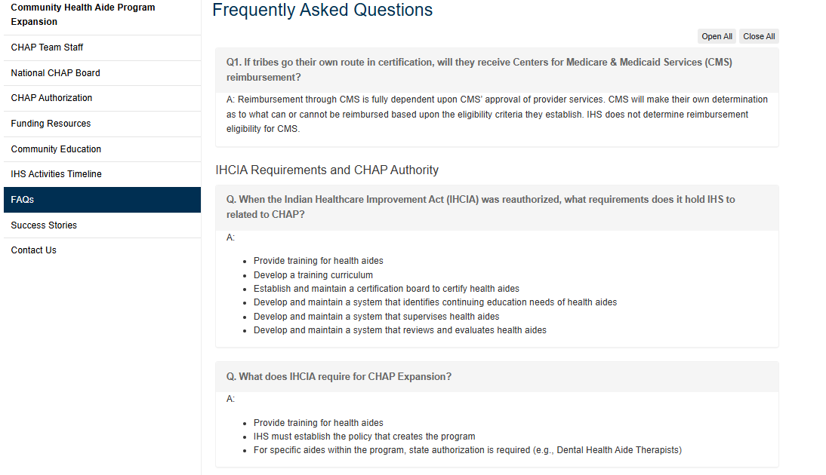
Notes:
8. FAQs
Highlights key information and clarifications for stakeholders and partners
Emphasizes consistency in program understanding, requirements, and implementation pathways
Reinforces transparency and accessibility of information

Slide 10
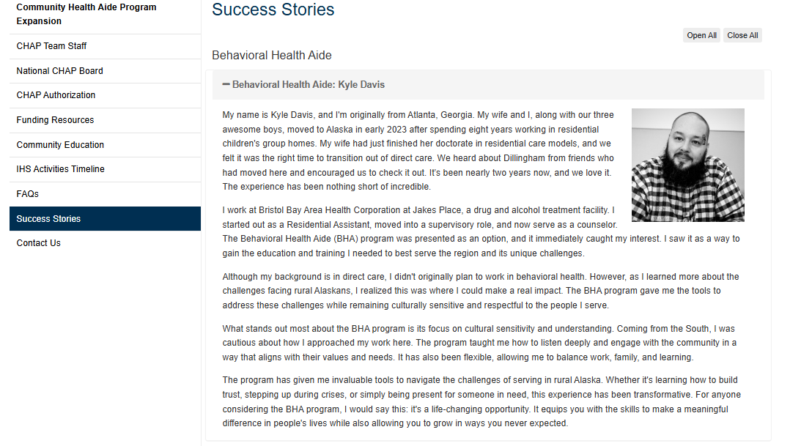
Notes:
9. Success Stories
Highlights real-world examples of CHAP implementation and impact
Emphasizes improvements in access to care, workforce development, and community outcomes
Reinforces CHAP’s value and effectiveness at the local level

Slide 11
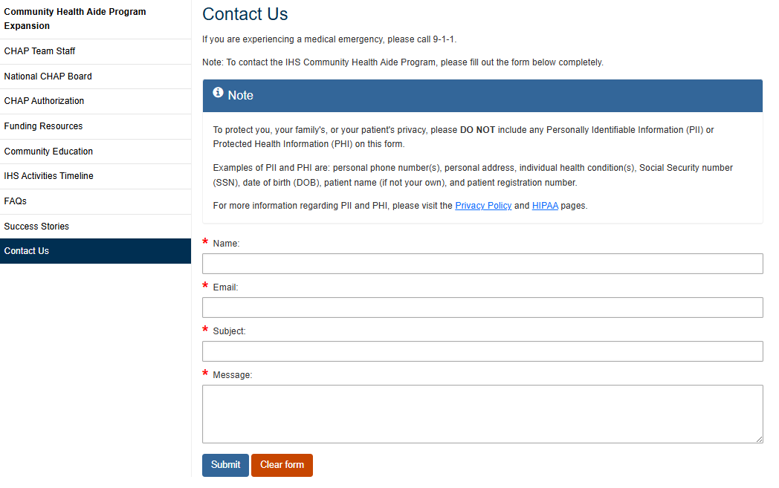
Notes:
10. Contact Us
Highlights a centralized point for communication and support
Emphasizes access to technical assistance, program inquiries, and stakeholder engagement
Reinforces ongoing collaboration and responsiveness

