Slide 1
Community Health Aide Program

Slide 2
CHAP Overview
PACCB is authorized to certify PDHA I, DHATs, and BHAs I-III
11 Tribal representatives have been appointed to the NCHAPB
IHS CHAP SMEs, in collaboration with field SMEs, are reviewing S&Ps for national implementation
NCHAPB members are finalizing board Bylaws, Policies, & Procedures
IHS CHAP Team continues providing TA to T/TOs implementing CHAP in the lower 48 states
Oct. 1
2nd year funding awarded to CHAP grantees (8 total)
Nov. 7
CHAP Circular 24-16 published
Nov. 28
Portland Area CHAP Certification Board established
Feb. 28
Appointed NCHAPB members convened for inaugural meeting
May 28
Alaska CHAP Board shared Alaska S&Ps to support national infrastructure
June 12
HQ CHAP Team completed CHAP grantee site visits
June 13
6 Tribal members graduated from the Inaugural Washington Dental Therapy Program
Oct. 22
NCHAPB adopted Alaska S&Ps as template for National S&Ps
Oct. 31
IHS published the updated CHAP website
Dec. 10
NCHAPB met virtually to discuss end of year deliverables
April 2
NCHAPB convened to review 2026 activities
2024
2025
2026

Slide 3
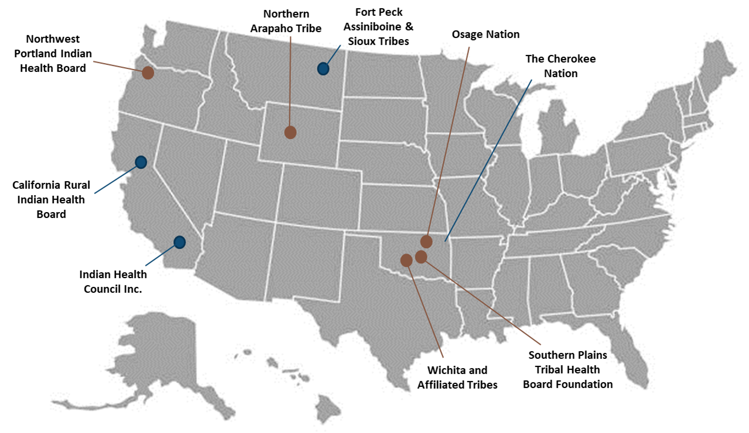
CHAP Grantees
Tribal Assessment and Planning (TAP) Grantees
Tribal Planning and Implementation (TPI) Grantees
  NWPAIHB “graduated” to ACB phase

Slide 4
National CHAP Board Members
Alaska Area
Albuquerque Area
Bemidji Area
Representative: Crystal Stordahl
Title: CHAP-CHC Director
Title: Laguna Community Health & Wellness Program Director
Representative: Ramona Dillard
Representative: Robert Houle
Title: Tribal Health Director Bad River Health & Wellness Center
Billings Area
Representative: Dennis Four Bear
Title: Tribal Health Director, Fort Peck Tribes
California Area
Representative: Angelina Renteria
Title: Chief Operating Officer
L
.
.
Great Plains Area
Nashville Area
Navajo Area
Representative: Lisa Schrader
Title: Tribal Health Director
Title: Mashpee Wampanoag Tribal Secretary/Health Advisor
Representative: Cassie Jackson
Representative: Buu Nygren
Title: Navajo Nation President
Oklahoma City Area
Representative: Tasha Mousseau
Title: Vice President, Wichita & Affiliated Tribes
Phoenix Area
Representative: Brook Bender
Title: Director, Hualapai Senior Services
.
.
Portland Area
Representative: Brenda Meade
Title: Chairwomen

Slide 5
CHAP Disciplines
The Community Health Aide Program (CHAP) is a multidisciplinary system of mid-level behavioral, community, and dental health professionals working alongside licensed providers to offer patients increased access to quality care in Tribal communities.
Behavioral Health Aide
Behavioral Health Aide I
Behavioral Health Aide III
Community Health Aide
Community Health Aide I
Community Health Aide II
Dental Health Aide
Primary Dental Health Aide I and II
Behavioral Health Aide II
Behavioral Health Aide Practitioner
Expanded Function Dental Health Aide I and II
Dental Health Aide Hygienist
Dental Health Aide Therapist
Community Health Aide III
Community Health Aide IV
Community Health Aide Practitioner

Slide 6
Community Health Aide Types
CHA I
Training: Completes Session I (4wks) followed by 20 pt. encounters. Includes required emergency care training (minimum: EMR/ETT or ACB-approved equivalent)
Focus: Foundational clinical skills, basic assessment, and preventive care.
CHA II
Training: Completes Session II (4wks) followed by 200 hrs of fieldwork and 60 PT encounters.
CHA III
Training: Completes Session III (3wks) followed by 200 hrs of fieldwork and 60 PT encounters.
CHA IV
Training: Completes Session IV (4wks) followed by 200 hrs of fieldwork and 60 PT encounters.
CHA/P
Clinical Responsibility: Provides basic PT care under direct supervision.
Skills Learned: Basic patient assessment, vital signs, patient intake, infection control, specimen collection, wound care, documentation, and introduction to emergency stabilization.
Supervision: Higher-level CHAs, RNs, or physician.
Training: CHA IVs must complete a one-week preceptorship with 15 PTs encounters as the primary provider.
Clinical Responsibility: Functions as a primary healthcare provider in remote settings, delivering diagnostic, treatment, and prescribing services within their scope.
Skills Learned: Advanced patient assessment, clinical decision-making, diagnosis and treatment planning within defined scope, medication management, emergency stabilization, and management of acute and chronic conditions across the lifespan.
Focus: Expanded assessment, chronic condition support, and acute care skills.
Clinical Responsibility: Conducts focused assessments, supporting management of acute and chronic conditions, assisting with diagnostic and treatment activities,.
Skills Learned: Focused assessment, health screenings, chronic disease monitoring, basic diagnostic support, medication assistance within defined scope, and participation in emergency response.
Supervision: Limited supervision with access to consultation as needed.
Focus: Maternal and child health, preventive services, and emergency response.
Clinical Responsibility: Proficiency in advanced patient assessments, laboratory testing, and acute care interventions.
Skills Learned: Advanced assessment, laboratory testing, care planning, maternal and child health support, STI and preventive services, emergency stabilization, and behavioral health awareness.
Supervision: Consultative supervision; increasing autonomy within established protocols.
Focus: Chronic disease management, care coordination, prevention, and community-based care.
Clinical Responsibility: Provides comprehensive patient care within defined scope and supports care coordination.
Skills Learned: Comprehensive assessment, chronic disease management, care coordination, prevention planning, patient education, emergency response, and support in clinical decision-making..
Supervision: Minimal supervision with consultative support as needed...
Supervision: Works independently, but maintains consultative relationship with higher-level providers.

Slide 7
Behavioral Health Aide Types
BHA I
Training: Must complete the required training track for BHA I; work experience; practicum requirements; and complete the knowledge and skills competency checklist.
Clinical Responsibility:
• Wellness Promotion/Prevention
BHA II
Training: Must complete the required training track for BHA II; work experience; practicum requirements; and complete the knowledge and skills competency checklist.
BHA III
Training: Must complete the required training track for BHA III; work experience; practicum requirements; and complete the knowledge and skills competency checklist.
BHP
Training: Must complete the required training track for BHAP, work experience, practicum requirements, and complete the knowledge and skills competency checklist.
Supervision: Licensed behavioral health provider.
Clinical Responsibility:
• SUD Assessment/ Diagnosis/ Treatment Planning/Implementation
Supervision: Licensed behavioral health provider.
Clinical Responsibility:
• Treatment Planning and Implementation of co-occurring disorders
Supervision: Licensed behavioral health provider.
Clinical Responsibility:
• BHA Mentoring
Supervision: Licensed behavioral health provider. .
• Education/Advocacy on BH topics
• Community Needs Assessments
• Early intervention/ Screening/Intake/Referral
• Crisis Management
• Case Management
• Life Skill and Resource Development and Coaching
• Medication Management
• Psychoeducation
• Individual & Group Interventions
• Community Readiness Assessment
• Individual, Group, and Family Counseling
• All Areas of practice in level I
• Child and Youth Services
• Clinical Case Reviews
• Quality Assurance Case Review
• All Areas of practice in level I and II
• Child-Centered Interventions
• All areas of practice in Level I, II,III

Slide 8
Review of Dental Health Aides
Primary Dental Heath Aides (PDHA)
Expanded Function Health Aides
Dental Health Aide Hygienist
Dental Health Aide Therapist

Slide 9
PDHAs
PDHA I
PDHA II
BLS certification and DHA Core Curriculum Course
Trained to provide oral health instruction, diet education and topical fluoride application
Requires the completion of a preceptorship and standing orders
BLS certification, DHA Core Curriculum Course, and Advanced Dental Procedures
At least one of the following courses: Dental Radiology, Dental Prophylaxis, Atraumatic Restorative Treatment (ART), or Sealants (4 separate courses, each with a preceptorship)
PDHA II’s can work under indirect or general supervision after taking the Village Based Dental Practice course.
Requires Standing Orders

Slide 10
EFDHAs
EFDHA I
EFDHA II
Trained to provide a dental prophylaxis or basic restorative function (Class I, Class II, Class III and Class V restorations)- each course has preceptorship requirements.
A student can complete one or both courses.
Certified EFDHAs may opt to take courses for sealants, dental radiology, (ART), or stainless steel crown placement on primary teeth - each require a preceptorship.
An EFDHA I can work under indirect or general supervision depending on the skillset specifications after completing the Village Based Dental Practice course.
Requires Standing Orders
BLS certification, DHA Core Curriculum
BLS certification, DHA Core Curriculum, EFDHA I Basic, and Restorative Function courses
Trained to provide advanced restorative functions (complex restorations). Requires a preceptorship.
An EFDHA II can work under indirect or general supervision depending on the skillset specifications after completing the Village Based Dental Practice course.
Requires Standing Orders

Slide 11
DHAH
DHAH
BLS certification and current dental hygiene license in one of the states or territories of the United States
DHA Core Curriculum course
Hygiene license that allows administration of local anesthesia or take a local anesthesia course approved by the board
Requires preceptorship and standing orders

Slide 12
DHAT or Dental Therapist
DHAT
3 academic years of education through a Dental Therapy Educational Program accredited by the Commission on Dental Accreditation (CODA).
Trained to provide diagnosis and treatment planning, cleanings, sealants, fillings and extractions.
Notes:
CODA Accredited DT programs:
Dental Therapy - Ilisagvik College Alaska Dental Therapy Education Program (ADTEP), University of Minnesota School of Dentistry, Pacific University, Skagit Valley College, Northcentral Technical College

Slide 13
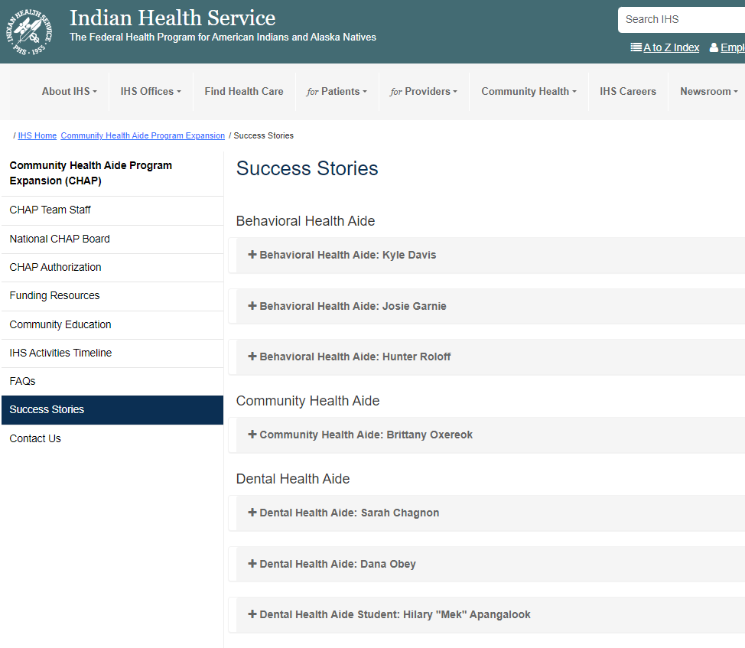
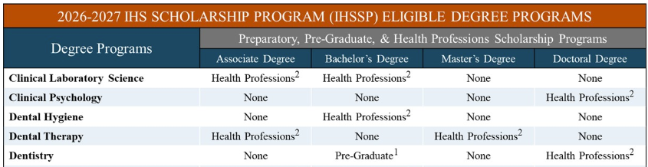
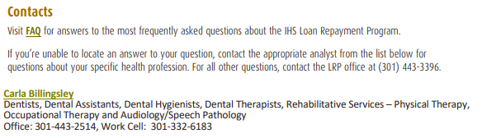
Dental Therapy
www.ihs.gov/CHAP/successstories/
IHS Scholarship and Student Loan Repayment
www.ihs.gov/scholarships

