Slide 1
Health Information Technology Modernization Program Update
Bemidji Area
May 5, 2026

Slide 2

Today’s Presenter
Mitchell Thornbrugh
Chief Information Officer (CIO), Indian Health Service

Slide 3
PATH EHR Build and Configuration

Slide 4
Building PATH EHR
PATH EHR is being built collaboratively by expert users across Indian Country
Enterprise Design Workshops
Future State
Review
Integrated
Testing
Enterprise Baseline
Checkpoint #1
Jan. – Nov. 2025
Nov. 2025
Dec. 2025 – Apr. 2026
Mar. 2026
Reviewed current-state workflows, assessed future-state designs, and made recommendations that reflect the diverse practices and needs across I/T/U sites
Ensure the designed workflows are streamlined, patient-centered, and aligned for implementation
Walked through common scenarios to confirm that the design decisions made during the workshops operate correctly within PATH EHR
Ensure the system meets the necessary security and compliance standards

Slide 5
Enterprise Collaboration Group
The ECG is comprised of expert end-users of PATH EHR, drawn from IHS and participating tribal/urban Indian organizations, to:
Ensure that inputs for PATH EHR configuration and change management are coming from actual users of the solution.
Prioritize patient safety and quality health care by building best practices into PATH EHR workflows, decision support, etc.
Address accreditation requirements to minimize risk of adverse findings.
15 ECG Domain Groups meet regularly during Enterprise Design Workshops to consider recommendations for PATH EHR configuration, based on their expertise.

Slide 6
Enterprise Design Workshop Key Impacts
Over 500 design decisions for PATH EHR configuration have been finalized in Enterprise Future State Design Workshops
VALIDATE DECISIONS
ADVANCE READINESS
BUILD RELATIONSHIPS
SHARE OWNERSHIP
Confirm alignment on key design elements, ensuring the system supports safe, efficient, and patient-centered care
Discuss workflow dependencies, identify opportunities to streamline processes, and avoid potential roadblocks
Foster connections between clinical, operational, and technical teams, which is vital to ensuring adoption and long-term success
Prioritize building collective responsibility, emphasizing every participant plays a role in preparing for the transition to PATH EHR

Slide 7
PATH EHR Solution Set (partial)
Emergency & Acute Care
Core Clinicals (EHR)
Emergency Department
Surgery & Perioperative
L&D Newborn
Critical Care
Rehab Services
Inpatient Behavioral Health
Acute Case Management
Tracking Boards
Ambulatory Care
Core Clinicals (EHR)
Specialty Practice
Public Health Nursing
Outpatient Behavioral Health
Outpatient Rehab
Team-Based Panel Management
Ancillary Services
Inpatient Pharmacy
Outpatient Pharmacy
Lab
Blood Bank
Micro & Anat Path
Radiology
Inventory Management
Population
Health & Quality
Population Health Management
Care Management
Reporting & Analytics
Quality Measures
Revenue Cycle & HIM
Registration
Scheduling
Purchased/ Referred Care
Release of Information
Document Management
Patient Accounting
Contract Management
Revenue Cycle Analytics
Patient
Engagement
Patient Portal
Self-Scheduling
Care Team Comms
Telehealth
Patient Forms
Interoperability & Technology
AI-Facilitated Documentation
Mobile Device Integration
e-Prescribing, EPCS, PDMP
Immunization Information Exchange
Health Information Exchange
Public Health Reporting

Slide 8
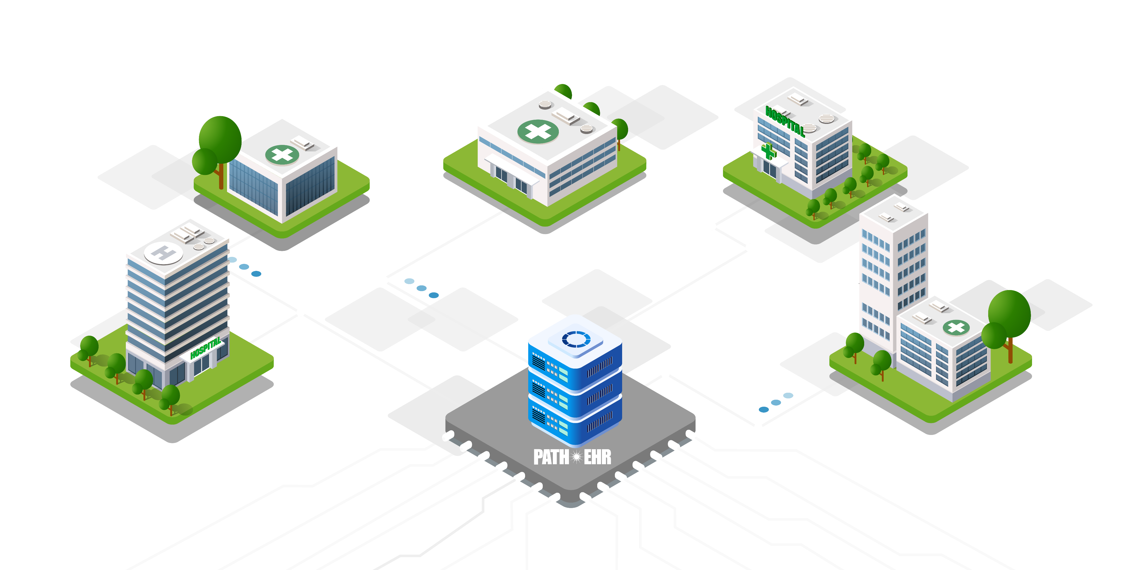
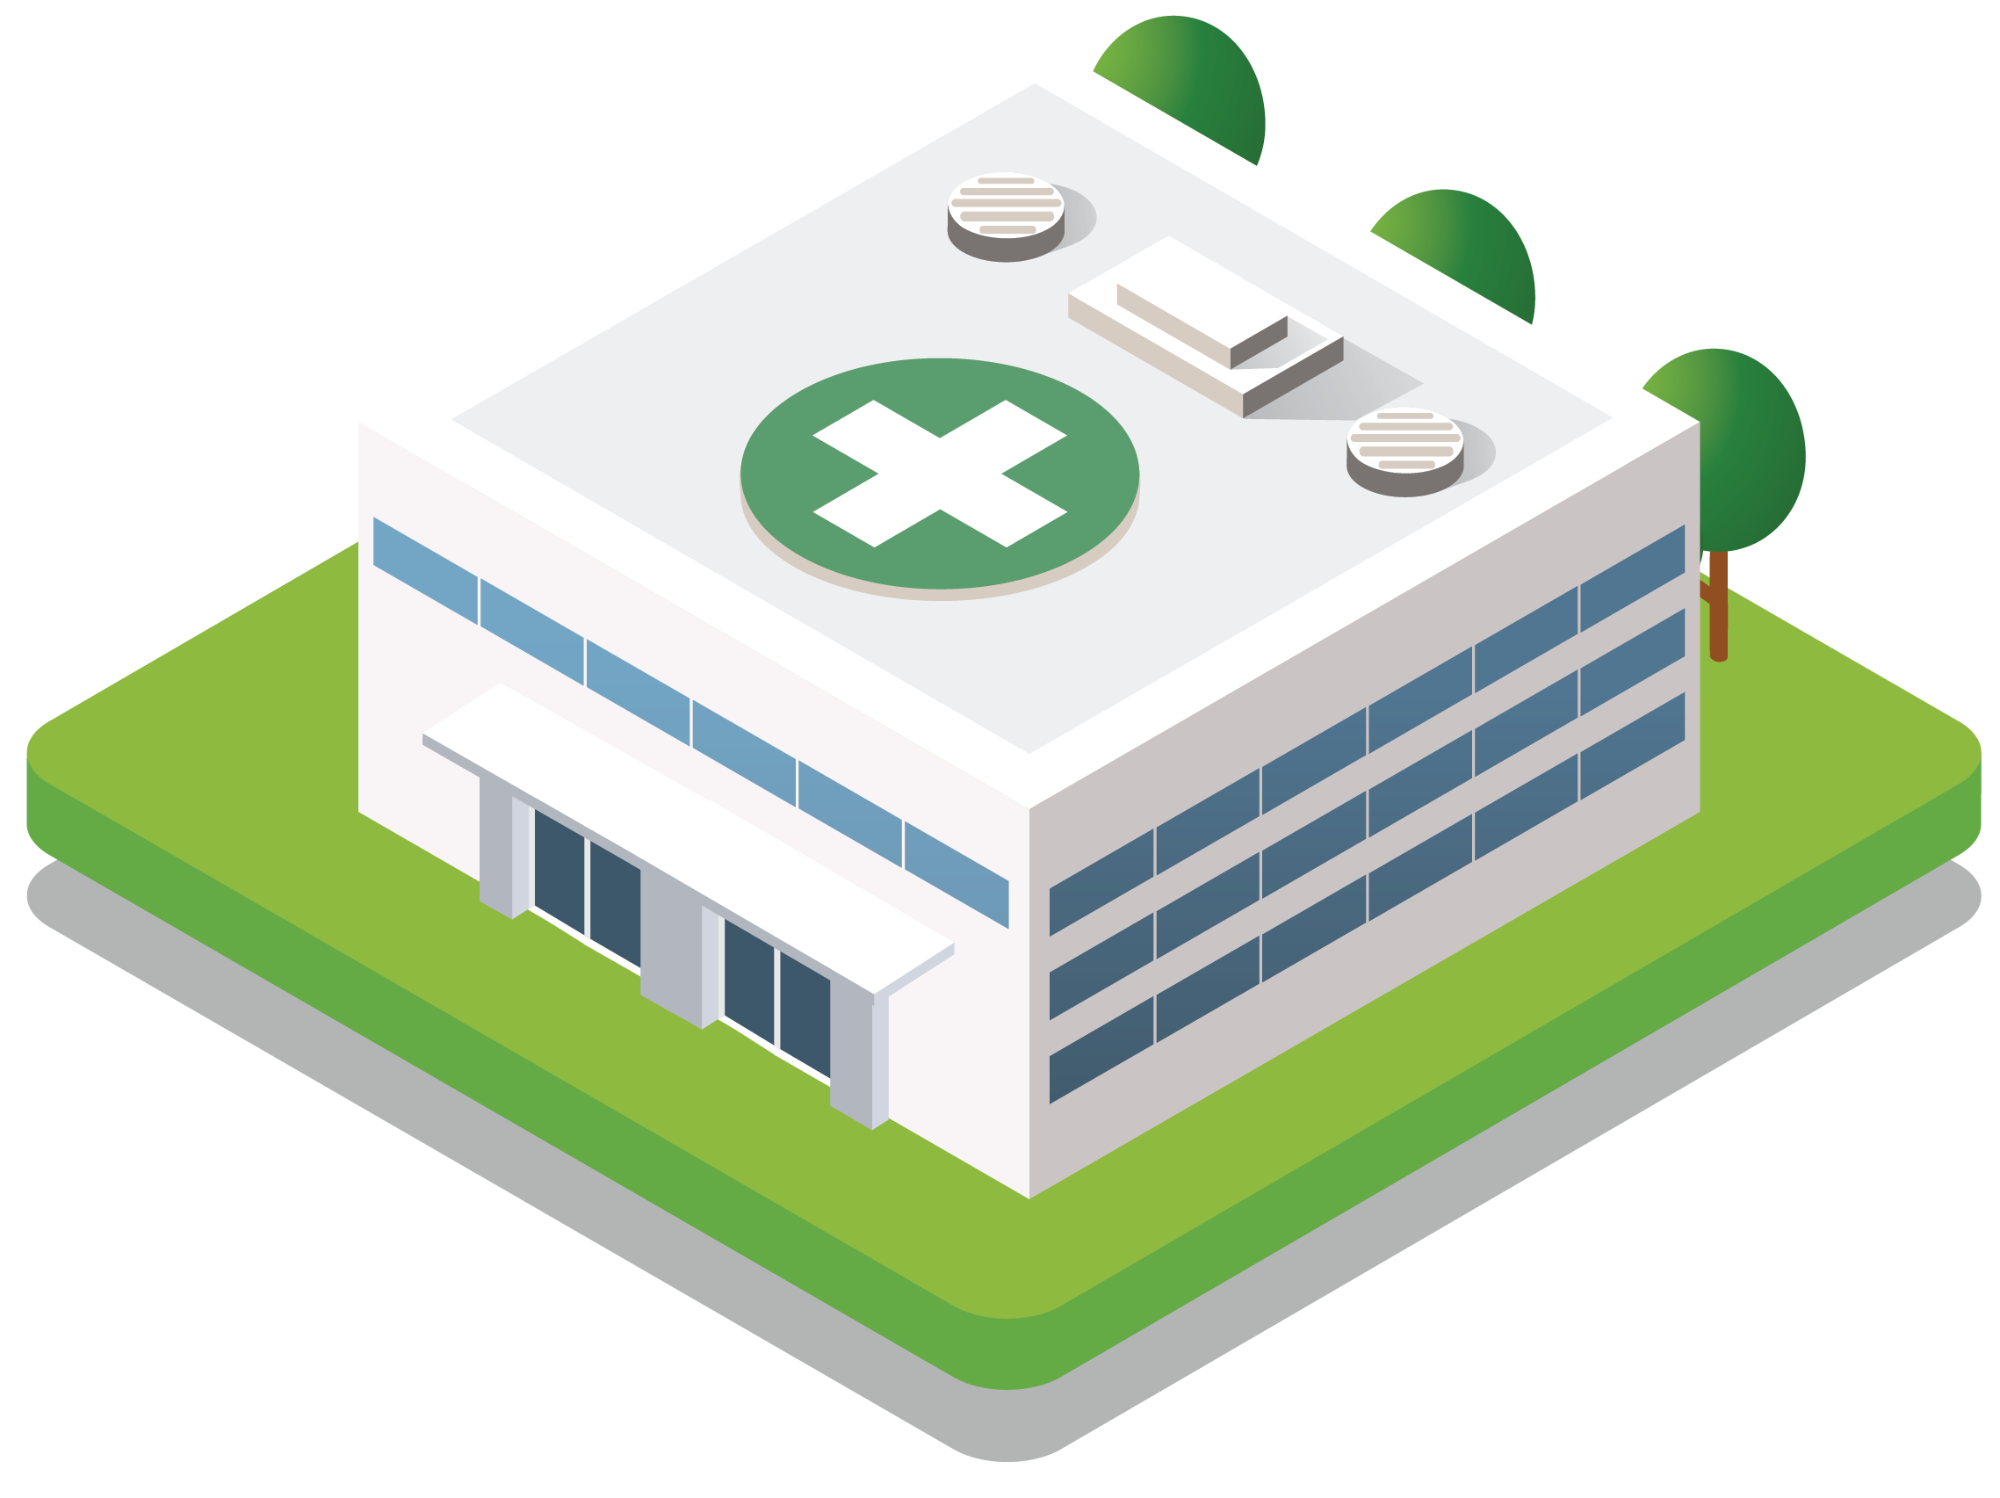
Enterprise vs. Localization
Establishing an enterprise foundation with intentional local flexibility
ENTERPRISE
LOCALIZATION
The standardized PATH EHR foundation built with input from subject matter experts to support consistent, high-quality care across Indian Country
Defined elements of PATH EHR that are intentionally configured at the site level to fit local operations, resources, and clinical processes
Impact: Local-level adjustments follow defined standards to maintain system integrity while keeping PATH EHR relevant and effective for site users.
Impact: Centralized PATH EHR build and maintenance ensure secure, reliable performance, streamlined updates, and strong data integrity.

Slide 9
Streamlined Workflows with PATH EHR
Examples of how PATH EHR can streamline day-to-day work over time. These are not comprehensive, and implementation timing will vary by site.
Medication Safety &
Pharmacy Continuity
Care Coordination &
Follow-Through
Patient Access &
Communication
Shared medication histories across sites
Barcode enabled medication safety
Safer medication renewals
Linked orders and appointments
Comprehensive care follow-through across sites
Reduced uncertainty in scheduling completion
Accessible patient portal
Automated appointment reminders
Reduced reliance on paper communications
Why it Matters: Supports safer care, reduces rework, and improves continuity for patients across sites
Why it Matters: Improves visibility and helps care teams stay aligned
Why it Matters: Expands access, improves communication, and supports timely patient engagement

Slide 10

Homeland Security Presidential Directive (HSPD-12)
An HSPD-12 card, also known as a Personal Identity Verification (PIV) card, is a U.S. federal government-wide credential used to access federally controlled facilities and information systems at the appropriate security level, as mandated by Homeland Security Presidential Directive 12.
PATH EHR is a federal system and will operate under federal guidelines, therefore, user access will require a PIV card.

Slide 11
Modernization Program Recent Activities

Slide 12
Recent Program Activities
Lawton Readiness
Check 2.1
Feb. 2
Analyzed key PATH EHR implementation activities and addressed roadblocks to help Lawton Service Unit prepare for go-live.
Lawton Design Workshop 4
Feb. 2-13
Marked the final large design event to connect Lawton Service Unit needs to PATH EHR enterprise standards.
Lawton Super User Orientation
Feb. 24-25
Introduced the Super User Program, outlined roles and PATH EHR training requirements, and clarified peer support strategies.
Enterprise Baseline Acceptance #1
Mar. 2-5
Ensured the PATH EHR enterprise system met security and compliance standards.
TC/UC Session
Mar. 5
Hosted Modernization Tribal Consultation and Urban Confer (TC/UC) session, highlighting PATH EHR activities and progress.
HIMSS Conference
Mar. 9-12
Attended key industry conference to raise awareness of PATH EHR and engaged with industry leaders.

Slide 13

Integrated Readiness & Training Model
Building a framework to achieve streamlined management, standardization, and usability
Enterprise Level
Site Level
Establishes the framework for implementing PATH EHR, emphasizing efficiency through process and technology standardization
A flexible approach to successfully implement at facilities of diverse sizes with appropriate workflows and change impact levels, emphasizing scalability

Slide 14


End User Learning Experience
Empowering users with the knowledge to adopt and skills to use PATH EHR
Self-Paced e-Learning
End-User Training
Instructor-Led Training
(Enterprise workflows)
Practice Labs, Favorites Fair and
Sign-on Fair
Hands-On Practice & Events
Continuous Learning via SharePoint
(Job Aids, Quick Reference Guides, and Refresher Training)
Reinforcement Learning
Lessons Learned and Optimization Activities Post Go-Live
Ongoing Process Improvement

Slide 15
Pilot Site: Continuous Improvements
Lawton Service Unit helps to identify challenges, gather feedback, and refine the implementation process for future sites
What We’re Learning
Impacts for Future Sites
Engage early and often to identify roles, provide access to resources, and set expectations to build readiness and confidence
  Tested engagement approach with clearly defined roles
  Pre-validated technical requirements and system configurations
  Repeatable process for assessing workflows and system customization
People
Validate clinical
and operational workflows early to streamline system configuration and
support usability
Process
Technology
Evaluate hardware, equipment, and interfaces early to better support implementation

Slide 16
Funding
Notes:
Mitchell Thornbrugh
Chief Information Officer

Slide 17
Funding to Date & Future
IHS uses one-time and recurring funding to support Health IT Modernization.
The Lifecycle Cost Estimate (LCCE) for all tribal, urban, and federal sites is $4.5 - $6.2 billion over 10 years for implementation, operation, and maintenance.
(requested)
The LCCE accounts for facility physical and IT infrastructure needs necessary to operate an enterprise EHR solution.
Follows the GAO 12-step cost estimation process and incorporates labor and non-labor categories
Funding for FY2026 and FY2027 is requested

Slide 18
Estimated Cost and Additional Funding
Limitations
Opportunities
Looking Forward
IHS does not have the authority or mechanisms to retroactively reimburse Tribes for monies with which they elected to supplement shares received in prior years.
IHS may designate a proportion of congressionally allocated funding for shares in accordance with existing processes for Programs, Functions, Services, and Activities (PFSA).
IHS is continually updating and refining the cost analysis, incorporating insights and data drawn from our ongoing experience with the vendor to enhance accuracy and relevance in financial planning and assessment.

Slide 19
Stay Connected

Slide 20


Slide 21






Stay Connected with IHS
Questions?
Please email the Modernization Program at modernization@ihs.gov
IHS Mission
To raise the physical, mental, social, and spiritual health of American Indians and Alaska Natives to the highest level
Stay informed on the Health IT Modernization Program at www.IHS.gov/HIT
or by following us on social media
IHS Vision
Build healthy communities and quality health care systems through strong partnerships and culturally responsive practices
Facebook
LinkedIn
X (formerly Twitter)

Slide 22
End

