Slide 1
Workforce Sustainability & Provider Burnout
Indian Health Service
CAPT Amy Hatcher, MD, FAAP, CPE
Bemidji Area Chief Medical Officer
May 6, 2026

Slide 2
Overview
Definitions
Data
System Context
Protective Factors
Operational Strategies
Discussion

Slide 3
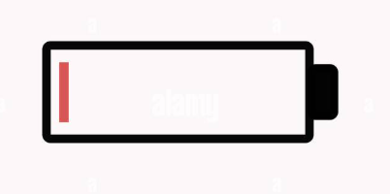
What is Burnout?
Characterized by three dimensions
1. Emotional Exhaustion: Feeling drained or depleted by work demands
2. Depersonalization (Cynicism): Emotional distancing from patients or work
3. Reduced Professional Efficacy: Feeling less effective or less accomplished
Defined by:
Maslach Burnout Inventory (MBI)
World Health Organization (ICD-11)
Maslach & Jackson; WHO ICD-11; Shanafelt et al., Mayo Clinic Proceedings

Slide 4

How Burnout is Measured in the Studies
Most physician studies use the Maslach Burnout Inventory (MBI)
– 22-item validated survey instrument
– Measures the three domains separately
Some large national surveys use:
Single-Item Emotional Exhaustion Measures
– Validated against full MBI
– Used for large-scale workforce studies (e.g., AMA)
Burnout threshold typically defined as:
High emotional exhaustion ± high depersonalization
Shanafelt et al.; JAMA; JABFM; Mayo Clinic Proceedings

Slide 5


Burnout vs. Depression
Burnout
• Work-related
• Tied to chronic occupational stress
• Often improves when work conditions improve
• Defined as an occupational syndrome (WHO ICD-11)
Depression
• A clinical medical condition
• Affects multiple life domains
• Persists outside of work context
• Requires clinical evaluation and treatment
Key Distinction:
Burnout is an occupational systems issue.
Depression is a medical diagnosis

Slide 6
National & System Context
6

Slide 7
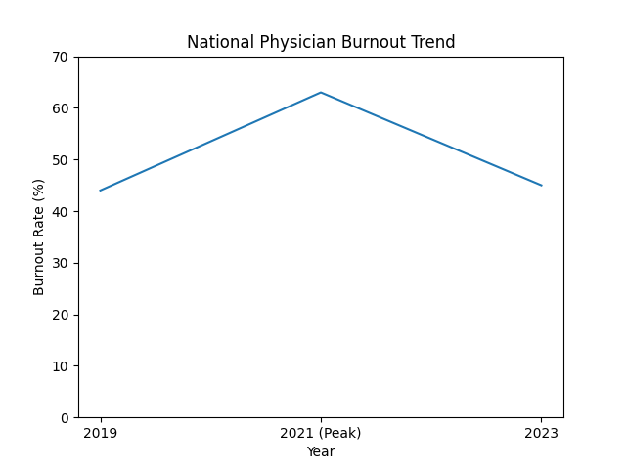
National Physician Burnout Trend
2019: ~44%
2021: ~63% (peak)
2023: ~45%
Consistent national tracking began ~2011

Slide 8
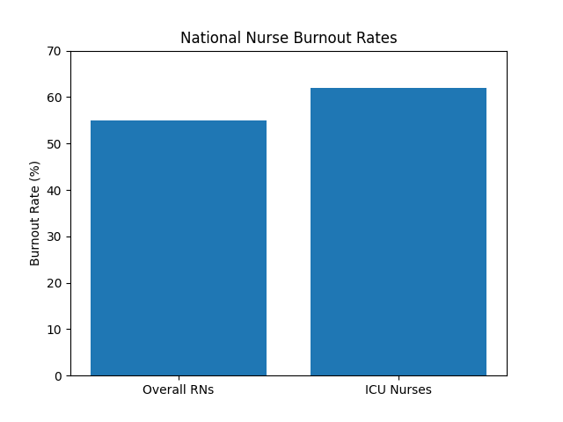
National Nurse Burnout Rates
~ 50-60% of nurses report burnout
ICU among highest risk
Majority report burnout at some point in their career

Slide 9
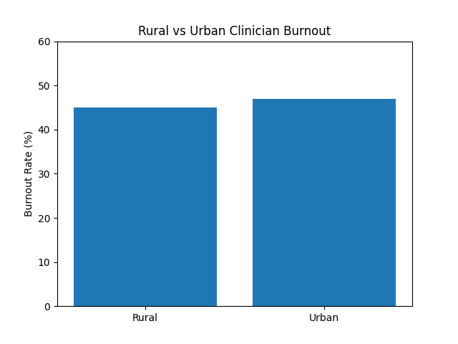
Rural vs. Urban Clinician Burnout
~45% rural vs. ~47% urban
No significant difference
Work conditions > geography
Rural vs. Urban burnout comparison from peer-reviewed research (JABFM, 2024)

Slide 10
IHS Workforce Vacancy Rates Reported data reflect federal IHS-operated facilities
36% – Physicians
44% – Behavioral Health
35% – Nurse Practitioners
Vacancy = Workload Multiplier
• Fewer providers covering same demand
• Reduced flexibility
• Increased after-hours work
Source: U.S. Congressional Testimony – Indian Health Service Workforce Data (2024)

Slide 11
The Cost of Losing One Physician
$500,000 – $1,000,000+
Replacement Costs Include:
  Recruitment & incentives
  Lost revenue during vacancy
  Locum coverage
  Ramp-up productivity loss
In small/rural systems, impact is amplified.
AMA; AAMC Workforce Studies; MGMA Retention Analyses

Slide 12

Burnout Among Healthcare Administrative Leaders
National Survey Findings:
• ~33% of healthcare CEOs and senior leaders report high burnout scores
• Burnout measured using validated occupational instruments
• Associated with lower professional fulfillment
Why This Matters:
• Leadership burnout affects organizational stability
• Decision fatigue increases under chronic strain
• System redesign capacity may be reduced
Shanafelt et al., Journal of Healthcare Management (2022) — national survey of healthcare administrative leaders

Slide 13
Evidence-Based Protective Factors
Burnout is responsive to structural change
Workload control
Team-based care
Leadership transparency
Reduced documentation burden
Mission alignment
Shanafelt TD et al., Mayo Clinic Proceedings

Slide 14
Operational Strategies
14

Slide 15
Operational Lever #1: Workload control
Goal: Increase perceived control
Protected admin time
Flexible scheduling
Shared call coverage
Provider input into templates
Workflow input

Slide 16
Operational Lever #2: Reduce Documentation Burden
Goal: Reduce after-hours work
Team documentation models
Scribe support
Inbox protocols
Standardized templates
Shanafelt TD et al., Annals of Internal Medicine

Slide 17
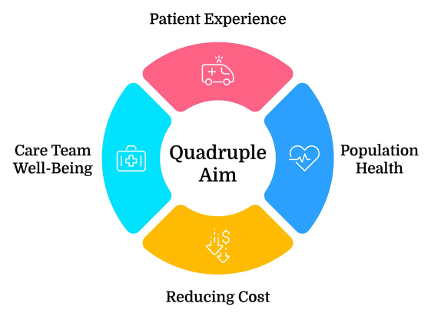
Operational Lever #3: Strengthen Team-Based Care
Goal: Distribute cognitive
load
• Top-of-license redesign
• Behavioral health integration
• Case management support
• Daily huddles
Shanafelt TD et al., Annals of Internal Medicine

Slide 18
Operational Lever #4: Leadership & Culture
Goal: Build organizational trust
• Listening sessions
• Transparent dashboards
• Rapid workflow response
• Visible leadership engagement
Shanafelt TD et al., Mayo Clinic Proceedings, 2015

Slide 19
Operational Lever #5: Staffing Stabilization
Goal: Reduce vacancy-driven overload
• Retention incentives
• Workforce pipeline programs
• Loan repayment optimization
• Telehealth partnerships
U.S. Congressional Testimony – Indian Health Service Workforce (2024).

Slide 20
Organizational Redesign > Resilience Alone
Burnout is not primarily a resilience problem.
It is a Systems Design problem.
Organizational interventions are more effective than individual-focused approaches.
Panagioti M et al., JAMA Internal Medicine, 2017

Slide 21
Discussion
21

Slide 22
Transition to Discussion
Burnout is a systems signal – not an individual failure
What does this look like in your facilities?
  Where are you seeing the most strain?
  Which roles feel most vulnerable?
  What is driving that strain?

Slide 23
Strategic Questions
Where do you have the most control to reduce strain?
What operational change would make the biggest difference?
What is already working well?

Slide 24
Summary
When we see:
Emotional exhaustion
Turnover
After-hours documentation
Staffing instability
Leadership strain
We should ask:
Where is workflow overloaded?
Where is control too low?
Where has complexity outpaced capacity?

Slide 25
Burnout reveals design gaps
Prevention is design
Design is a leadership function

Slide 26
References
Maslach C, Jackson SE. (1981). The measurement of experienced burnout. Journal of Occupational Behavior.
World Health Organization. (2019). Burnout in ICD-11.
Shanafelt TD, et al. (2015–2023). Physician burnout and leadership research. Mayo Clinic Proceedings; Annals of Internal Medicine.
Panagioti M, et al. (2017). Association between physician burnout and interventions to reduce symptoms. JAMA Internal Medicine.
Harry E, et al. (2024). Rural and urban clinician burnout comparison. Journal of the American Board of Family Medicine.
Shanafelt TD, et al. (2022). Burnout among healthcare administrative leaders. Journal of Healthcare Management.
Bodenheimer T, Sinsky C. (2014). From triple to quadruple aim: Care of the patient requires care of the provider. Annals of Family Medicine.
U.S. Congressional Testimony. (2024). Indian Health Service workforce vacancy reporting.

