Slide 1
Ambulatory Accreditation Trends 2024
May 6th 2025
Indian Health Service
Jonathan Merrell Director Office of Clinical Support,
Acting Director Field Operations Bemidji Area Office

Slide 2
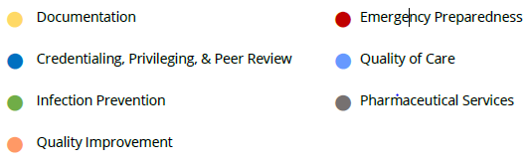
High Deficiency Standards in AAAHC Ambulatory Accreditation (AMB) Surveys All AAAHC Customers

Slide 3
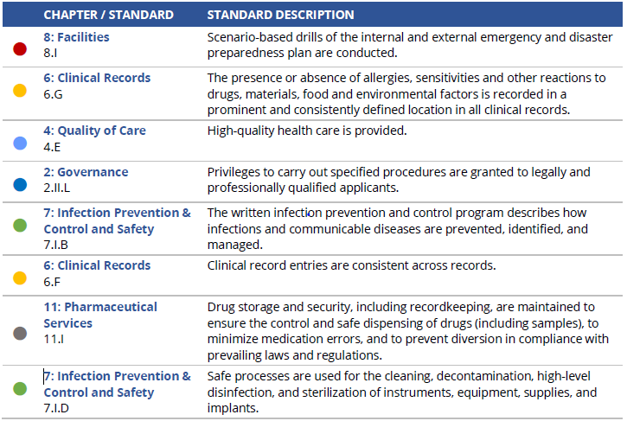
Standard description listed in order of percent deficient (Chapter/Standard)
Notes:
The following findings represent 1,233 organizations completing surveys between January 1, 2023 – March 31,
2024 under the Accreditation Handbook for Ambulatory Health Care, v42. These include Standards rated as less
than Fully Compliant (FC) 15% or more of the time, as a percentage of all ratings for the Standard.
The overall results are consistent with findings from previous years, including deficiencies related to emergency
preparedness, documentation, credentialing and privileging, infection prevention, and quality improvement.

Slide 4
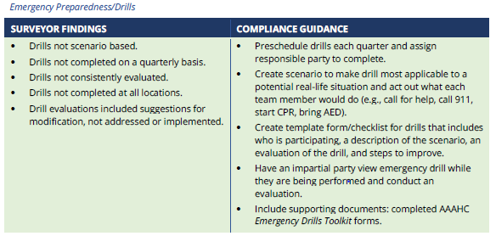
8.I.1 Scenario-based drills of the internal and external emergency and disaster preparedness plan are conducted.

Slide 5
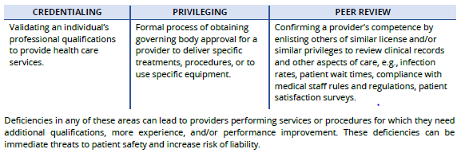
Credentialing, Privileging, Peer Review
“Credentialing, privileging, and peer review are three separate but related processes.”

Slide 6
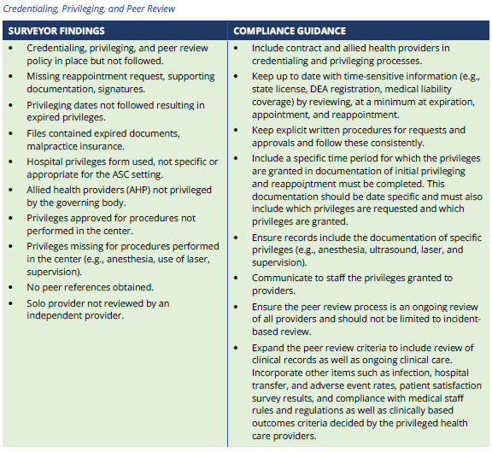
Credentialing, Privileging, Peer Review
Notes:
2.II.L.1 Privileges to carry out specified procedures are granted to legally and professionally qualified
applicants.
1. Privileges are granted based on:
a. The applicant’s written request for privileges.
b. Qualifications for the services provided by the organization.
c. Recommendations from qualified medical or dental personnel.
2.II.K.3,4 Solo providers adhere to appropriate credentialing, initial appointment and reappointment
procedures.
3. To ensure currency, accuracy, and completeness of credentials, the provider’s credentials file
is reviewed by an outside physician (for a medical practice) or an outside dentist (for a dental
practice) at least every three years, or more frequently if state law or organizational policies
so stipulate.
4. An outside physician (for medical practices) or dentist (for dental practices) has reviewed the
granting of privileges and provided documentation of his/her recommendation.
2.II.G.2 Members of the medical and/or dental staff apply for reappointment every three years, or more
frequently if prevailing laws and regulations, or organizational policies, so stipulate.
2. The reappointment application includes, at minimum:
a. Updated personal information.
b. Completed attestation questions.
c. Dated signature of the applicant.

Slide 7
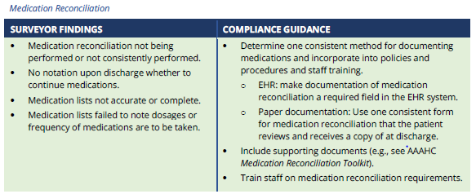
Documentation
Includes allergy documentation and medication reconciliation.
Requirements for documentation appear throughout the Standards. Often, it may be that an organization has a
process to meet the requirement of a Standard, but the process does not include follow-through in the form of
written documentation.
Notes:
4: Quality of Care
4.E.3 The organization facilitates the provision of high-quality health care by:
3. Medication reconciliation is performed.
6: Clinical Records
6.G.1-3 The presence or absence of allergies, sensitivities and other reactions to drugs, materials, food
and environmental factors is recorded in a prominent and consistently defined location in all
clinical records.
1. Clinical records document that patients are asked to provide information about allergies and
sensitivities at each encounter.
2. Clinical records document that patients reporting allergies and sensitivities describe their
reaction(s) to the allergen or irritant.
3. Information about allergies, sensitivities and reactions is recorded in a prominent and
consistently defined location in all clinical records.
6.F.7 Clinical record entries are consistent across records.
7. Entries for each visit include signature of, or authentication by, the health care professional.

Slide 8
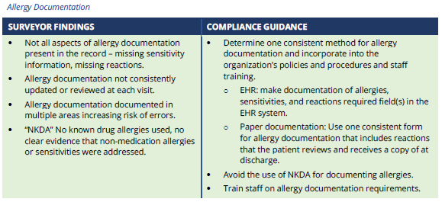
Documentation
Notes:
4: Quality of Care
4.E.3 The organization facilitates the provision of high-quality health care by:
3. Medication reconciliation is performed.
6: Clinical Records
6.G.1-3 The presence or absence of allergies, sensitivities and other reactions to drugs, materials, food
and environmental factors is recorded in a prominent and consistently defined location in all
clinical records.
1. Clinical records document that patients are asked to provide information about allergies and
sensitivities at each encounter.
2. Clinical records document that patients reporting allergies and sensitivities describe their
reaction(s) to the allergen or irritant.
3. Information about allergies, sensitivities and reactions is recorded in a prominent and
consistently defined location in all clinical records.
6.F.7 Clinical record entries are consistent across records.
7. Entries for each visit include signature of, or authentication by, the health care professional.

Slide 9
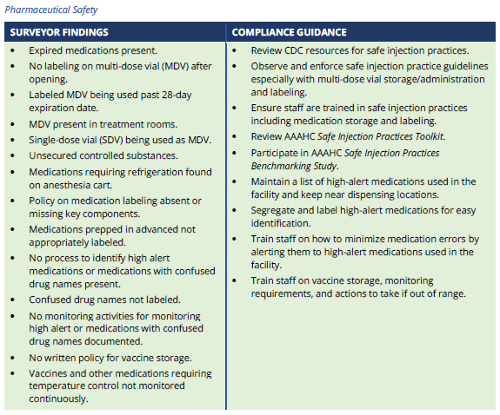
Pharmaceutical Safety
Pharmaceutical services provided by an accreditable organization meet the needs of the patients and are
provided in accordance with ethical and professional practices and legal requirements.
Notes:
Intent of the Standards
The purpose of these Standards is to ensure organizations maintain pharmaceutical services in accordance with
prevailing laws and regulations. Standards and regulations play an important part in medication safety, storage,
security and the safeguarding of patient safety, and public health.
The AAAHC Standards on pharmaceutical services apply to any organization that uses drugs or pharmaceutical
medical supplies, regardless of the presence or absence of an onsite pharmacy.
11.I.6 Drug storage and security, including recordkeeping, are maintained to ensure the control and
safe dispensing of drugs (including samples), to minimize medication errors, and to prevent
diversion in compliance with prevailing laws and regulations.
6. Medications are stored and managed in accordance with manufacturer requirements, and
state and/or CDC guidelines.
11.G.2 Procedures are in place to prevent errors from high-alert medications.
2. Processes are in place to prevent errors from administration of these medications, in
accordance with nationally recognized guidelines.
11.H.2 Procedures are in place to prevent errors from medications with confused drug names.
2. Processes are in place to prevent errors from administration of these medications, in
accordance with nationally recognized guidelines.
11.K.2 If not administered immediately, all medications (injectable, oral, etc.) removed from the original
container or packaging are labeled in a standard format in accordance with law, regulation and
standards of practice.
2. At minimum, the policy requires that labels include:
a. Drug name(s).
b. Drug strength(s).
c. Amount(s) or volume(s) if not apparent from the container or packaging.
d. Expiration date and time.
e. Name or initials of person transferring the drug(s)
11.N.5 Nationally recognized guidelines for vaccine storage and handling are followed.
5. The vaccine storage unit is equipped with a temperature monitoring device in accordance
with the adopted guidelines.

Slide 10
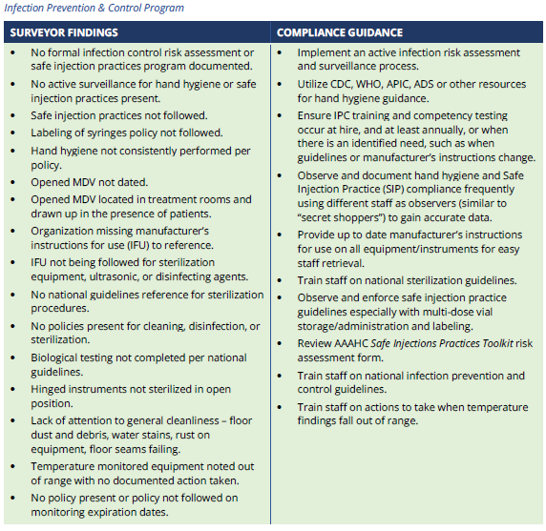
Infection Prevention and Control and Safety
Non-compliance with Standards specific to infection prevention and control and safety place patients at risk and are a potential liability for organizations. Organizations must address these issues promptly and on an ongoing basis to ensure compliance with Standards and delivery of high-quality patient care.
Notes:
Intent of the Standards
The purpose of these Standards is to ensure that organizations reduce the risk of infection by developing and
regularly reviewing infection control and prevention programs, having a designated Infection Prevention and
Control (IPC) provider oversee the program, training staff in all aspects of the program, having policies and
procedures to manage infections and communicable diseases, managing expiration dates of products,
monitoring temperature sensitive products and medications, and using nationally-recognized guidelines to
develop the organization’s policies and procedures related to infection control, cleaning and disinfection, and
safe injection practices.
7.I.B.2 The written infection prevention and control program describes how infections and transmission
of communicable diseases are prevented, identified, and managed.
2. To reduce the risk of health care-acquired infection, the program requires education and
active surveillance consistent with:
a. WHO, CDC, or other nationally recognized guidelines for hand hygiene.
b. CDC or other nationally recognized guidelines for safe injection practices.
7.I.D.4 Safe processes are used for the cleaning, decontamination, high-level disinfection, and
sterilization of instruments, equipment, supplies, and implants.
4. Cleaning, decontamination, high-level disinfection, and sterilization processes adhere to:
a. Nationally recognized guidelines.
b. Manufacturer’s instructions for use.
c. State and federal guidelines.

Slide 11
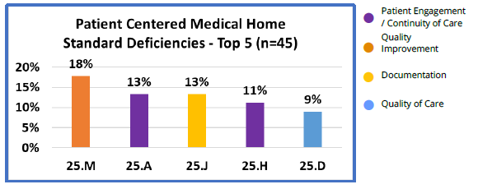
Common Findings in PCMH
The top five highest deficiency Standards and highest deficiency Elements are outlined below.

Slide 12
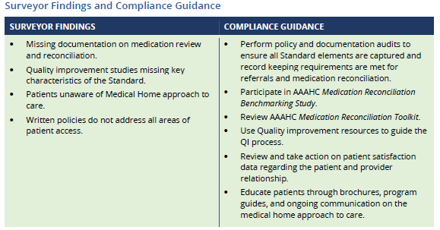
Common Findings in PCMH

Slide 13
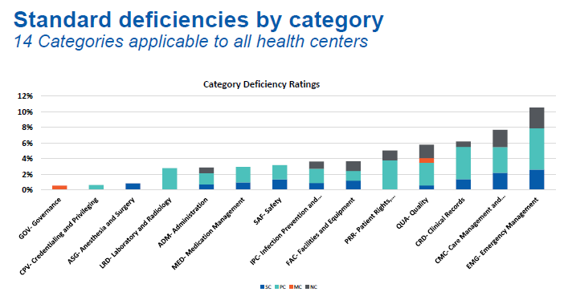
IHS Specific Standard Deficiency Trend CY 2024

Slide 14
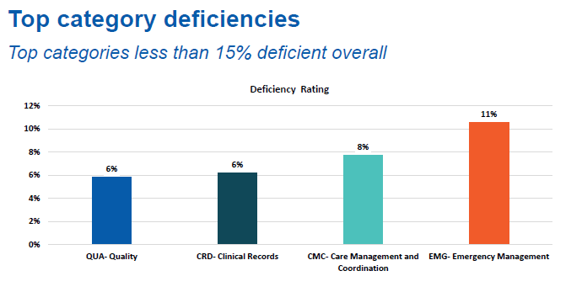
IHS Specific Standard Deficiency Trend

Slide 15
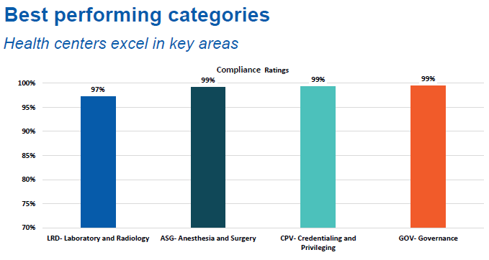
IHS Specific Best Performing Trend

Slide 16
References and Appreciation
AAAHC Mona Sweeney and the 2024 AAAHC Quality Roadmap
IHS Office of Quality Nicole Flom

Slide 17
Area Accreditation Support
OCS can provide consultative support for organizations seeking New accreditation
  AAAHC Standards Training
  Support with annual IPC programmatic infection control risk assessment
  AAAHC policy review and development
  Implementation of IPC and Safety accreditation Dashboards and resources
  Limited onsite mock surveys, accreditation prep activities and coaching
  Infection Control and Safety Committee Consultation
  Connection to IHS HQ Office of Quality accreditation and consulting contracts for Accreditation Association for Ambulatory Healthcare (AAAHC), The Joint Commission (TJC), and Joint Commission Resources (JCR)

Slide 18
Office of Clinical Support (OCS) Staff
Jonathan Merrell RN, BSN, MBA Director jonathan.merrell@ihs.gov
Behavioral Health Consultant-Tele-Behavioral Health Consultant (Acting) Dr. Travis Townsend MD travis.townsend@ihs.gov
Tele-Behavioral Health Provider- Janet Erickson PMHNP-BC
Area Statistician- Jason Douglas Jason.douglas@ihs.gov
Diabetes and Nursing Consultant- Phil Heuer DNP NP-BC philip.Heuer@ihs.gov
HPDP-CHR Consultant- Lucinda Charleston MPH Lucinda.Charleston@ihs.gov
Patient Safety-Infection Control Consultant- Matthew Ellis MPH, CIC, CDIPC, REHS/RS matthew.ellis@ihs.gov
Administration Support- Paula Jourdain

Slide 19
Office of Clinical Support Staff
Pharmacy Consultant-Jessica Anderson PharmD, MHA, BCACP Jessica.Anderson@ihs.gov
Area Professional Recruiter-Anthony Buckanaga anthony.buckanaga@ihs.gov
Cindy Gunderson PharmD- Revenue Cycle Management Director
Clinical Applications Coordinator- Massa Kofa Ph.D., MHIHIM massa.kofa@ihs.gov
Interoperability Coordinator Karla Svingen CPHIMS karla.svingen@ihs.gov
Health Information Management Consultant – Vacant
  Cindy Gunderson Acting HIM cynthia.gunderson@ihs.gov
Area Pharmacy Consultant LaDonna Lock BCACP, TTS ladonna.lock@ihs.gov

Slide 20
Questions??
Jonathan Merrell RN, BSN, MBA
Bemidji Area Deputy Director, Office of Clinical Support Services
Jonathan.Merrell@ihs.gov
Or
Matthew R. Ellis, MPH, CIC, CDIPC, REHS/RS
Commander, USPHS
Office of Clinical Support
Area Infection Prevention & Control Consultant
Area Patient Safety Lead
Area I-STAR Quality Manager
Mobile: 218.407.3890
Email: matthew.ellis@ihs.gov

