Slide 1
Indirect Cost and Contract Audit Division
Mark W. Stout, MBA
Branch Chief, DOI/IBC/ICCAD
May 8, 2025

Slide 2
Agenda
COVID & IDC Rates
ICRP Due Dates
Audit Due Dates
2-year –v– 3-year CF
CARES Act Exception
ARPA/SLFRF Exception
Becerra –v– San Carlos Apache Tribe
AKA Third Party Revenue
Summary Schedules
IDC Collections
3 Optional Bases
CF & Rate Computation
Supplements
Negotiator’s Questions
Ongoing Concerns

Slide 3
COVID & Indirect Cost Rates
Proposal Due Dates and Audited Financial Statements
A proposal containing actual costs is due within six months after the close of the fiscal year, unless an exception is approved by the cognizant agency for indirect costs.
Ref: 2 CFR Part 200 Appendix VI Subsection D.2.d
The audit must be completed and submitted to the Federal Audit Clearinghouse within 30 calendar days after the auditee receives the auditor’s report(s) or nine months after the end of the audit period (whichever is earlier.)
Ref: 2 CFR Part 200 Subpart F Subparagraph 200.507(c)(1)
Resolution: Three-year carryforward cycle – basically gives the tribe an additional nine (9) months between completing the audit and submitting their next indirect cost rate proposal.

Slide 4
Timelines for Submission-F/P
Final / Provisional Rates
2022 Final Rate:
Due within six months after fiscal year-end
2024 Provisional Rate:
Negotiated six months prior to beginning of the fiscal year
2022: | Jan | Feb | Mar | Apr | May | Jun | Jul | Aug | Sep | Oct | Nov | Dec | Final rate proposal due within six months after the close of the fiscal year
2023: | Jan | Feb | Mar | Apr | May | Jun | Jul | Aug | Sep | Oct | Nov | Dec
2024: | Jan | Feb | Mar | Apr | May | Jun | Jul | Aug | Sep | Oct | Nov | Dec | Provisional rate proposal due within six months prior to the start of the fiscal year

Slide 5
Timelines for Submission-FCF (2-yr)
Fixed Carryforward Rate
2022 Actual Expenditures:
Used to compute the carryforward adjustment which is then applied to the FY 2024 FCF rate
2024 Fixed Carryforward Rate:
Proposal due within six months prior to beginning of the fiscal year
2022: | Jan | Feb | Mar | Apr | May | Jun | Jul | Aug | Sep | Oct | Nov | Dec | 2024C proposal for year is due within six months prior to the start of the fiscal year
2023: | Jan | Feb | Mar | Apr | May | Jun | Jul | Aug | Sep | Oct | Nov | Dec | 2022 Audit with actual costs is due nine months after the end of the fiscal year
2024: | Jan | Feb | Mar | Apr | May | Jun | Jul | Aug | Sep | Oct | Nov | Dec | Two-year carryforward cycle (2024C) versus three-year carryforward cycle (2025C)

Slide 6
Timelines for Submission-FCF (3-yr)
Fixed Carryforward Rate
2022 Actual Expenditures:
Used to compute the carryforward adjustment which is then applied to the FY 2025 FCF rate
2025 Fixed Carryforward Rate:
Proposal due within six months prior to beginning of the fiscal year
2022: | Jan | Feb | Mar | Apr | May | Jun | Jul | Aug | Sep | Oct | Nov | Dec
2023: | Jan | Feb | Mar | Apr | May | Jun | Jul | Aug | Sep | Oct | Nov | Dec | 2022 Audit with actual costs is due nine months after the end of the fiscal year
2024: | Jan | Feb | Mar | Apr | May | Jun | Jul | Aug | Sep | Oct | Nov | Dec | Three-year carryforward cycle (2025C)

Slide 7
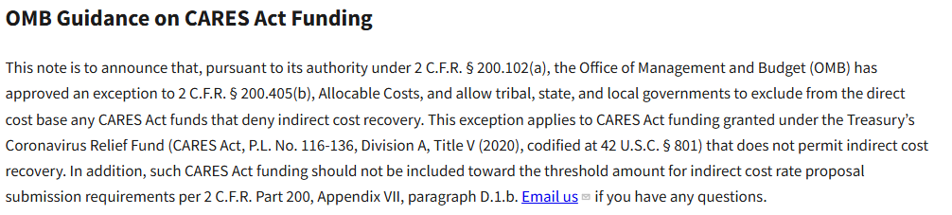
CARES Act Exception

Slide 8
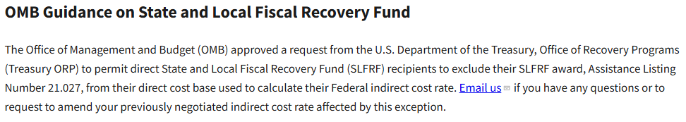
ARPA/SLFRF Exception
Notes:
American Rescue Plan Act / State and Local Fiscal Recovery Fund

Slide 9
Summary Schedules – Exhibit C (Actual) / Exhibit D (Proposed)
Placement
Federal Programs (ties to Schedule of Expenditures of Federal Awards (SEFA)
State and Other Programs
Third Party Revenue
Tribal Programs
Separately Administered
Footnote: Program income collected from Medicare, Medicaid, and private insurance by tribal contractors for Tribes that operate their own healthcare systems under the Indian Self-Determination and Educations Assistance Act (ISDA). This does NOT include tribal supplements to programs.

Slide 10
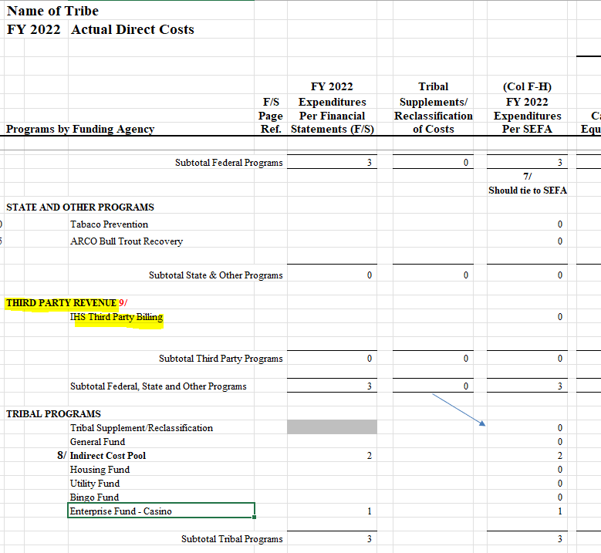

Slide 11
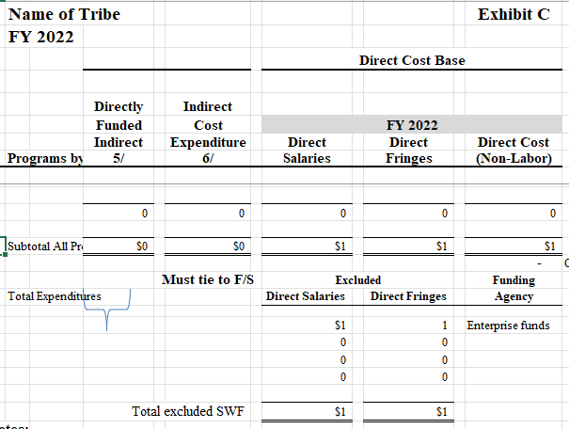
Three (3) Optional Bases

Slide 12
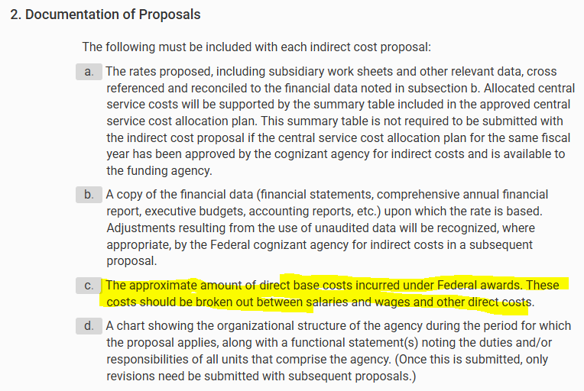
Uniform Guidance 2 CFR Part 200
A
P
P
E
N
D
I
X
7
§D

Slide 13
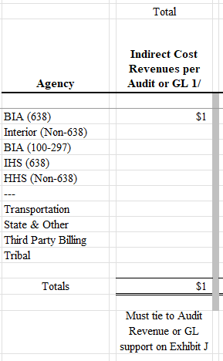
Indirect Cost Collections – Exhibit C-1

Slide 14
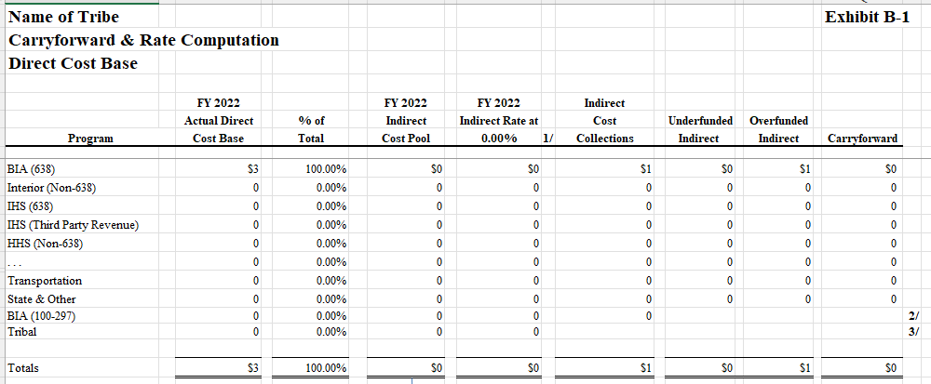
Carryforward & Rate – Exhibit B-1 (TDC), Exhibit B-2 (SW) and Exhibit B-3 (SWF)

Slide 15
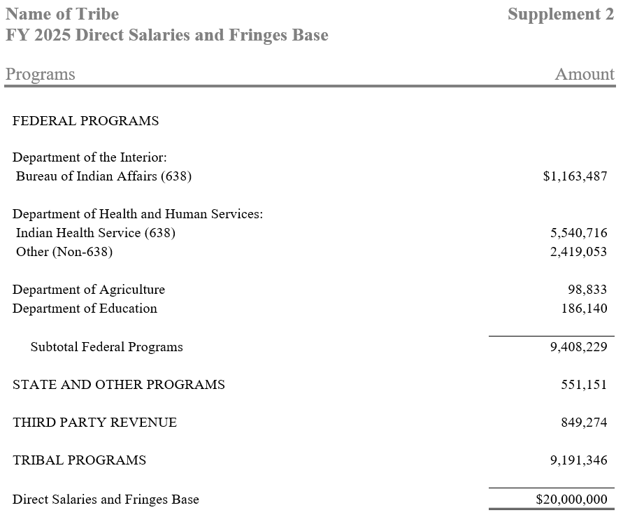
Supplement – Direct Cost Base

Slide 16
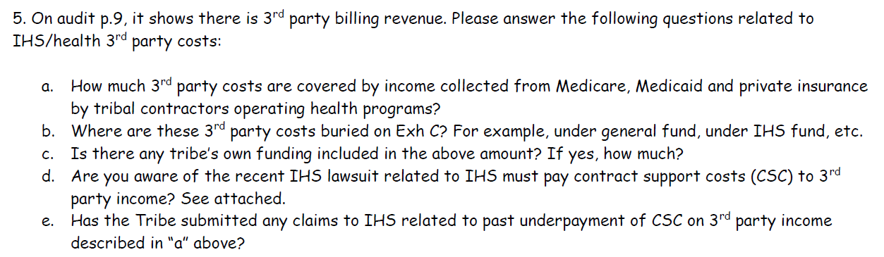
ICS Negotiator Sample Questions

Slide 17
Ongoing Concerns
Validating actual costs
Separating Federal from non-federal (Third Party Revenue) expenditures
Validating estimates
Cross-Agency Collaboration
Central POC
Awarding Officials

Slide 18
Questions?

