Slide 1
Health Information Technology Modernization Program Update
Bemidji Pre-Negotiations
May 6-8, 2025

Slide 2
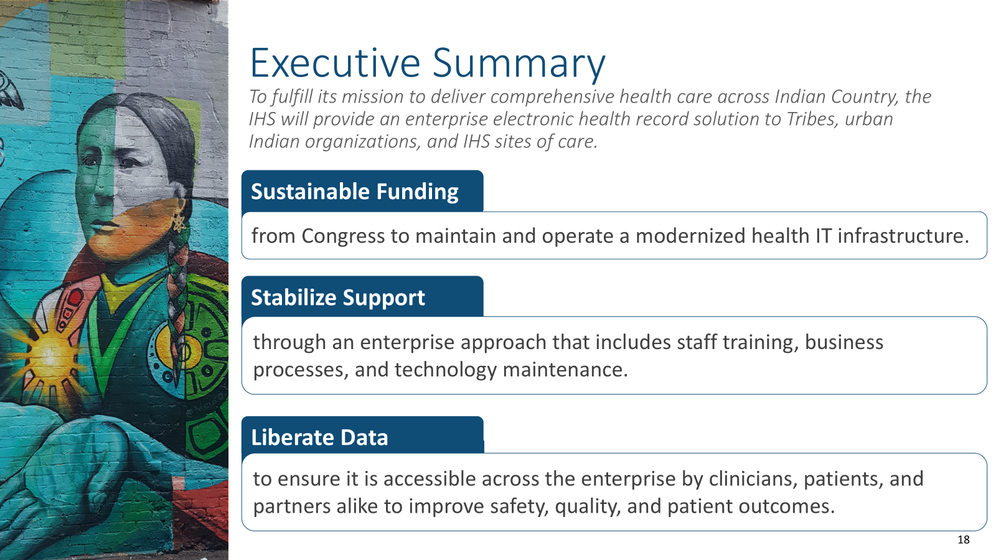

Slide 3

Modernization Program Timeline
Modernization Decision and Establishing Governance
Pilot Site Selection
Initial Pilot Launch
Lawton Service Unit including Lawton Indian Hospital, Anadarko Indian Health Center, and Carnegie Indian Health Center were chosen as the initial pilot site for implementing and deploying PATH EHR
The first pilot site deploys PATH EHR to evaluate performance in real-world setting
Official launch April 2021, creation of Executive Steering Committee, and Program Office
2026
2021-2022
2024
2018+
2022-2023
2024-2025
2027+
Continuous Collaboration
with I/T/U Partners
Support Contracts and
Product Solicitation
System Build and Test
Multi-Year Rollout
of PATH EHR
Build, configure, and test cloud
infrastructure and 100s of packages
comprising PATH EHR suite
Regular and ongoing Tribal
Consultation/Urban Confer informing
the overall modernization approach
Contract awards for Program Mgmt., Org Change Mgmt., and EHR
integrator and vendor
Deployment in cohorts of IHS,
tribal, and urban facilities, with
intensive training and support
To fulfill its mission to deliver comprehensive health care across Indian Country, the IHS will provide an enterprise electronic health record solution to Tribes, urban Indian organizations, and IHS sites of care.
3

Slide 4
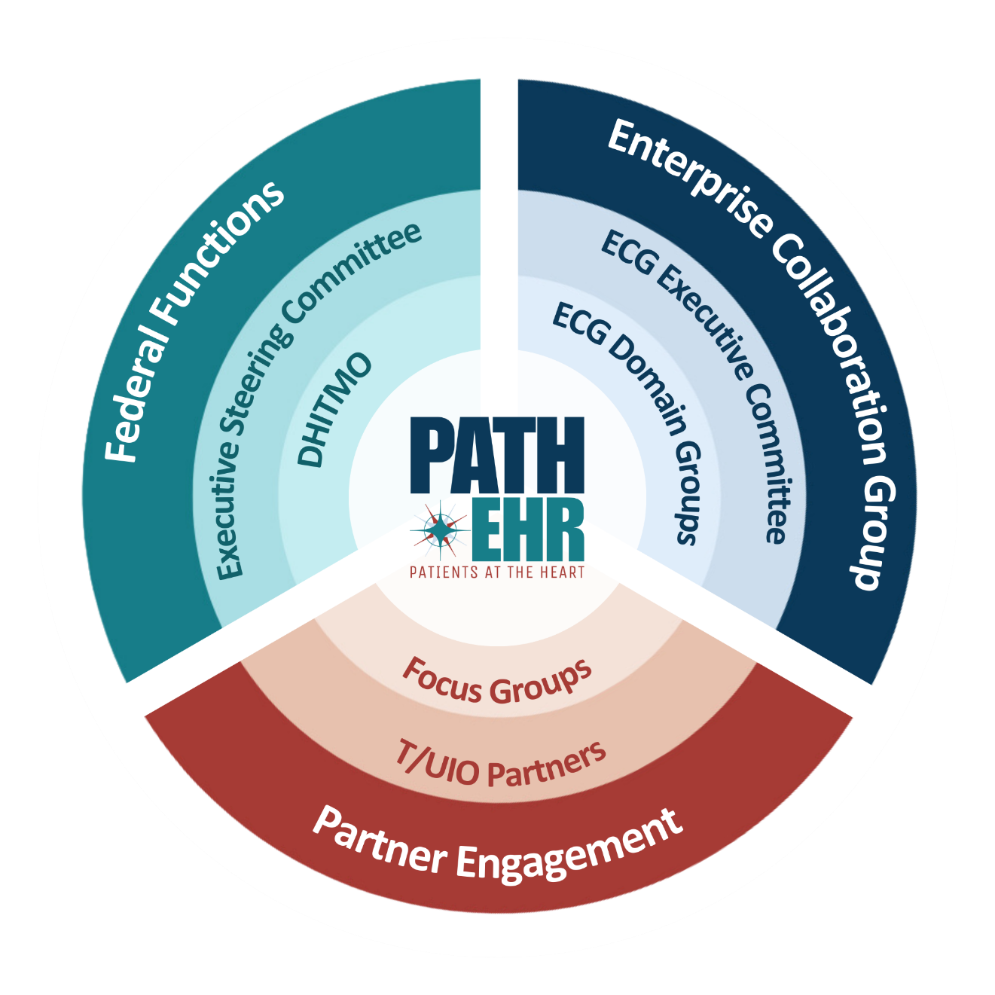
PATH EHR: Made With Our Partners
Governance is the cornerstone to the successful implementation of PATH EHR and the Health IT Modernization Program’s efforts. Oversight of the Health IT Modernization Program is centered on:
Tribal Input
Industry Standards
Federal Compliance
Patient Outcomes
Federal Functions
Enterprise Collaboration Group
Partner Engagement
The federal government manages and provides strategic oversight on the scope, funding, risk management, and partnerships of the Program’s initiative.
The ECG is the governance body that collaborates with expert users from I/T/U partners to review evidence-based practices and support the PATH EHR system for clinical and administrative areas.
We welcome partners to participate in engagement activities that provide opportunities to share their expertise and experiences with Program leadership.
We invite our I/T/U partners to participate in Program activities such as Tribal Consultation and Urban Confer sessions and Domain Groups. Please email modernization@ihs.gov to express interest.
Notes:
Clarity on the level of customization allowed for those joining the IHS Oracle/Cerner platform.

Slide 5




FY25 Recent Activities
Activities
Updates
Enterprise Collaboration Group (ECG)
Identified ECG Domain Chairs in preparation for Enterprise Workshops in December 2025; Launched ECG in January
z
Pre-Workshop Design Event (PWDE)
Hosted 33 total sessions (15 individual and 18 integrated) during the week of January 27
Hosted 95 total sessions during the week of March 3 and three additional sessions the week of March 10
Enterprise Workshop 1
Dot Workshops
Hosted dot workshops focused on select solutions and domains beginning during the week of March 24
Lawton Site Assessment
Initial technical assessment conducted onsite during the week of March 24

Slide 6
Pilot Sites

Slide 7




Purpose and Priorities of the Pilot Site
Purpose of the Pilot Site:
Pilot
Go-Live
  Test PATH EHR functionality, usability, and compatibility in a real-world healthcare setting
  Identify challenges, gather feedback, and refine the system for future implementations
ALIGN
ENGAGE
ACTIVATE
MEASURE
Pilot Phase Priorities
Pilot Site Selection:
  Build a strong foundation for future IHS, tribal, and urban Indian organization sites
  Ensuring smooth execution with minimal disruptions
  Laying groundwork for consistent security practices
  Chosen based on service range (inpatient, outpatient, specialty care)
  Ensures smooth change management and secure system setup
Notes:
This site will test the functionality, usability, and compatibility of PATH EHR in a real-world healthcare environment before it is rolled out on a larger scale. This will allow the IHS to identify and address any issues, refine the solution, and gather feedback to ensure a smoother implementation for health care facilities in the future.
Initial planning efforts identified 3 candidate Service Units, covering 6 locations in total that are representative of typical services for Hospital Inpatient, Ambulatory Outpatient, and community-based care. Due to recent budget actions in Congress, the IHS is not expecting to receive funding levels that would support all 3 candidate Service Units. To mitigate risk to the pilot phase, but continue to make progress, the IHS will limit the pilot to 1 Service Unit at this time.
IHS will continue to preserve the comprehensive scope of the PATH EHR to ensure that all services needed by our I/T/U Partners are addressed. Changes in funding levels will impact the speed at which the modernization program will implement the new system.
Why was the IHS Service Unit selected?
The IHS wants the pilot phase to focus on technical and functional capabilities that represent a wide range of services that PATH EHR will deliver, including inpatient, ambulatory, and specialty care. It is important that during the pilot phase the site and the Program develop a collaborative partnership to effectively address organizational change, test, and configure the PATH EHR for future cohort implementations.
To meet these important goals, the IHS determined that the pilot site would be an IHS operated service unit, to ensure security protocols are constant, complex issues can be promptly addressed, and can deliver a save, fully functional EHR to our partners

Slide 8
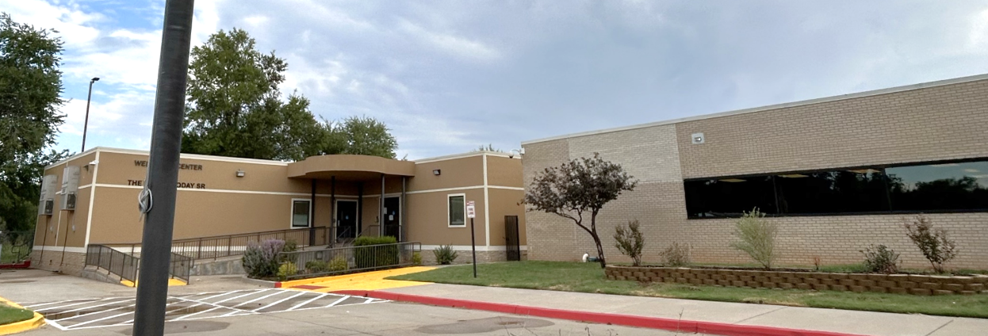
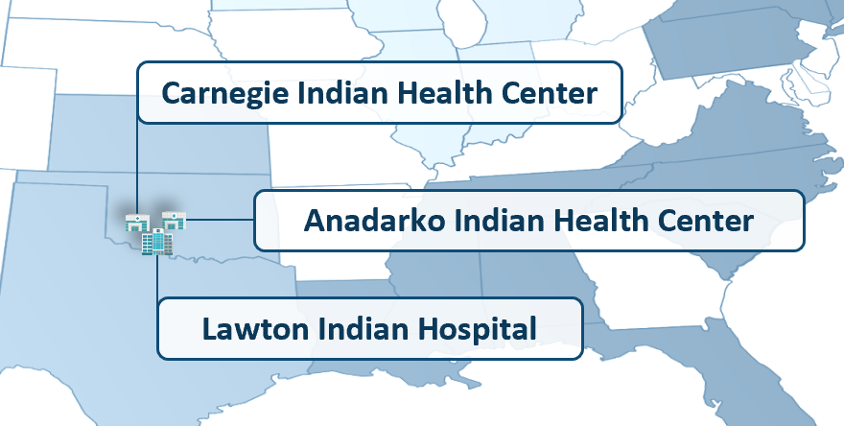
Pilot Site Selected: Lawton Service Unit
The Lawton Service Unit includes:
  Lawton Indian Hospital
  Anadarko Indian Health Center
  Carnegie Indian Health Center
After thorough screening, the Lawton Service Unit was chosen as the pilot site for PATH EHR implementation.
Notes:
I&D’s scope of work and they will support sites readiness
Deployment team is comprised of two groups facilitators and I&D along with OCM and they can expect to be contacted from all three – do sites need to be informed at this time that there will be 3 different Points of contact and how GDIT’s responsibility

Slide 9
Deployment and Cohort Planning

Slide 10



Deployment Approach
Experienced Deployment
Functional-Based Structure
IHS-Site Collaboration
The Implementation Plan is based on extensive experience in federal, tribal, and commercial deployments:
  Best practice workflows, functionality, and clinical content
  Mapped to the IHS EPLC to ensure alignment to IHS best practices and requirements
Use functional teams to deliver PATH EHR
Teams work together to apply enterprise standards:
  Site Activation (Design/Build)
  Devices/Hardware
  Interfaces
  Validation/Testing
  Training
  Adoption
  Sustainment
Site Leaders and selected personnel take ownership of the PATH EHR processes and requirements
The IHS implementation team advises and provides recommendations on critical success factors and escalations
Site and IHS leads provide oversight and guidance

Slide 11
Implementation Strategy Overview
Standardization and Continuous Improvement
Enterprise
Pilot
Optimization
Cohort
Enterprise design and build sets the standard for future deployments
Governance structure is developed in Enterprise design and followed to ensure adherence to standards
The first location to take the Enterprise design standard with localization
Pilot validates the Enterprise build for future cohort implementation for I/T/Us
Review lessons learned and address any changes needed to Enterprise design or deployment methodology
IHS communicates lessons learned and value achieved
Cohorts benefit from the lessons learned from the Pilot site deployment and measure phase while deploying PATH EHR
Cohorts continue to learn and adapt for I/T/U implementation

Slide 12
Implementation Approach
Iterative Cohorts of I/T/U sites
Cohort
Go-Live
ALIGN
ENGAGE
ACTIVATE
MEASURE
Cohort 1
Continuous Improvement
Cohort 2
Cohort 3
Pilot
Pilot
Cohort
The first group of facilities selected for simultaneous system implementation
Pilot sites will be direct service facilities, which are yet to be determined
Cohorts will be sequenced based on their organizational, operational, and technical readiness
A group of sites that share readiness characteristics. Cohorts are not limited to federal sites and will include tribal and urban organizations
The cohort selection process will utilize information from iterative site assessments and readiness reviews

Slide 13


Influence of Lifecycle Cost Estimate (LCCE) on Cohort Selection
  Ensuring technical and people readiness prior to starting and throughout the implementation journey.
Site Preparation for
Go-Live
Facility Assessment
Operating Procedures
Each facility will be individually reviewed to develop a cost estimate
Factors include user counts, provider counts, beds, and other utilization data
DHITMO will review utilization data with site
Develop both an implementation estimate and an annual sustainment estimate
Items subject to the IHS Annual HIT Assessment process
DHITMO is establishing procedures
Procedures will support cost estimates for implementation, sustainment, and HIT Assessment
Details will be communicated after leadership review and approval
Notes:
• The LCCE was initially developed in FY20-21 using publicly available industry data for similar efforts to assist the IHS in projecting the Enterprise and per-facility cost estimates for the modernized EHR Solution.
• DHITMO is in the process of using specific cost data from the awarded EHR IDIQ contract to update projections based on the negotiated contract pricing for the EHR Product licenses, cloud hosting costs, transaction fees, and associated hardware costs where applicable.
• Each facility will be individually assessed to develop a cost estimate for their location based on a number of different factors, such as user counts, provider counts, beds (for inpatient facilities), and other similar utilization data that are still being evaluated.
• As part of preparing a site for go-live, DHITMO will review the applicable utilization data with the site to develop both an implementation estimate and an annual sustainment estimate, including which items will be subject to the IHS’ Annual HIT Assessment process.
• The new EHR solution provides robust system capabilities that will allow for data to be pulled for monitoring electronically transmitted prescriptions, messaging, and other system utilization processes that will be used as part of future HIT Assessment processes and related cost estimates.
• DHITMO is in the early stages of learning the details and establishing the specific operating procedures that will be followed to collect, report, and reconcile the data that will support our implementation, sustainment, and HIT Assessment cost estimates – these will be communicated in detail once they have been through leadership review and approval.

Slide 14

Homeland Security Presidential Directive (HSPD-12)
An HSPD-12 card, also known as a Personal Identity Verification (PIV) card, is a U.S. federal government-wide credential used to access federally controlled facilities and information systems at the appropriate security level, as mandated by Homeland Security Presidential Directive 12.
PATH EHR is a federal system and will operate under federal guidelines, therefore, user access will require a PIV card.
Notes:
There is also pending guidance regarding separate actions from IHS to ensure access to PIV cards and associated costs will be addressed through a standard process across all urban Indian organizations and tribes.

Slide 15
Interoperability

Slide 16



Interoperability
Interoperability in PATH EHR ensures patients and providers have seamless, secure access to health data across the I/T/U system.
Why It Matters
Core Components
Tribal Input
Enables better clinical decisions
Reduces patient burden
Improves outcomes by ensuring data flows seamlessly across care sites
Personal Health Record (PHR)
Direct Secure Messaging
Four Directions Hub (4DH)
Master Patient Index (MPI)
Health Information Exchange (HIE) Repository
Interoperability efforts are guided by tribal, urban, and IHS voices
Collaborative input is driven through the Enterprise Collaboration Group (ECG) and Interoperability Focus Groups
Notes:
Overview: One of the central principles of the IHS Health IT Modernization is that PATH EHR supports patient-centered care through improved access to patient data and enhanced communication with providers. PATH EHR’s commitment to interoperability ensures that patients have better access to personal health records, including test results, medications, and care plans. This interoperability will improve access to patient data across IHS, tribal, and urban Indian (I/T/U) facilities, giving patients more control over their care and providing clinicians with a comprehensive care overview.
Why it Matters: Interoperability supports better clinical decisions, reduces patient burden, and improves outcomes by allowing data to flow seamlessly across sites of care.
Tribal-Led Input: Interoperability efforts are guided by Tribal, Urban, and Federal voices through the Interoperability Focus Group and Enterprise Collaboration Group (ECG).

Slide 17
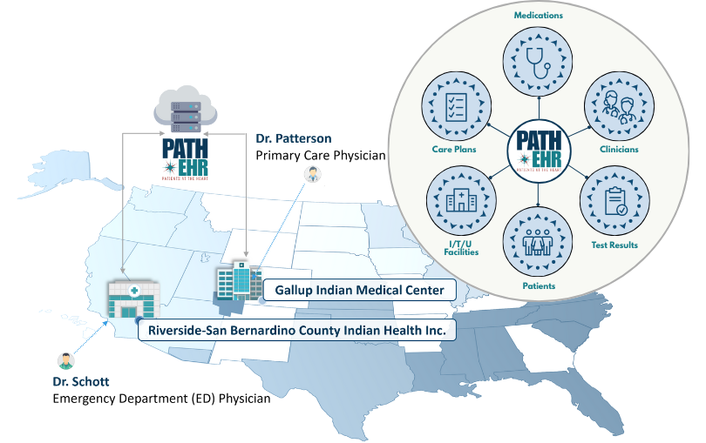
Example of a Single Patient Record in Action
Patient Scenario
Hypothetical Example
Overview:
  Vacation in Riverside, CA
  ED visit for severe abdominal pain
PATH EHR Benefits:
  ED access to complete medical history
  No need for a patient to provide records
  Seamless follow-up
Patient Experience:
  Reduced burden
  Improved care coordination
Notes:
By using a hypothetical patient scenario, we can see how integrated IT systems like PATH EHR, facilitate better data flow between different health care providers.
This graphic tells the story of Lisa, a 35-year-old woman, who has been receiving her primary care at the Gallup Indian Medical Center from Dr. Patterson. She has a well-documented medical history that includes mild asthma and a recent knee injury from a hiking accident. During the summer, Lisa decides to visit her extended family in Riverside, California. One evening while on vacation, Lisa begins experiencing severe abdominal pain and nausea, which leads her to visit the emergency room at the Riverside-San Bernadino County Indian Health Clinic where she sees Dr. Schott.
At the ER, the staff quickly access Lisa’s comprehensive patient record. They can view her Problems, Allergies, Medications, Procedures, and Immunizations from the Gallup Indian Medical Center without needing Lisa to provide her paper records or recall details herself. At the ER, Lisa is diagnosed with a severe case of food poisoning. They administer the necessary treatments and before discharging her they update her patient record with details of the visit, treatments, and recommended follow-up.
After returning to New Mexico, Lisa schedules a follow-up appointment with her primary care doctor at the Gallup Indian Medical Center. Thanks to PATH EHR’s interoperability and shared patient records, her primary care can see the complete details of her emergency visit in California. This seamless access to her updated medical records allows her doctor to ensure that Lisa is recovering well and to provide any additional care if needed.
As we’ve just seen with our patient scenario, PATH EHR enables health care providers across different locations to access complete medical histories seamlessly. Now, let’s delve deeper into how PATH EHR ensures that this information is not only accessible bus also secure and properly managed

Slide 18
Funding

Slide 19



Estimated Cost and Additional Funding
Limitations
Opportunities
Looking Forward
IHS does not have the authority or mechanisms to retroactively reimburse Tribes for monies with which they elected to supplement shares received in prior years.
IHS may designate a proportion of congressionally allocated funding for shares in accordance with existing processes for Programs, Functions, Services, and Activities (PFSA).
IHS is continually updating and refining the cost analysis, incorporating insights and data drawn from our ongoing experience with the vendor to enhance accuracy and relevance in financial planning and assessment.

Slide 20
Funding to Date & Future
IHS uses one-time and recurring funding to support Health IT Modernization.
The Lifecycle Cost Estimate (LCCE) for all tribal, urban, and federal sites is $4.5 - $6.2 billion over 10 years for implementation, operation, and maintenance.
The LCCE accounts for facility physical and IT infrastructure needs necessary to operate an enterprise EHR solution.
Follows the GAO 12-step cost estimation process and incorporates labor and non-labor categories
Requested $435,000,000 for FY2025
Notes:
Recurring Appropriations
FY2022 appropriations provided a total of $145M in recurring funding for EHR modernization, an increase of $111M from FY2021.
FY2023 Omnibus Appropriation increased recurring EHR modernization funding to $217.5M.
FY2024 Enacted Budget includes $190.564M for IHS Health IT Modernization - a $27M reduction from FY2023.
The advance appropriation for FY2024 specifically excludes use of funds for EHR modernization
FY2025 - The FY 2025 budget submission for Electronic Health Record Modernization is $435 million. This is an increase of $218 million above the FY 2023 Final level.

Slide 21
Upcoming Engagements
Notes:
Mitchell Thornbrugh
Chief Information Officer

Slide 22
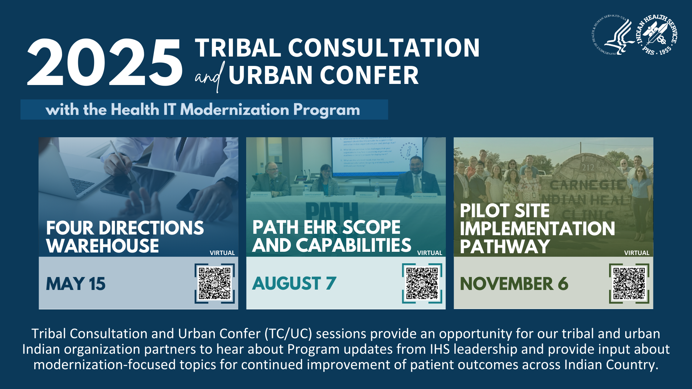
2025 Tribal Consultation and Urban Confer with the Health IT Modernization Program

Slide 23






Stay Connected with the IHS
Stay informed on the Health IT Modernization Program at www.IHS.gov/HIT
or by following us on social media
Facebook
LinkedIn
X (formerly Twitter)

Slide 24



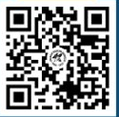
Question & Answer Forum
Add questions, feedback, or recommendations in the chat
Take the Health IT Modernization Awareness Survey
Scan Here
Use the Raise Hand function to ask questions aloud
Notes:
Note to presenter: Utilize this slide during Q&A sessions to provide time and space for participants to engage

Slide 25
End

