Slide 1
Pharmacy Prime Vendor and HRSA 340B Program
May 7, 2025
Indian Health Service CAPT Jessica Anderson, Bemidji
Area Pharmacy Field Consultant

Slide 2
Agenda
Comparison of Pharmacy Prime Vendor and 340B
Review of Pharmacy Prime Vendor
Review of 340B
Questions

Slide 3

Pharmacy Humor

Slide 4
Pharmacy Prime Vendor
Vs HRSA 340B

Slide 5
Pharmacy Prime Vendor vs 340B
PHARMACY PRIME VENDOR
340B
Interagency agreement between VA and IHS
Administered through the National Supply Service Center (NSSC)
Vendor- McKesson
Eligible patient populations- IHS eligible patients
Tribes can add non-IHS beneficiaries. Requires Tribal Resolution, update to AFA, notification to NSSC to establish contract
Billing third party payors- no limitations. No copay collection
Caveats- adherence with contract
Administered via HRSA
Vendor- Any pharmaceutical vendor
Eligible patients- must have established relationship with covered entity (CE)
Billing third party payers- avoid “double dipping.” Carve-in/carve-out with Medicaid
Caveats- audits
Notes:
Upon enrollment in the 340B Program, a covered entity site must inform HRSA whether it will use 340B drugs for its Medicaid fee-for-service patients (carve-in), or whether it will purchase drugs for its Medicaid fee-for-service patients through other mechanisms (carve-out).

Slide 6
Pharmacy Prime Vendor

Slide 7
Pharmacy Prime Vendor
Pharmacy Prime Vendor (PPV) revolutionized ordering process and placed control with pharmacy programs
Based upon a VA National Contract that IHS is allowed to participate in through an Interagency Agreement (IAA)- partnership started in 1996
VA solicits for Prime Vendor Contract and has representation on pre-solicitation workgroup- last awarded in 2020 and will expire in 2028
Notes:
IHS has representation on pre-solicitation work group.
Currently, 2 year contract with three 2 year options.
Includes all VA facilities, CMOP, IHS, Bureau of Prisons and other government agencies and programs.

Slide 8
Pharmacy Prime Vendor
1996- ~30 facilities accessed PPV. Annual expenditures of ~$23 million
2012- >257 facilities accessed PPV. Annual expenditures of ~$330 million
2023- >290 facilities accessed PPV. Annual expenditures of ~$751 million
History:
1996-1999: Walsh Distribution
1999-2004: Amerisource Bergan
2004-2012; 2012-2020; 2020-present: McKesson

Slide 9
Pharmacy Prime Vendor
Advantages:
High quality pharmaceuticals at the best prices
Increased buying power
Just in time ordering; next day delivery
Assists with formulary management
Recalls
Cost containment
Notes:
As a smaller agency, IHS would have limited market power to negotiate similar pricing

Slide 10
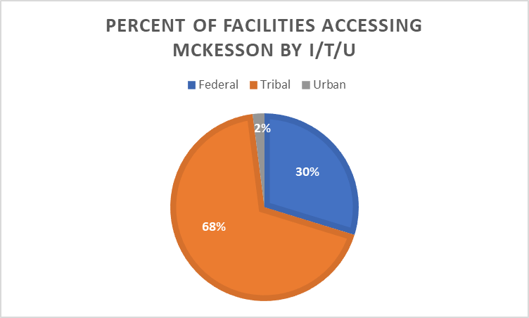
Pharmacy Prime Vendor FY2024
~300 facilities currently access PPV
Over $1.01 billion in pharmaceutical expenditures
Generated $1.01 billion in cost avoidance
ITU | Total PPV Sites
Federal | 89
Tribal | 204
Urban | 6
Total | 299

Slide 11
Pharmacy Prime Vendor
Requirements
Tribes and Urban programs are required to go through IHS and the National Supply Services Center (NSSC) and Area COR
Changes in account status must be coordinated with Area COR and NSSC for incorporation into contract if necessary (for example: address change, additional accounts)
Facility DEA must be on file with Prime Vendor and NSSC
Hospital Identification Number (HIN) for facilities without DEA- order non-controlled substances only
Notes:
Facilities should not request prime vendor to complete tasks outside of terms/conditions of contract. Should occur in conjunction with NSSC or risk liability for potential bill from prime vendor.
Renewed DEA must be submitted to McKesson and NSSC

Slide 12
Pharmacy Prime Vendor
All orders must be submitted by 6:00 pm local time for next day delivery
No backorders- any items on backorder must be reordered daily
Per contract, PPV delivers orders between 8:00 am and 3:00 pm the next day
Emergency Orders are available:
6 emergency orders are allowed per month at no cost- 24 hrs per day, 7 days per week for contract items
Delivery within 12 hrs

Slide 13
Pharmacy Prime Vendor
PPV is required to visit/make contact every month
Can be less frequent if agreed upon by facility and PPV
PPV provides hardware and software (2 handheld, mobile devices per ordering account)

Slide 14

Pharmacy Humor

Slide 15
HRSA 340B Drug Pricing Program

Slide 16
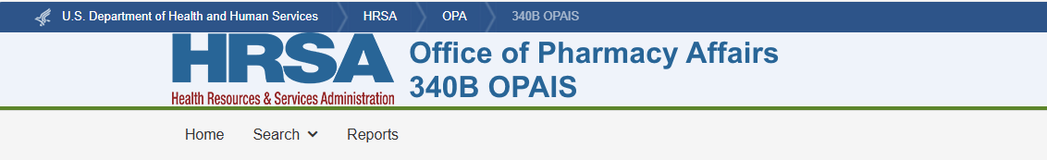
340B Drug Pricing Program
Requires drug manufacturers to provide covered outpatient drugs to eligible covered entities at reduced prices
Manufacturers that participate in Medicaid are agree to participate in the 340B Program
Covered entities must register to enroll and comply with 340B requirements.
20 different types of organizations eligible for 340B program
Enrollment website: Office of Pharmacy Affairs 340B OPAIS (hrsa.gov)
Notes:
The intent of the 340B program is enable providers “to stretch scarce Federal resources as far as possible, reaching more eligible patients…” H.R. Rep No. 102-384(II), at 12(1992).
“reduced prices” lower than the 340B ceiling price
FQHC, FQHC- look alikes, Urban Indian Programs, Tribal Compacts, Critical Access Hospitals, Disproportionate Share Hospitals- defined by statue.

Slide 17
340B Drug Pricing Program
Two ways covered entities (CE) can deliver 340B drugs to patients:
In-house pharmacy owned by CE
Contract Pharmacy- Independent Pharmacy or Chain Pharmacy
CE maintains responsibility for 340B drugs and compliance- including oversight of contract pharmacies
Notes:
CE must register contract pharmacies online during open registration period after their written contract is in place. Contracted pharmacies may participate after approval by the Office of Pharmacy Affairs and the contract pharmacy is listed

Slide 18
340B Drug Pricing Program
Office of Pharmacy Affairs Information System (OPAIS) is the official site for all 340B Program entity information
Know your 340B ID
Address must be an EXACT match- wholesalers may not ship discounted drugs unless the address matches OPAIS.
Maintain correct contact information in OPAIS
Drug pricing can be found on OPAIS

Slide 19

Pharmacy Humor

Slide 20
340B Drug Pricing Program
Program Prohibitions
Duplicate discounts- manufacturers are not required to provide 340B discounts AND Medicaid drug rebates for the same drug. CE must have mechanisms in place to prevent duplications
Diversion- CE are prohibited from reselling or transferring 340B drug to a person who is not a patient of the CE
Notes:
CE should work closely with State MA office to ensure duplicate discounts are not occurring.

Slide 21

340B Drug Pricing Program
Annual recertification is required for all CE
The annual schedule-
January-February- CHC, FQHCLA, R, HTC, BL, NH, UI, and FQHC638
April- May- FP, STD, and TB
August-September- DSH, CAH, CAN, SCH, RRC, and PED
Maintain updated contact information at all times- turn off SPAM filters.
Notes:
Ensures program integrity, compliance, transparency, and accountability.
This occurs annually during the same time period.
AOs and PCs will receive notification that recertification is coming up and will receive contact via email. It is critical to maintain up-to-date contact information at all times.

Slide 22
340B Drug Pricing Program
Keep OPAIS up-to-date- it’s communication tool with HRSA
Only AOs can submit updates in OPAIS
How to maintain records
Register on the quarterly schedule
Check OPAIS regularly, submit change requests
Terminate entities when no longer eligible
Submit self-disclosures to report non-compliance
Maintain contact information

Slide 23
340B Drug Pricing Program
Adding Child Sites and Contract Pharmacies
Submit in OPAIS
Occurs quarterly, the first two weeks of January, April, July, and October
Check email regularly for task notifications
Make sure your AO can bind the entity to an agreement with the Federal Government.
Contract agreements must be in place prior to registration
Have contract pharmacy DEA numbers handy
AO must submit and approve contract pharmacy registration within 15 days
Notes:
A change in contract, pharmacy, ownership or change in DEA requires a separate, new registration in advance as much as possible to ensure continuity of care.
Reminder that manufacturers do not have to ship drugs if addresses and records are not up-to-date.

Slide 24

340B Drug Pricing Program
Termination
If your CE becomes ineligible, go into OPAIS and terminate immediately to stop the purchase of drugs
Will need to provide month, date, year CE became ineligible
Will need to provide month, date, year CE last purchased off of 340B
Notes:
If your entity purchases 340B drugs beyond eligibility date, the entity will be liable to repay the manufacturer.

Slide 25
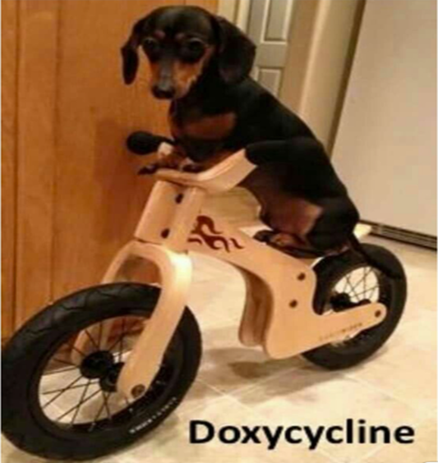
Pharmacy Humor

Slide 26
340B Drug Pricing Program
Self Disclosures
Know how to report non-compliance to HRSA using self disclosure template
Report non-compliance immediately
Include the following:
Letter to HRSA including 340B ID
Violation
Corrective Action Plan
Plan for financial remedy with manufacturers
Notes:
Self-disclosures submitted after receiving an audit engagement letter will be subject to the audit review.

Slide 27
340B Drug Pricing Program
Duplicate Discounts
CE must have mechanisms in place to prevent duplicate discounts
Medicaid Exclusion File- know the deadlines
Carve in- purchasing 340B drugs for Medicaid patients
Must list each state the CE plans to bill and corresponding billing numbers- NPI or Medicaid number
Carve out- purchasing drugs for Medicaid patients through other mechanisms
340B contract pharmacies must have an agreement in place with state Medicaid to prevent duplicate discounts AND the CE must report to HRSA.
Apexus has a helpful checklist
Notes:
Upon enrollment in the 340B Program, a covered entity site must inform HRSA whether it will use 340B drugs for its Medicaid fee-for-service patients (carve-in), or whether it will purchase drugs for its Medicaid fee-for-service patients through other mechanisms (carve-out).

Slide 28
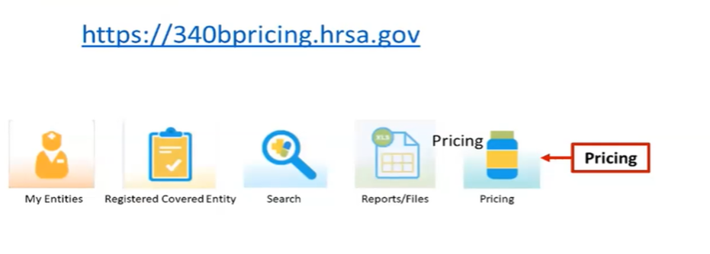
340B Drug Pricing Program
Drug Pricing
Access to pricing is limited to manufacturer and CE AO and PC
Cannot be downloaded/exported
Log into 340B OPAIS-> Pricing from AO/PC Home Page

Slide 29

Pharmacy Humor

Slide 30
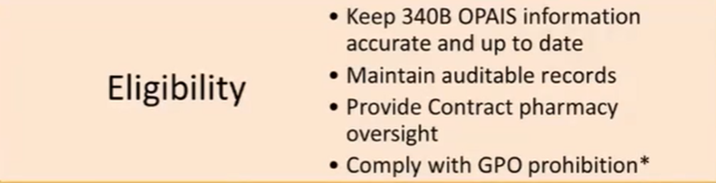
340B Drug Pricing Program
Program Integrity
Begins when you register for the program
Eligibility- Only organizations with certain Federal designations or receive funding from specific programs are eligible for registration and enrollment
Notes:
Importance of auditable records- touches on so many compliance aspects including diversion and duplicate discounts.
CE are responsible for contract pharmacy oversight to ensure prevention of diversion and duplicate discounts.

Slide 31
340B Drug Pricing Program
Audits
Evaluate for 340B Program compliance- policies and procedures
Eligibility
Diversion
Duplicate Discounts
Group Purchasing Organization (GPO) prohibition as applicable
Opportunities to improve oversight through monitoring for potential violations through self-disclosure process
Final Report
Agree
Disagree- must submit notification to HRSA within 30 calendar days of the date of the audit letter.
Notes:
CE is solely responsible for compliance. Any contract pharmacies and third party vendors involved in administration must understand the CE. HRSA will need access to these records for auditing purposes.
CE, contract pharmacies both need policies and procedures to prevent diversion and duplicate discounts. Must include how the CE monitors compliance of contract pharmacy.
Final report- CE can agree/disagree with findings. Must submit all applicable documentation to support the disagreement. Must notify HRSA within 30 calendar days of the date of audit letter specifying the nature of the disagreement and provide supporting documentation of its position.

Slide 32
340B Drug Pricing Program
Two types of audits:
Risk-based audit- CE who have been in the 340B program for more than 1 year and 1 quarter are considered based on complexity of CE
Targeted Audit- Triggered by a report of non-compliance
Audits can also be onsite or remote.
Notes:
Program complexity is determined by the number of offsite facilities, number of contract pharmacies, and purchase volume.

Slide 33

340B Drug Pricing Program
Pre-Audit
Engagement Letter- one month in advance.
Begin planning for the 340B Audit
Explains what to expect
Pre-site visit conference call- objectives, logistics, scheduling, and initial data request
Notes:
Data requests can include policies/procedures including determination of patient eligibility, purchasing, ordering, invoicing, inventory replenishment, MA billing, contract pharmacy processes.

Slide 34
340B Drug Pricing Program
Data request- electronic or paper format
Policies and procedures
Orders/prescriptions issued during the audit period (~ 6 month window of time)
Purchases for contract and in-house pharmacies
Recently filed Medicare cost report (as applicable)
List of providers eligible to write for 340B drugs (employed and contracted)
List of contracted pharmacies and current contracts
Prescription-specific information from acquisition, provider ordering, prescription-specific data, and billing info.

Slide 35
340B Drug Pricing Program
Opening Meeting with CE Staff-
Agenda
Evaluate relevant policies and procedures
Verify facility eligibility- OPAIS record accuracy
Evaluate compliance, verification of internal controls to prevent diversion/supplicate discounts
Patient eligibility
Medicaid exclusion

Slide 36
340B Drug Pricing Program
CE has 30 days from the date of the final report to review findings and submit a corrective action plan (CAP)
Failure to submit may result in removal from the 340B program
CE has an opportunity for notice and hearing for any findings
30 calendar days to respond specifying nature of disagreement with supporting documentation
Notes:
CAP must include a response for each finding- description of plan, implementation start/completion dates, and individuals responsible for implementation.
Full implementation is expected to be complete in 6 months.
Apexus assistance is available to assist with a CAP- 888-340-2787, or 340Bpvp.com

Slide 37
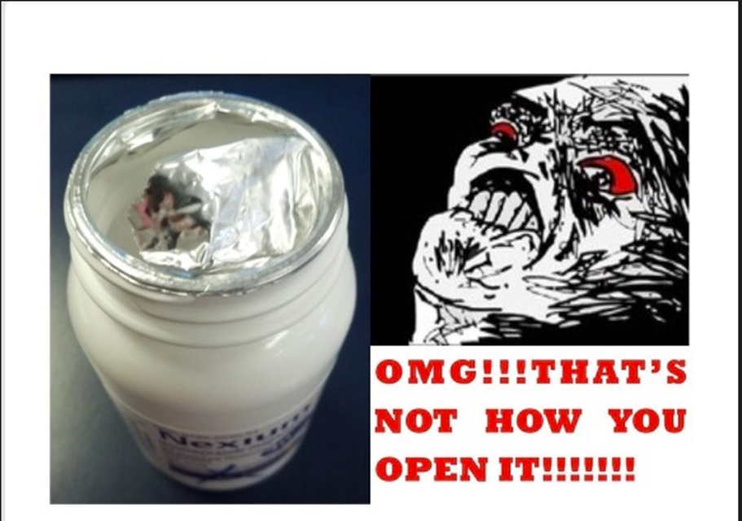
Pharmacy Humor

Slide 38
340B Drug Pricing Program
Best Practices
Ensure access to documentation to support eligibility- access noted in contracts with contract pharmacies and vendors including a timeframe for how quickly records will need to be available for auditors
Records stored securely
Accessible for future audits
OPAIS accuracy- perform frequent review (monthly is recommended)
Maintain policies and procedures specific to the CE
Diversion- patient eligibility checks
Duplicate Discounts- accuracy checks
Notes:
CE is responsible for compliance with 340B- not the company you hired or the outpatient facilities or contract pharmacies.

Slide 39

340B Drug Pricing Program
Best Practices
Tracers- patient eligibility checks (filters)
Outpatient status
Eligible location
Eligible status
Eligible prescriber
Drug is appropriate with healthcare service
Documented referral

Slide 40
340B Drug Pricing Program
Best Practices
Inventory- replenishment model
Ensure accumulation on 340B account is tied to the 11 digit National Drug Code or NDC that originally dispensed
Be prepared-
Educational resources found on OPAIS website
Notes:
Any system that allows one manufacturer’s drug to be counted in the accumulator, but replenished with another manufacturer’s drug product is non-compliant

Slide 41
340B Resources
Free services to all 340b stakeholders
Voluntary enrollment in pvp required to access
Answers for 340B questions
Apexus answers: 888-340-2787
apexusanswers@340bpvp.com
340B University- in-person, virtual, and online
Additional contracted discounts below 340B pricing
Brand/generic drugs, value-added supplies and vaccines
Enroll in 340B PVP free of charge
340Bpvp.com/enroll
Notes:
PVP refers to PVP- which is not the same

Slide 42
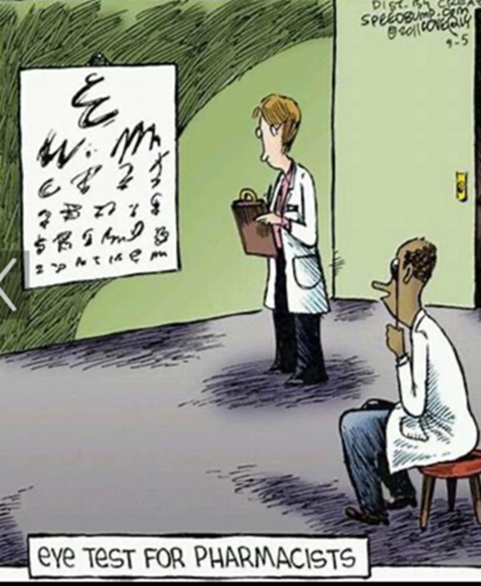
Pharmacy Humor

Slide 43
Other Pharmacy FAQ’s
Does a Tribal pharmacy need to be licensed in the state it is located in?
Do pharmacists at Tribal programs need to be licensed in the state?
NO
https://uscode.house.gov/view.xhtml?path=/prelim@title25/chapter18&edition=prelim

Slide 44
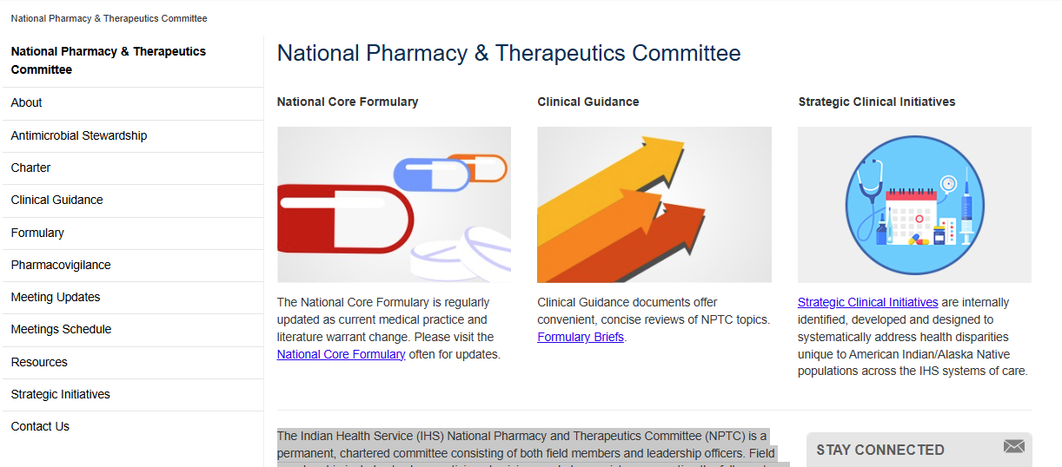
Formulary Management
IHS National Pharmacy and Therapeutics Committee
Chartered Committee that develops and maintains the National Core Formulary
Provides clinicians with tools to deliver evidence-based and cost-effective pharmaceutical services.
https://www.ihs.gov/NPTC/

Slide 45
Questions
Contacts:
CDR Matthew Miller, Deputy Director, NSSC Field Support
Phone: 405-951-6090; Mobile: 405-488-5905; Email: Matthew.Miller@ihs.gov
CAPT Jessica Anderson, Pharm D, MHA, BCACP
Jessica.Anderson@ihs.gov

